Slide 1
Artfully Designed – Architecture & Structures
Mrs. Senick
Perspectives in Art

Slide 2
What constitutes as a design??
What do you consider to be a
“good” design?

Slide 3
“Design” -
Design is the creation of a plan or convention for the construction of an object, system or measurable human interaction. Design is a process.
Design is planning to manufacture an object, system, component or structure. Then, the word "design" can be used as a noun or a verb. In a broader sense, the design is an applied art and engineering that integrate with technology.
Design has different connotations in different fields
Designing often necessitates considering the aesthetic, functional, economic, and sociopolitical dimensions of both the design object and design process. It may involve considerable research, thought, modeling, interactive adjustment, and re-design.
Architecture is both the process and the product of planning, designing, and constructing buildings and other physical structures.
https://en.wikipedia.org/wiki/Design

Slide 4
How does design influence architecture and structures??

Slide 5
What do you know about Stonehenge?
Stonehenge, Witshire, England

Slide 6
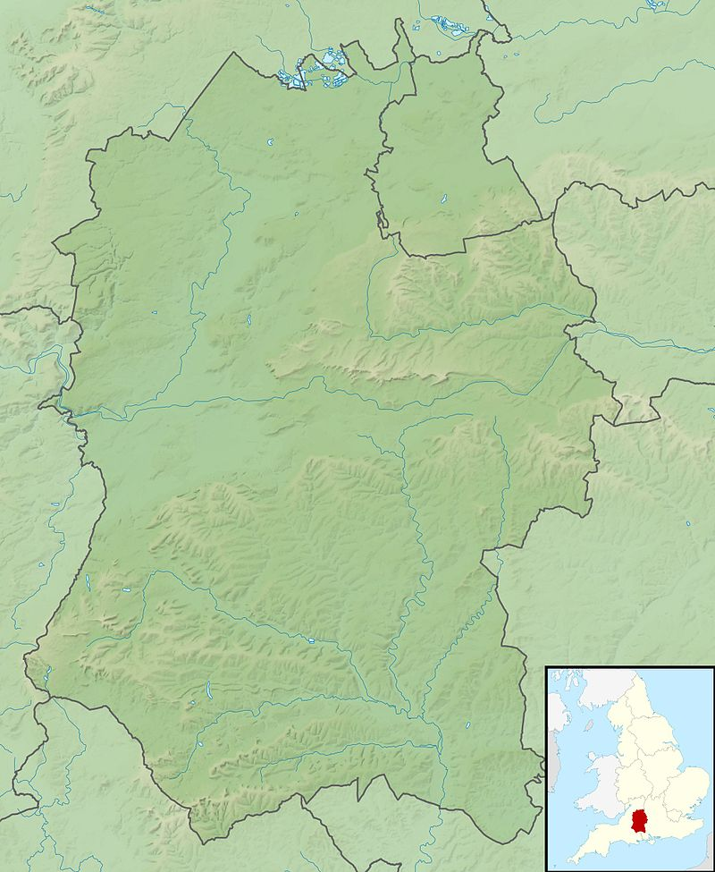
Stonehenge
Stonehenge is a prehistoric monument constructing of standing stones.
It is located in Wiltshire, England – 2 miles west of Amesbury and 8 miles north of Salisbury. Archaeologists believe it was constructed from 3000 BC to 2000 BC.
Thought to be a burial ground.

Slide 7
Parthenon, Athens, Greece. 447BC – 438BC

Slide 8
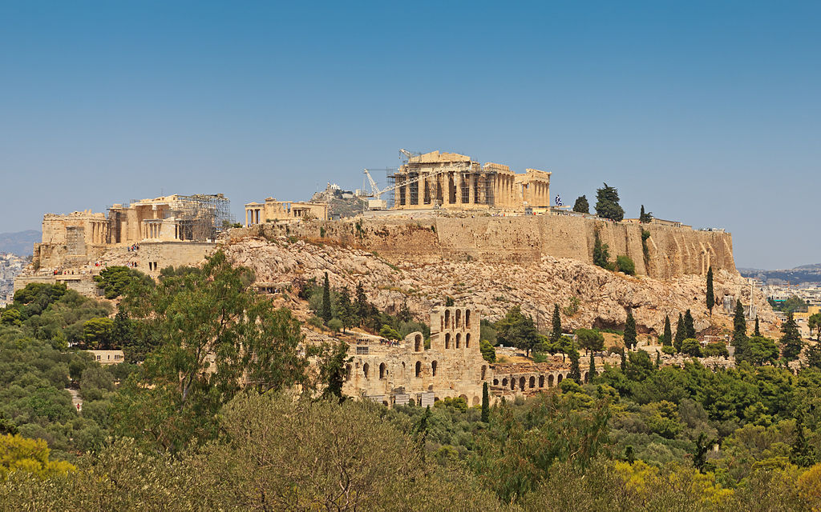
The Parthenon
Former Greek temple, dedicated to the goddess Athena
Construction began in 447 BC
It was completed in 438 BC although decoration of the building continued until 432 BC.
It is the most important surviving building of Classical Greece.

Slide 9
Why would someone design a round building?
Colosseum, Rome, Italy. 7-80 A.D.

Slide 10
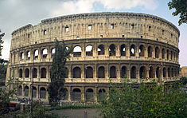
Colosseum, Rome, Italy 70 – 80 A.D.
Built of concrete and sand
It is the largest amphitheater ever built
The Colosseum could hold, it is estimated, between 50,000 and 80,000 spectators
Used for gladiatorial contests, animal hunts, executions, re-enactments of famous battles, and dramas based on Classical mythology.
Partially ruined because of damage caused by earthquakes and stone-robbers

Slide 11
How would people create such large structures back before machinery could help construction?
Great pyramid of Giza, 2560 BC. Cairo, Egypt

Slide 12
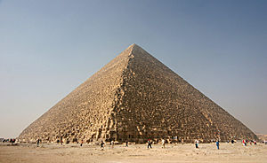
Great Pyramid of Giza
Built for the Fourth Dynasty Pharaoh Khufu
It was completed around 2560 BC..
It is part of a complex of 3 large pyramids and is the located in modern Cairo, Egypt.
The oldest and largest of the three pyramids in the Giza pyramid complex
https://en.wikipedia.org/wiki/Great_Pyramid_of_Giza

Slide 13
The Great Pyramid in cross-section
http://www.ancient-wisdom.com/Ghizaarchitecture.htm

Slide 14
What is unique about this house?
Frank Lloyd Wright, “Falling Water”, 1936 – 1939, Mill Run, Pennsylvania

Slide 15
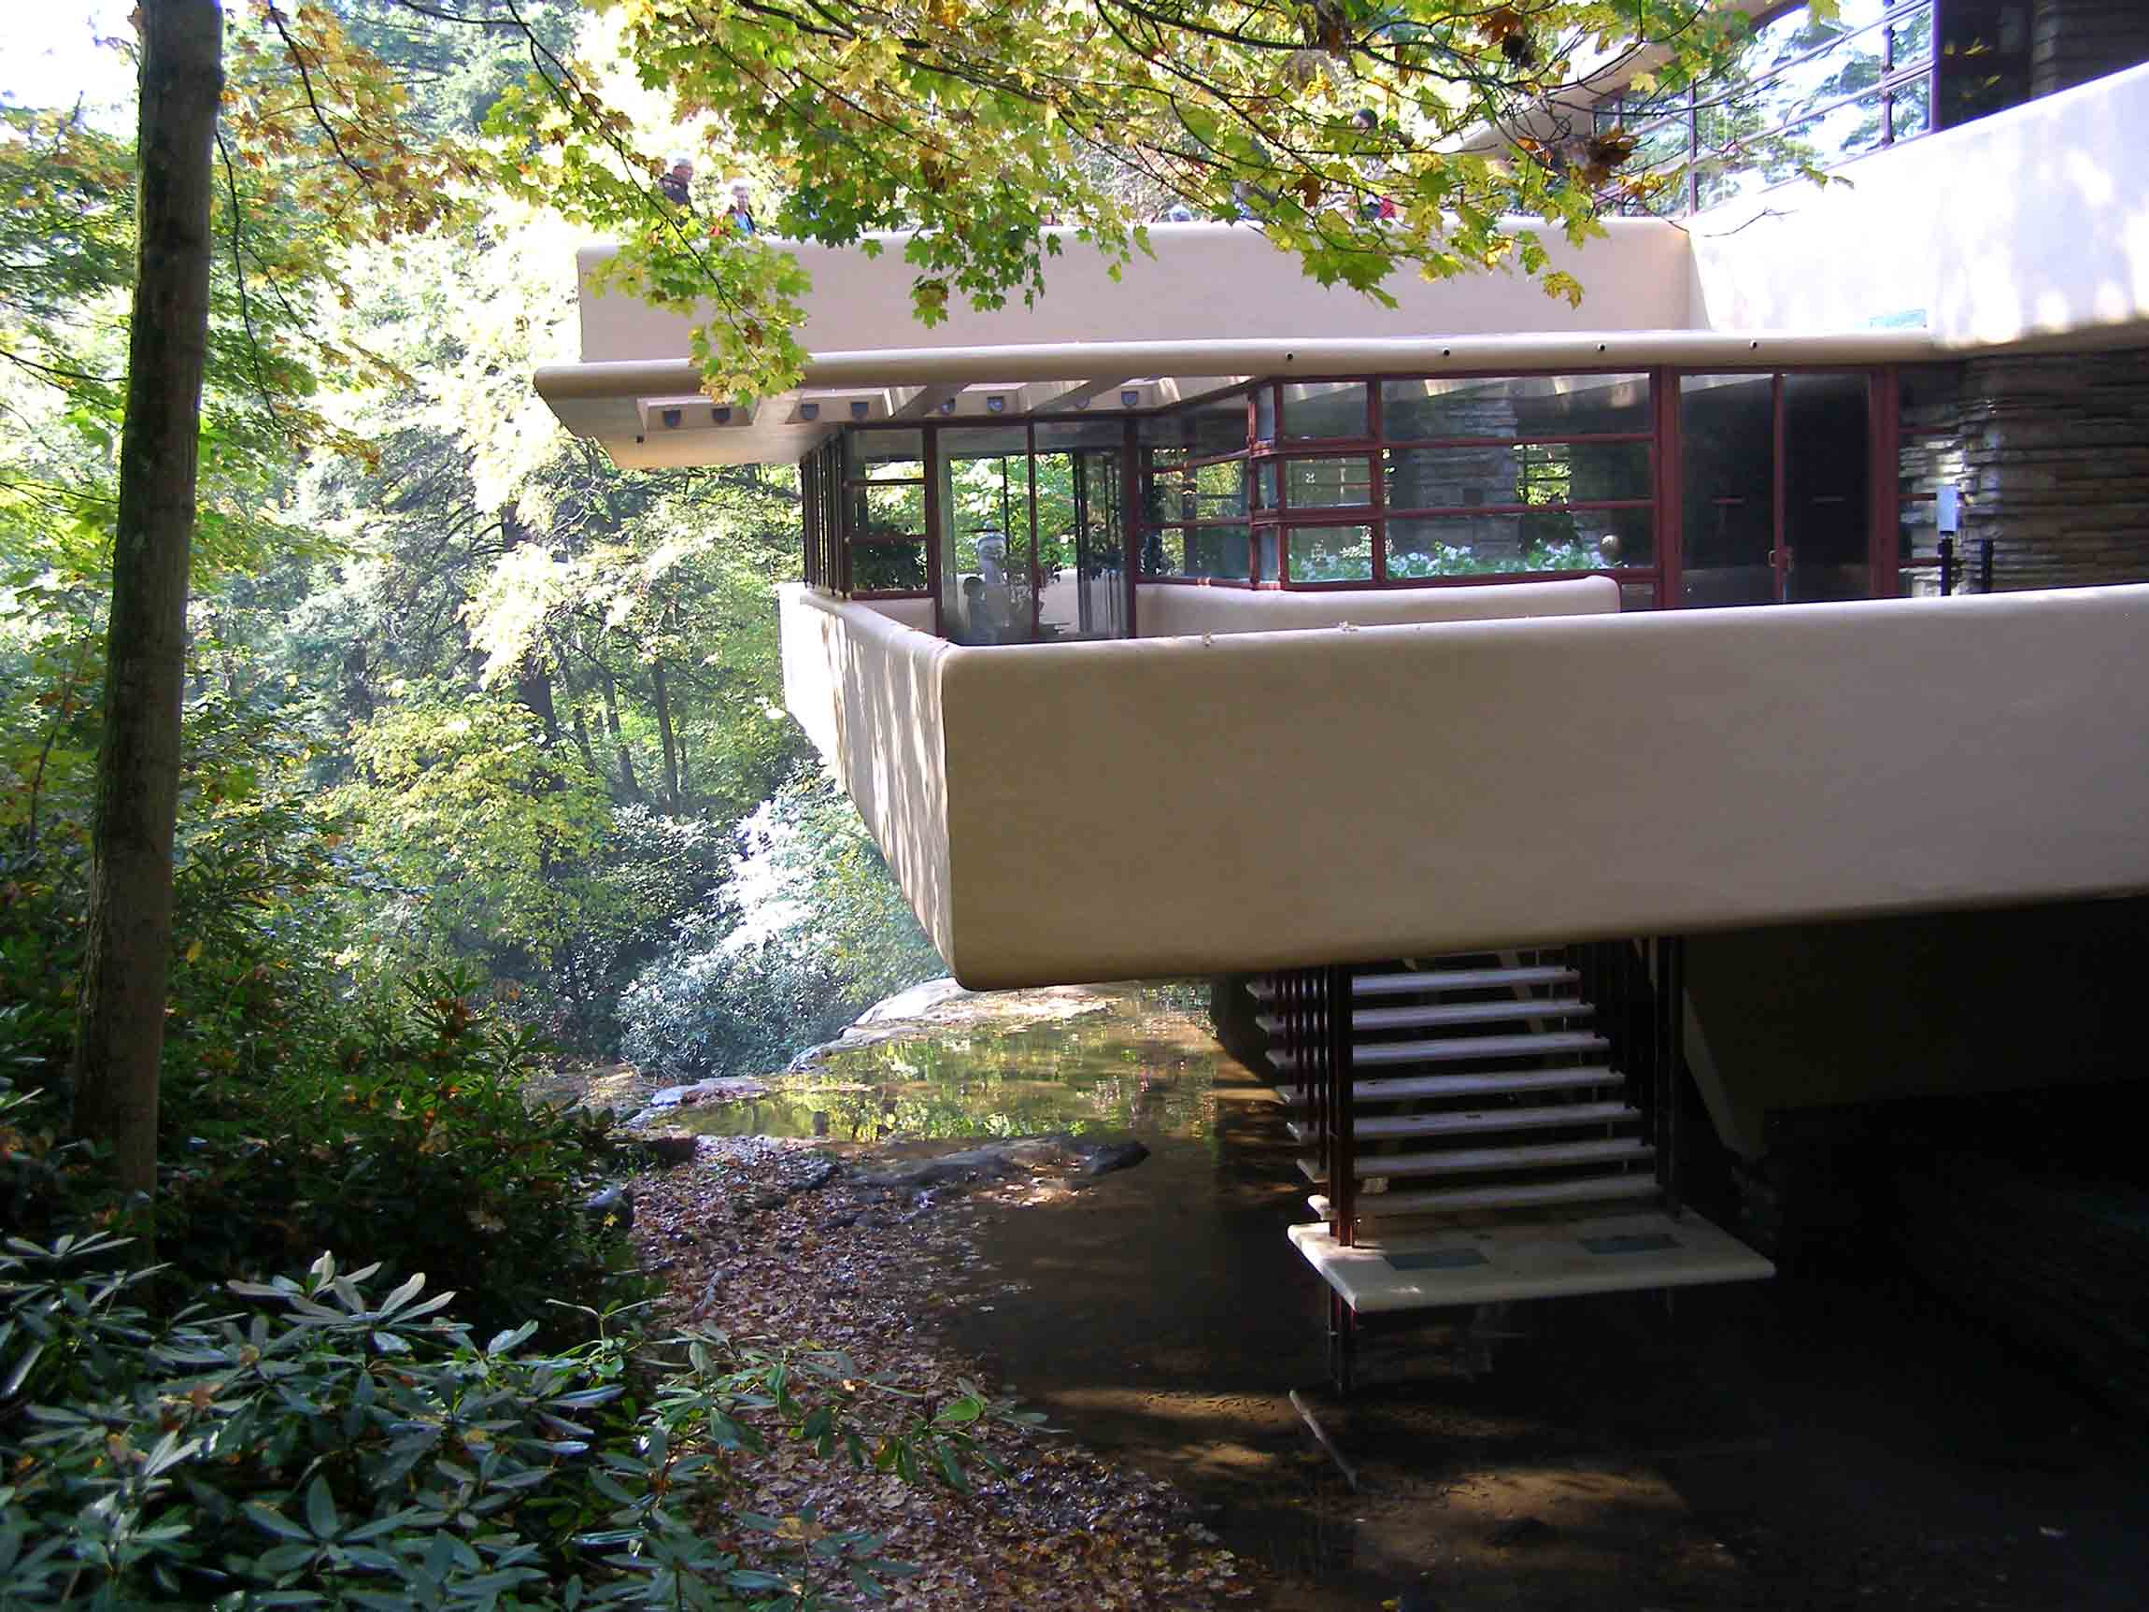
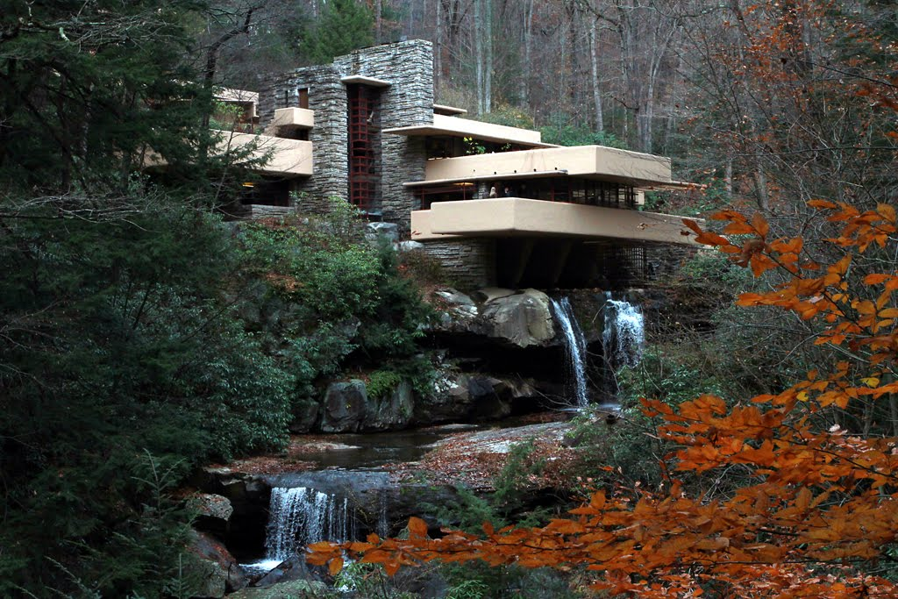
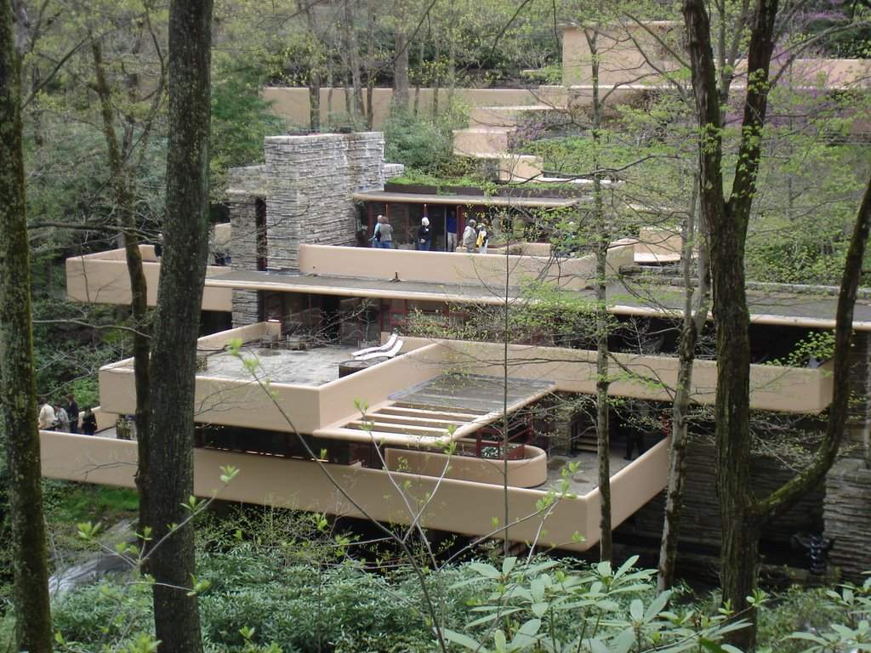
Frank Lloyd Wright
“Fallingwater”, 1936-1939, Mill Run, Pennsylvania
Frank Lloyd Wright built the Fallingwater house for the Kaufmann family, southeast of Pittsburgh, Pennsylvania. The structure seems to be floating, although it hovers over a 30’ waterfall.
He wanted the family to be a part of the waterfalls, not just see them

Slide 16
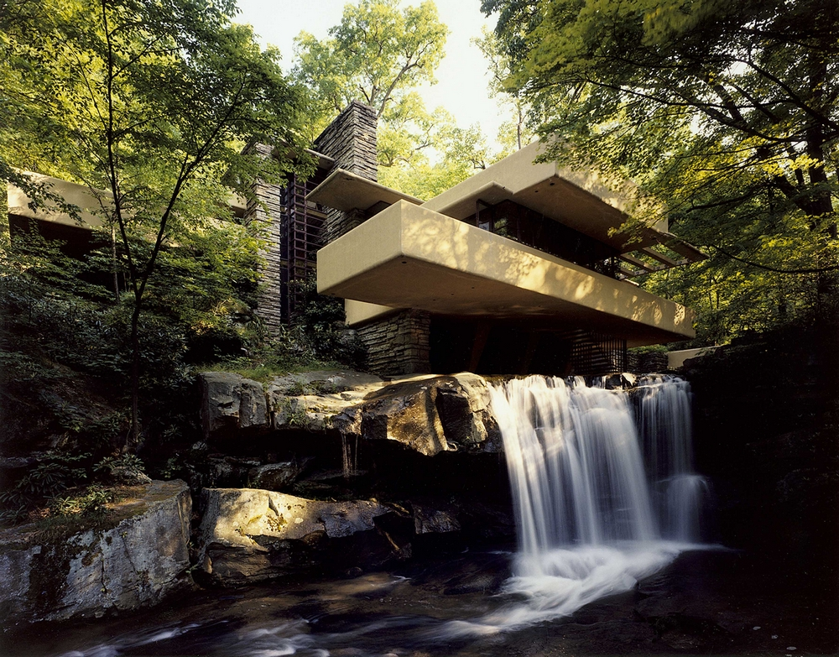
Let’s take a tour of the house & grounds…
It was the Kaufmann’s family weekend home from 1937 to 1963
Wright wanted to use the inspiration of nature as his guide
In 1964 it was opened to the public as a museum
The original estimated cost for building Fallingwater was $35,000
The final cost for the home and guest house was $155,000 (the price is equivalent to $2.6 million in 2014)
Falling Water Tour

Slide 18
Burj Khalifa
Burj Khalifa is a skyscraper in Dubai
Height of 2722.57 feet (251.5 stories) is the tallest manmade structure in the world.
The building officially opened on 4 January 2010

Slide 19
Lets take a look inside the world’s tallest building!
Burj Khalifa

Slide 20
What failures have/could result due to a poor design of a building / structure??

Slide 21
The World Trade Center

Slide 22
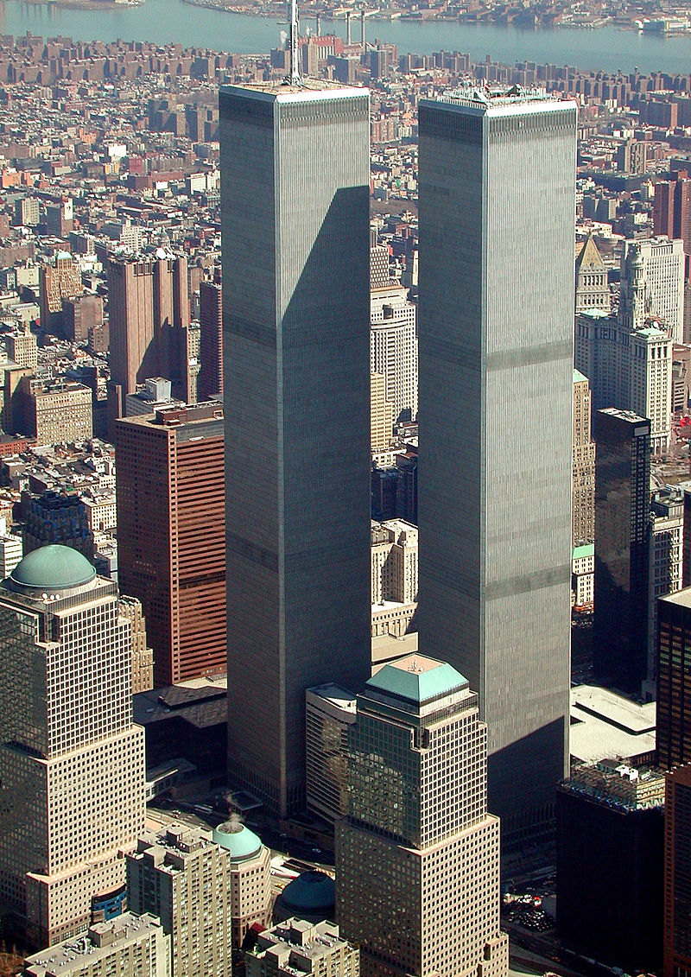
World Trade Center Design
The construction of the first World Trade Center was conceived as an urban renewal project, spearheaded by David Rockefeller, to help revitalize Lower Manhatten.
The towers were designed as framed tubed structures, which provided tenants with open floor plans, uninterrupted by columns or walls.
Lead architect - Minoru Yamasaki
Building involved many other innovative techniques:
the slurry wall for digging the foundation
wind tunnel experiments

Slide 23
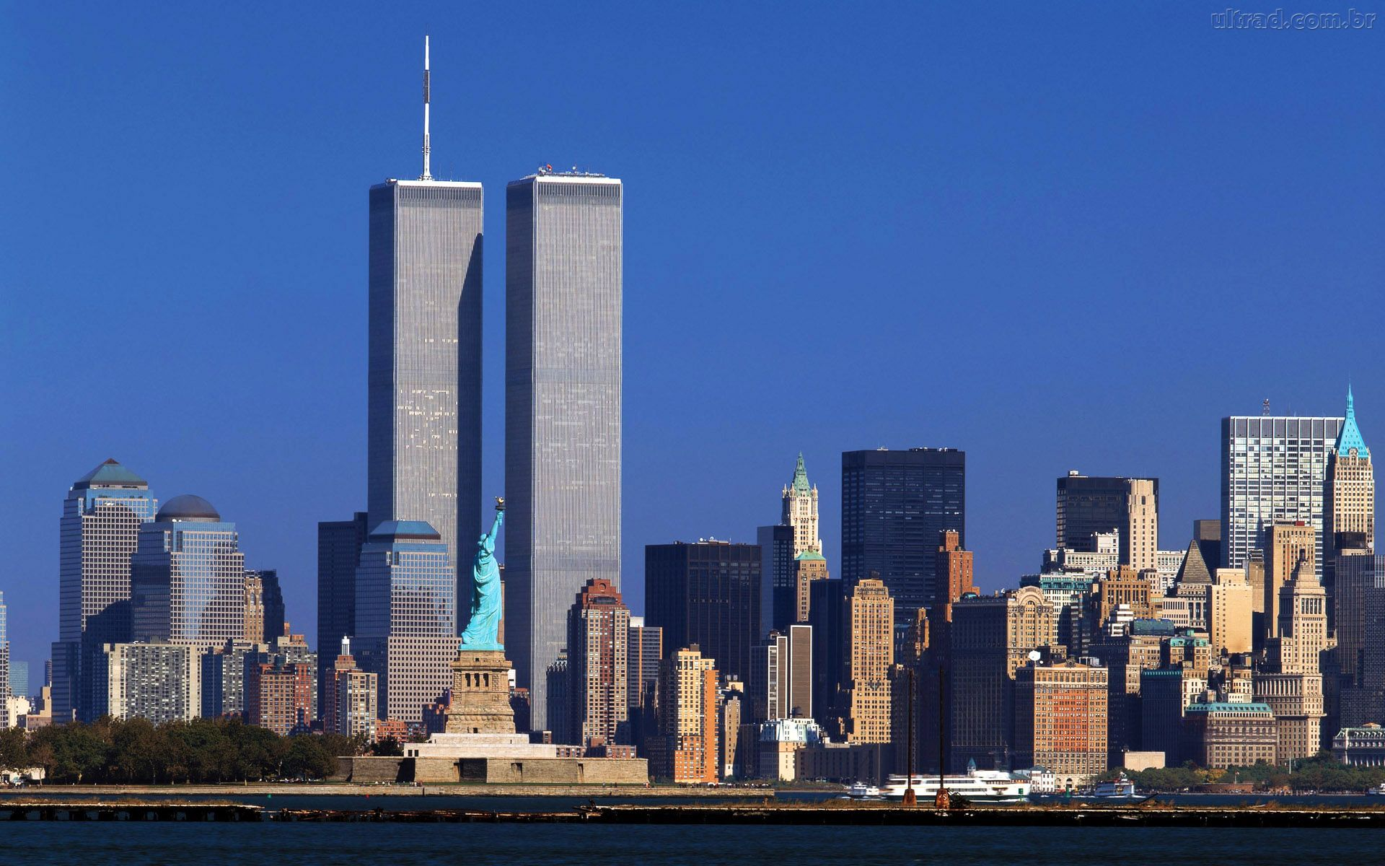
What happened on 9/11 to the Twin Towers?
Why would they collapse after impact?

Slide 24
Why did the WTC collapse?
The major events include the following:
The airplane impact with damage to the columns.
The initial impact was the explosion when 90,000 gallons of jet fuel, comprising nearly 1/3 of the aircraft’s weight, ignited. The ensuing fire was clearly the principal cause of the collapse.
The ensuing fire with loss of steel strength and distortion.
The collapse, which generally occurred inward without significant tipping.

Slide 25
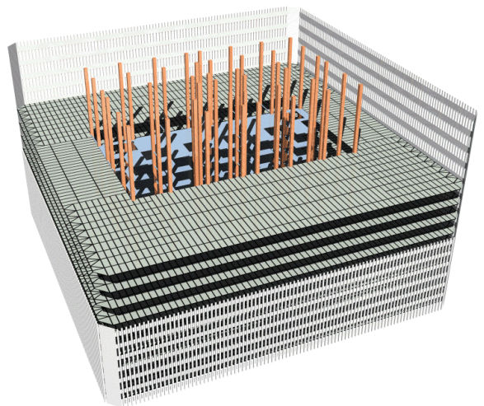
WTC Structure
To a structural engineer, a skyscraper is modeled as a large cantilever vertical column.
In order to make each tower capable of withstanding wind, the architects selected a lightweight “perimeter tube” design. Inside this outer tube there was a core, which was designed to support the weight of the tower. It also housed the elevators, the stairwells, and the mechanical risers and utilities. Web joists connected the core to the perimeter at each story. Concrete slabs were poured over these joists to form the floors. In essence, the building is an egg-crate construction that is about 95 percent air, explaining why the rubble after the collapse was only a few stories high.
http://www.tms.org/pubs/journals/jom/0112/eagar/eagar-0112.html

Slide 26
Was the WTC Defectively Designed?
The World Trade Center was not defectively designed. No designer of the WTC anticipated, nor should have anticipated, a 90,000 L Molotov cocktail on one of the building floors. Skyscrapers are designed to support themselves for three hours in a fire even if the sprinkler system fails to operate. This time should be long enough to evacuate the occupants. The WTC towers lasted for one to two hours—less than the design life, but only because the fire fuel load was so large. No normal office fires would fill 4,000 square meters of floor space in the seconds in which the WTC fire developed. Usually, the fire would take up to an hour to spread so uniformly across the width and breadth of the building. This was a very large and rapidly progressing fire
http://www.tms.org/pubs/journals/jom/0112/eagar/eagar-0112.html

Slide 27
Tacoma Narrows Bridge

Slide 28
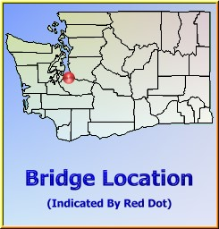
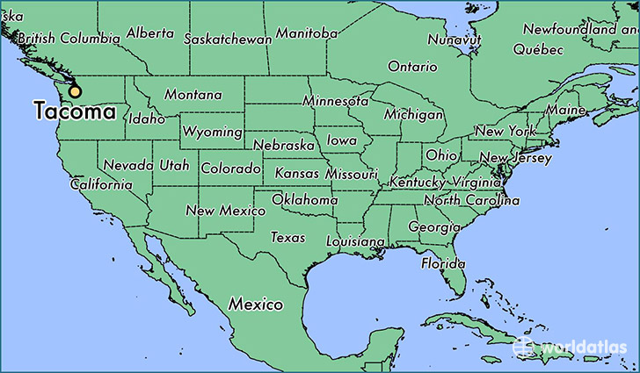
Tacoma Narrows Bridge Tacoma, Washington
Tacoma Narrows Bridge
Bridge that spanned the Tacoma Narrows strait of Puget Sound in Pierce County, Washington.
Nicknamed “Galloping Gertie” by the construction workers who noticed the bridge span movement during windy conditions

Slide 29
“Galloping Gertie”
To engineers Gertie's "bounce" represented "structural instability.
From the first week of May 1940, as workmen finished the bridge's floor system, engineers and others noticed the deck's vertical wave motions, or "bounce." They knew something was wrong. Months before, in the summer of 1939, they had heard rumors of similar small waves in another suspension span, the Bronx-Whitestone Bridge, which opened in April 1939. The Bronx-Whitestone Bridge, like the Tacoma Narrows Bridge, had been designed by consultant Leon Moisseiff of New York.
In May 1940 engineers tried to take the "bounce" out of the bridge. They installed four hydraulic jacks ("buffers") at the towers to act as shock absorbers. But, the devices made no noticeable improvement.
Immediately, the Toll Bridge Authority contracted with engineering Professor F. Bert Farquharson at the University of Washington to conduct wind tunnel studies and recommend a remedy.
In October, while the wind tunnel studies continued, engineers placed "temporary" tie-down cables (anchored restraining wires 1-9/16 inches in diameter) on the bridge's side spans some 300 feet out from each anchorage. At mid-span they placed diagonal wires between the main cables and the deck.
Farquharson and state bridge engineers believed they had solved the problem. On November 1, the east tie-down cable broke in a high wind when Gertie began to "gallop." Workmen immediately began repairs. The tie-down cables did reduce the "bounce" in the side spans, but they had no effect on the center span.

Slide 30
“Galloping Gertie”
The probable cause of Gertie's instability, Farquharson reported to the State Toll Bridge Authority, were the bridge's solid stiffening girders. He offered a choice of remedies: either allow the wind to pass through by cutting holes in the solid girders; or deflect the wind by covering the girder with sections of curved steel ("fairings").
On November 7th, just five days after Farquharson finished the studies, State authorities were drafting a contract to install the wind deflectors. Bridge engineer Clark Eldridge had met with Professor Farquharson and PWA engineer L. R. Durkee the day before. They agreed on a course for "streamlining" the south side of the center span. On November 7 Eldridge began preparing the sketches and getting prices for steel and other materials. In 10 days the bridge would have enough wind deflectors to achieve significant stability, if wind came from the south. In two weeks the south side of the center span would be fully covered with the protective deflectors. In 45 days the entire bridge on both sides would be covered. Eldridge and Farquharson felt optimistic.
That morning icy winds gusted up the Narrows into the side of Gertie's deck. Time ran out.

Slide 31
Tacoma Narrows Bridge
Leonard Coatsworth News editor, Tacoma News Tribune
"I saw the Narrows bridge die today, and only by the grace of God, escaped dying with it. . . .
"I drove on the bridge and started across. In the car with me was my daughter's cocker spaniel, Tubby. The car was loaded with equipment from my beach home at Arletta. "Just as I drove past the towers, the bridge began to sway violently from side to side. Before I realized it, the tilt became so violent that I lost control of the car. . . . I jammed on the brakes and got out, only to be thrown onto my face against the curb."
"Around me I could hear concrete cracking. I started back to the car to get the dog, but was thrown before I could reach it. The car itself began to slide from side to side on the roadway. I decided the bridge was breaking up and my only hope was to get back to shore."
"On hands and knees most of the time, I crawled 500 yards or more to the towers . . . . My breath was coming in gasps; my knees were raw and bleeding, my hands bruised and swollen from gripping the concrete curb . . . . Toward the last, I risked rising to my feet and running a few yards at a time . . . . Safely back at the toll plaza, I saw the bridge in its final collapse and saw my car plunge into the Narrows."
"I saw Clark Eldridge (Toll Bridge Authority engineer), his face white as paper. If I feel badly, I thought, how must he feel?"
"With real tragedy, disaster and blasted dreams all around me, I believe that right at this minute what appalls me most is that within a few hours I must tell my daughter that her dog is dead, when I might have saved him."

Slide 32
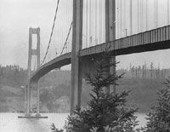
Interesting Facts about the collapse of Galloping Gertie -
Reporter Leonard Coatsworth, who lost his car (and poor Tubby) in the collapse of the first bridge, had trouble getting reimbursed for his loss. He sent in a claim, but six months passed with no news and no money. Finally, Coatsworth wrote a letter to the State Toll Bridge Authority, pleading for a response. But, more time passed before he received compensation. Finally, the WSTBA reimbursed Coatsworth for the loss of his car, $450.00. They had already paid him $364.40 for the loss of his car's "contents".
Engineer Moisseiff's heart also failed. The fate of Leon Moisseiff, whose design for Galloping Gertie now rests on the floor of Puget Sound at the Narrows, is a curious tale. After Gertie collapsed in 1940, the once proud and honored engineer continued to work. But, his brilliant career had ended in tragic failure. He was gravely dismayed and disheartened. Only three years later, at age 70, he died—of heart failure.

Slide 34
https://www.youtube.com/watch?v=j-zczJXSxnw
Footage of the Tacoma Narrows Bridge collapse

Slide 35
What role does technology play
in design?
Especially when constructing a large building (WTC) or a bridge (Galloping Gertie)?

