Slide 1
Art HERStory
A study of women in art

Slide 2
Objectives
Students will understand that…
Femaleness has been a fascinating topic for male and female artists alike.
Men and women may have different ways of depicting women and different messages they wish to convey in their art.
Women may have certain reactions to the ways they have been depicted.
That the depiction of the female and a fascination with femaleness are issues ingrained in many cultures today and throughout recorded history.

Slide 3
Essential Questions:
1) How have the ways women have been portrayed in art changed through the ages?
2) Do women portray themselves similarly to the way men portray them? Would they want to? Why or why not?
3) Why might women have felt resentment at men for the way they were portrayed by them?
4) What do we notice in the art the women create that speaks to this resentment?

Slide 4
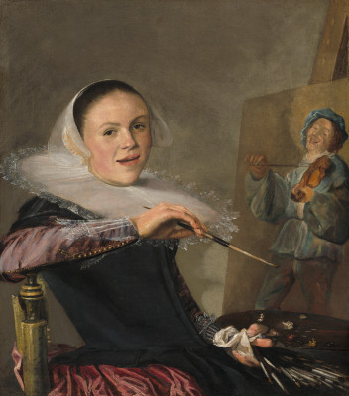
Judith Leyster
“Self-Portrait”
1630
Oil on Canvas
National Gallery of Art
29 3/8” x 25 5/8”
Dutch Baroque
https://www.khanacademy.org/humanities/monarchy-enlightenment/baroque-art1/holland/v/leyster-self

Slide 5
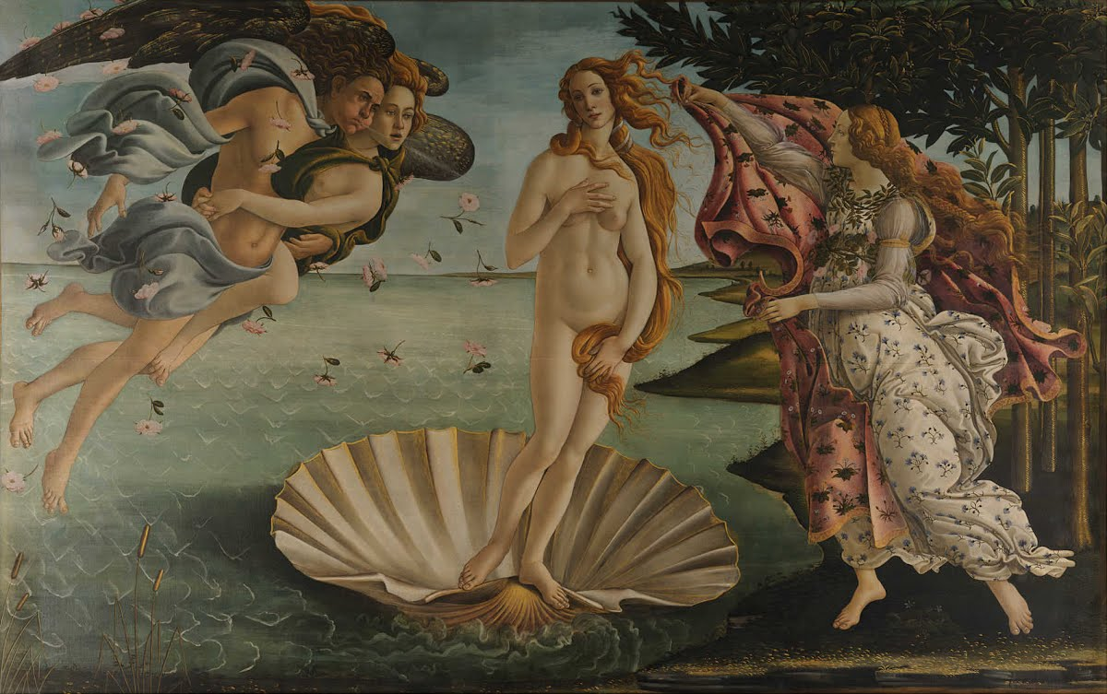
Botticelli
“The Birth of Venus”
1484-1486
Tempera on canvas
Uffizi Gallery
5’8” x 9’2”
Early Renaissance
https://www.khanacademy.org/humanities/renaissance-reformation/early-renaissance1/painting-in-florence/v/botticelli-the-birth-of-venus-1483-85

Slide 6
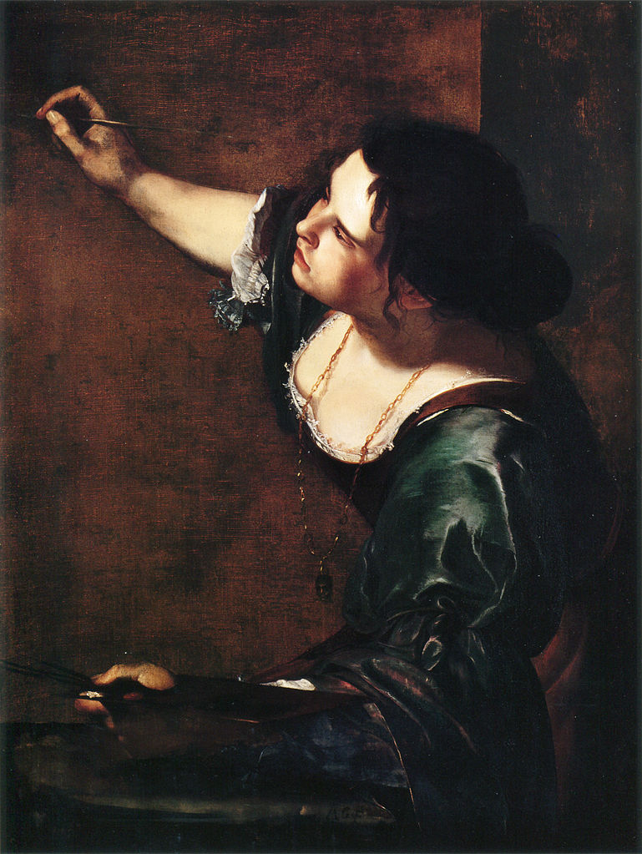
Artemisia Gentileschi
“Self-Portrait”
1639
Oil on canvas
London
0.965m by 0.737m
Baroque

Slide 7
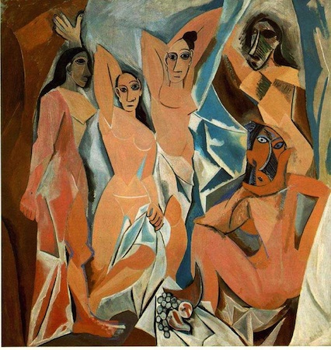
Pablo Picasso
“Les Demoiselles d’Avignon”
1907
Oil on canvas
Museum of Modern Art
8' x 7' 8"
Cubism
https://www.khanacademy.org/humanities/art-1010/early-abstraction/cubism/v/picasso-les-demoiselles-d-avignon-1907

Slide 8
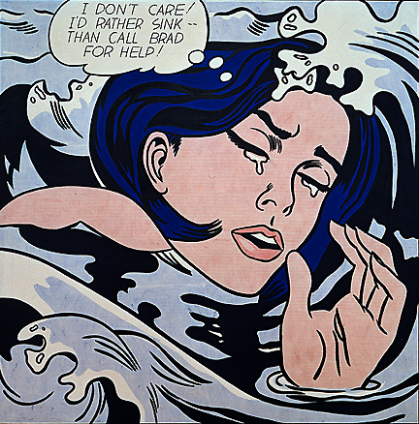
Roy Lichtenstein
“Drowning Girl”
1963
Oil and synthetic polymer paint on canvas
MoMA
5’8” x 5’7”
Pop Art

Slide 9
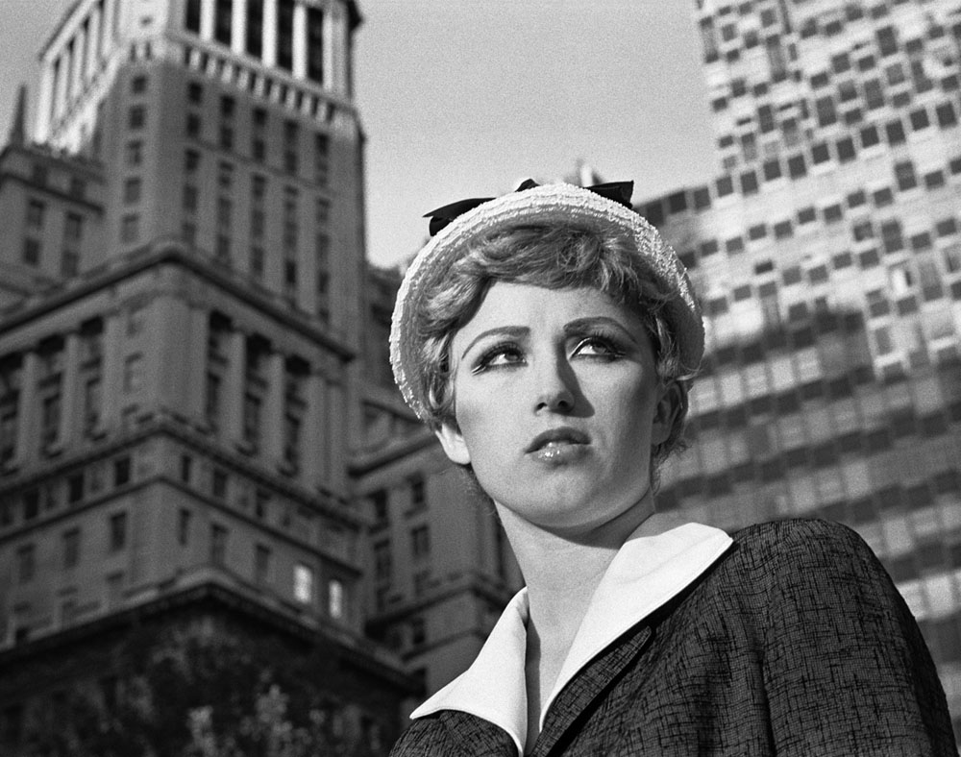
Cindy Sherman
Untitled Film Still #21
1978
Gelatin Silver Print
MoMA
7 ½” x 9 ½”
Contemporary Art
https://www.khanacademy.org/humanities/global-culture/identity-body/identity-body-united-states/v/cindy-sherman-untitled-film-still-21-1978

Slide 10
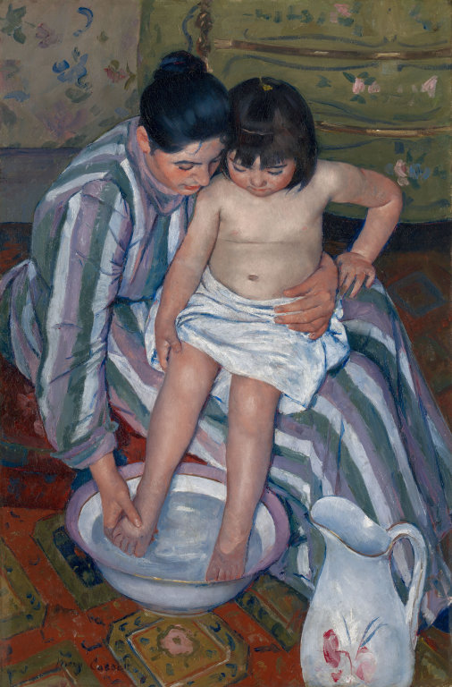
Mary Cassatt
“The Child’s Bath”
1893
Oil on Canvas
Art Institute of Chicago
3’3” x 2’2”
Impressionist
https://www.khanacademy.org/humanities/becoming-modern/avant-garde-france/impressionism/v/mary-cassatt-the-child-s-bath-1893

Slide 11
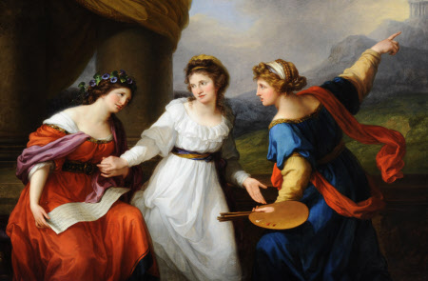
Angelica Kauffman
“Self Portrait, the Artist Hesitating Between the Arts of Music and Painting”
1794
Oil paint on canvas
Nostell Priory, West Yorkshire
1470 cm x 2150 cm
Neoclassicism

Slide 12
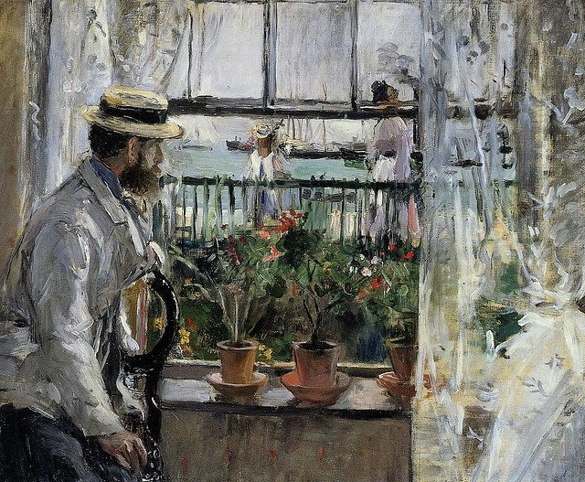
Berthe Morisot
“Eugene Manet on Isle of Wight”
1875
Oil Paint
1’3” x 1’6”
Paris, France
Impressionism

Slide 13
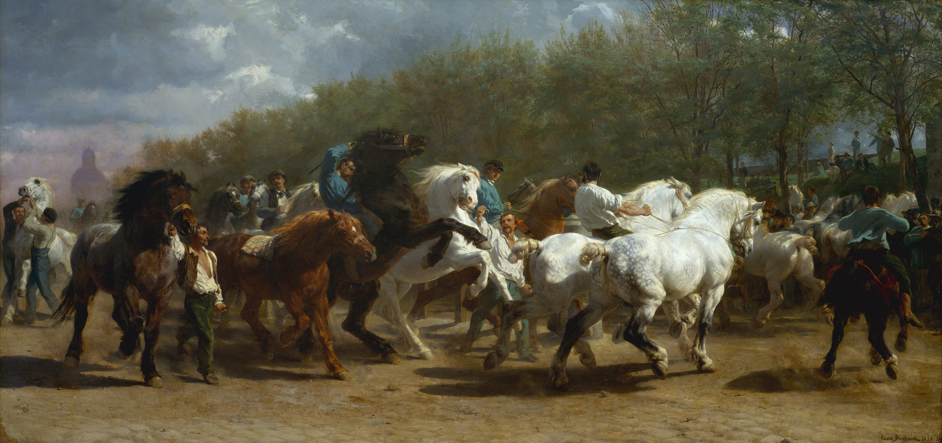
Rosa Bonheur
“The Horse Fair”
1852-55
Oil Paint
Metropolitan Museum of Art
8’ x 16’ 7”
Realism

Slide 14
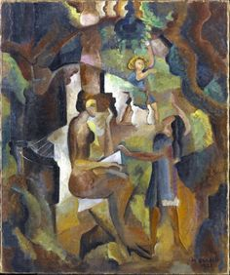
Marguerite Thompson Zorach
“Memories of My California Childhood”
1921
Oil on Canvas
Brooklyn Museum
30 ½” x 25 1/8”
Modernism

Slide 15
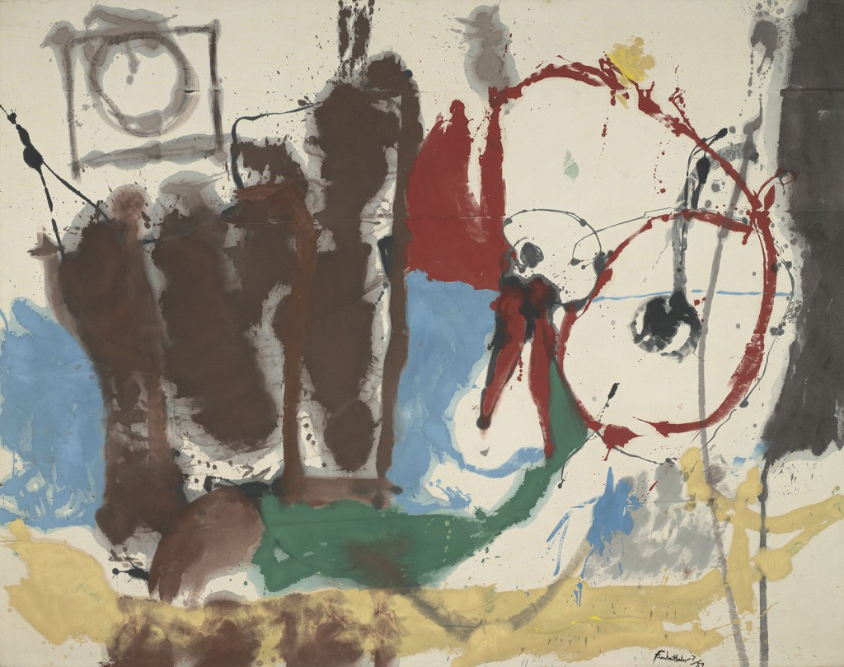
Helen Frankenthaler
“Mother Goose Melody”
1959
Oil on Canvas
81 ¾” x 103 ½”
Virginia Museum of Fine Arts
Abstract Expressionism

Slide 16
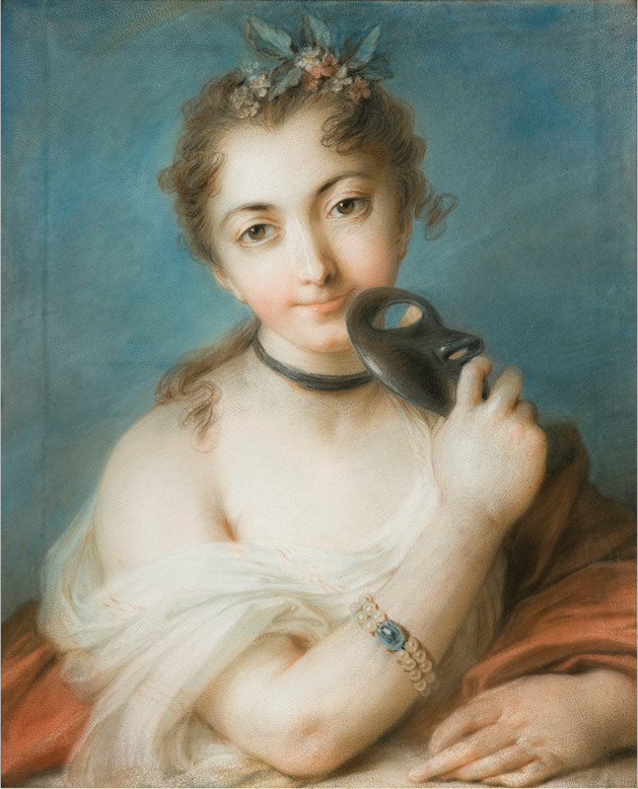
Rosalba Carriera
“Female Portrait with Mask”
1720-1730
Pastel on paper
Fondazione Cariplo, Milano, Italy
47 cm x 56 cm
Rococo

Slide 17
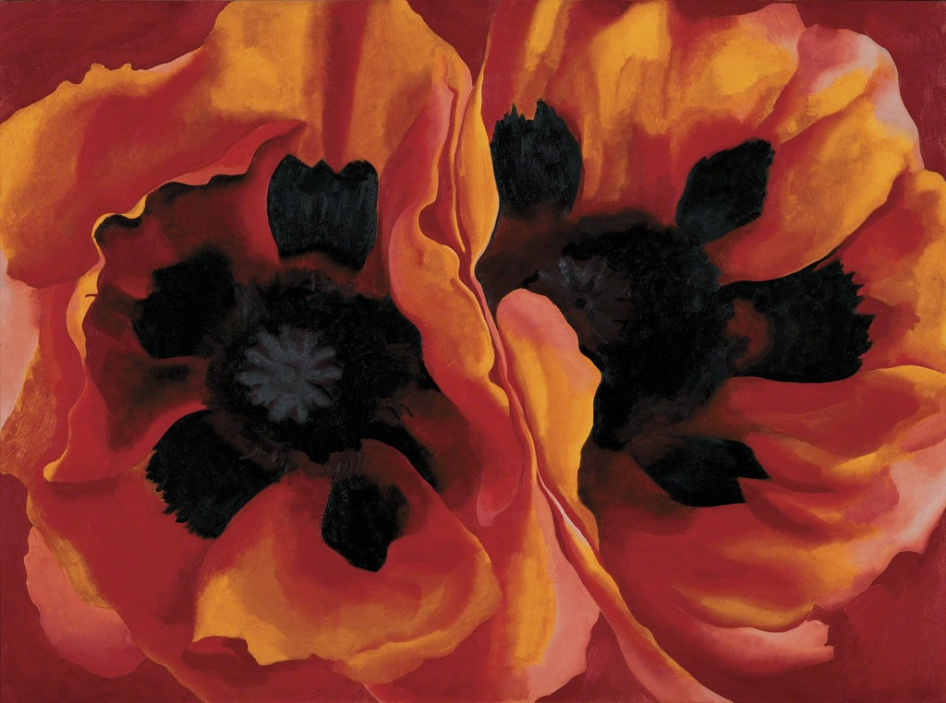
Georgia O’Keeffe
“Oriental Poppies”
1927
Oil paint on canvas
Tate modern, London
30” x 40”
American Modernism

Slide 18
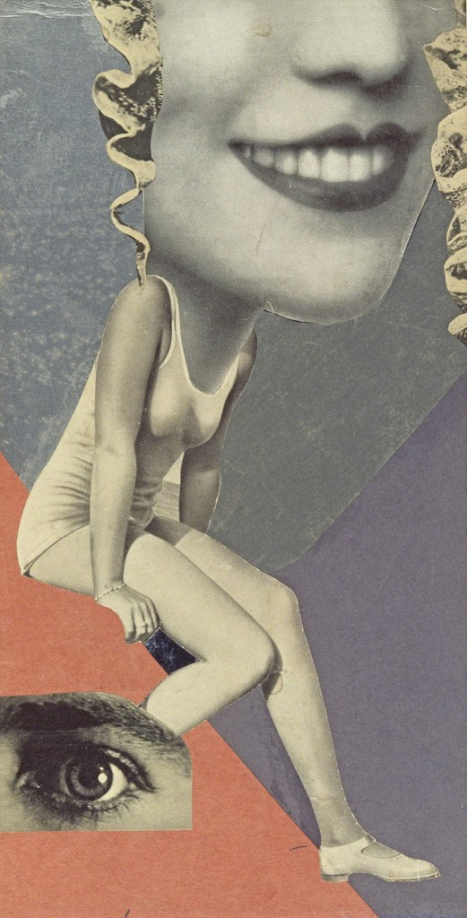
Hannah Hoch
“Made for a Party”
1936
Collage
14 1/5” x 7 4/5”
Whitechapel Gallery, London
Dada

