Slide 1
Before we start…
I’m handing back your work. If it says “DISPLAY?” and you would allow me to display your work, please leave JUST THE ARTWORK on the brown table where you get your warm ups.
KEEP ALL WORK IN YOUR PORTFOLIO. DO NOT TAKE WORK HOME
You will need it for the Art Show in MAY
Some of you might want to resubmit your article/artwork. You have ONE WEEK to do so. They’re do MONDAY, DECEMBER 4

Slide 2
Movement: Bad hair day
Art II – Senick

Slide 3
Using the groups at your table…
Choose one person to answer the questions
One person to give an example
One person to scribe
One person to provide answers to the class

Slide 4
Answer the following questions…
How can art benefit our mental health?
How can art benefit our physical health?
How can art be a form of therapy?

Slide 5
Let’s discuss!
How can art benefit our mental health?
How can art benefit our physical health?
How can art be a form of therapy?

Slide 6
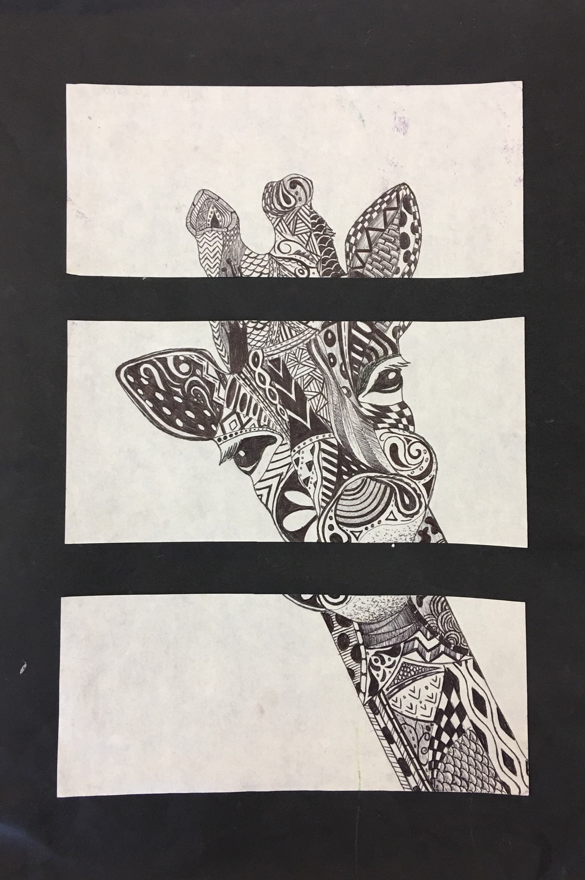
Zentangles
Remember these?
A glorified doodle
No pressure
No right or wrong
You can’t mess up!!

Slide 7
First, we have to practice
I know that some of you have done this before…
GOOD. YOU KNOW WHAT TO DO
Help those who do not!
Develop 25 designs/patterns using
Line – positive and negative
Shape – geometric/organic
Space – positive and negative
Patterns - animal prints

Slide 8
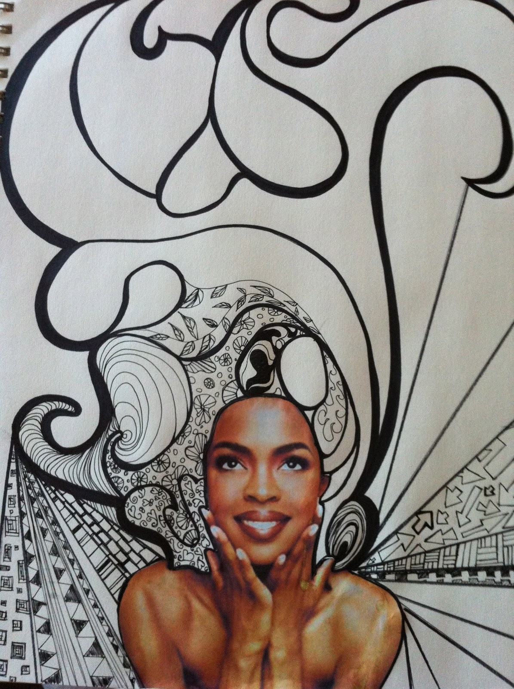
Bad hair day
Here’s the task list:
Choose an image from a magazine
Cut it out, without the hair
Glue it to a piece of final paper
Begin adding designs to the page
Use the designs to create long, flowing hair off of your person
Put zentangle designs into the “hair” of your person

Slide 9
guidelines
Place the image of your person at the very bottom of the page
They should meet up with the edge
The person should take up 1/3 of your page
The hair should take up the remaining 2/3 of your page
Zentangle designs must be included in the entire “hair” portion of the page
You may only use sharpie to complete the designs

