Slide 1
Body design
Perspectives in Art – Mrs. Senick

Slide 2
Warm Up
List as many beauty ideals as you can think of and the cultures that these ideals represent.
https://www.youtube.com/watch?v=5o9Dp6D91fI

Slide 3
Read the following article
Which do you find beautiful?
Why?
Which do you NOT find beautiful?
Why not?
Why do you think that these countries consider these characteristics beautiful?
Who determines beauty?

Slide 4
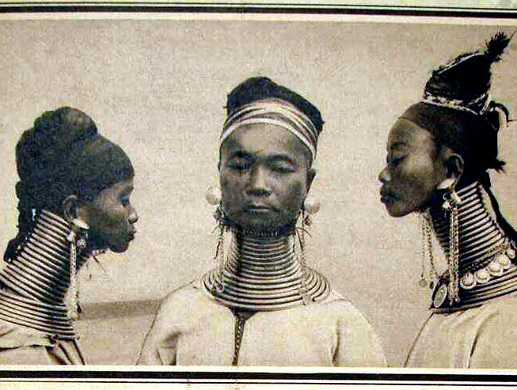
Thailand/burma
In Thailand and Burma, women are often considered beautiful by the amount of rings that they have around their necks.
Neck stretching begins at age 5
Each ring is 4.5 lbs
The rings can weigh up to 22lbs total
They are only removed on the woman’s wedding night

Slide 5
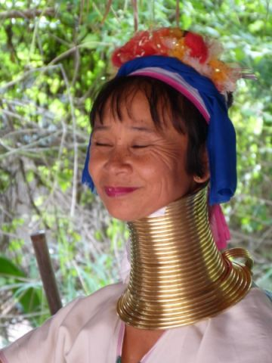
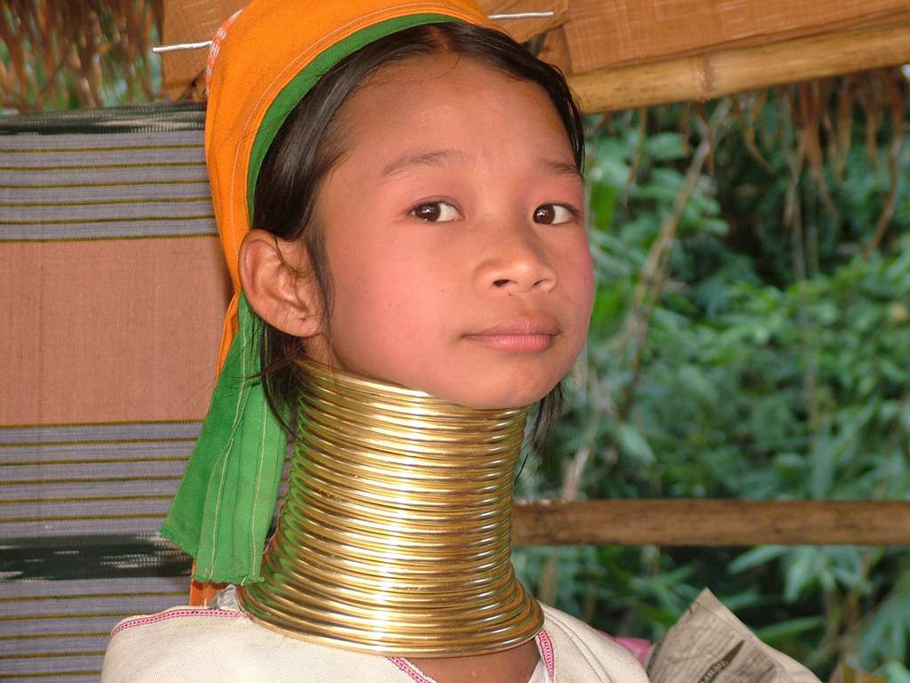
Women’s necks can become chafed, bruised, and discolored from the years of wear.
11th Century right of passage
A full set of neck rings is 25 coils

Slide 6
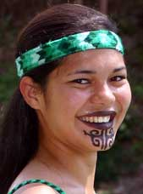
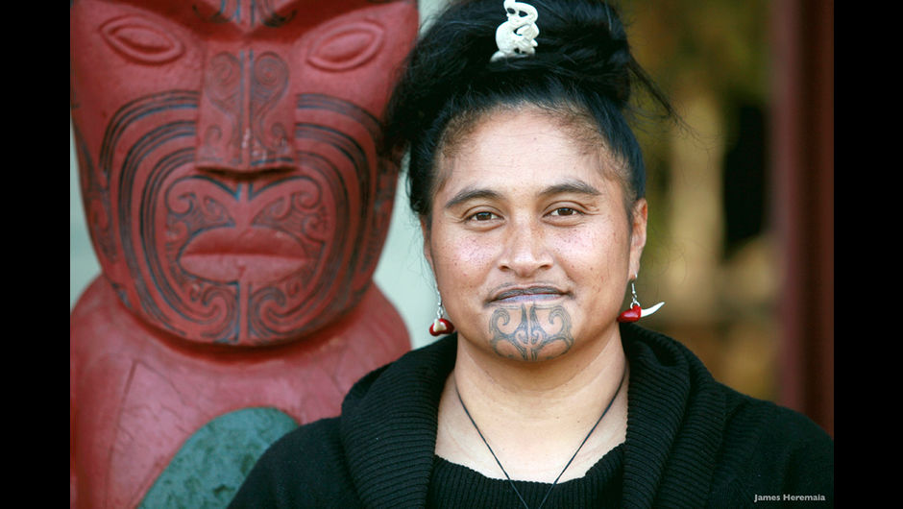
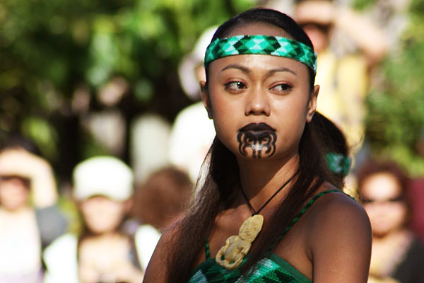
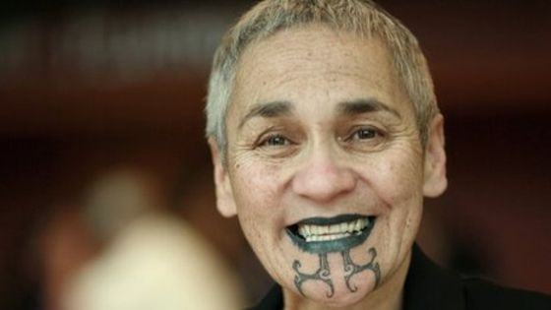
New zealand
Maori women have “blue tattoos”
These tattoos are placed on their lips and chin for the “ultimate beauty”

Slide 7
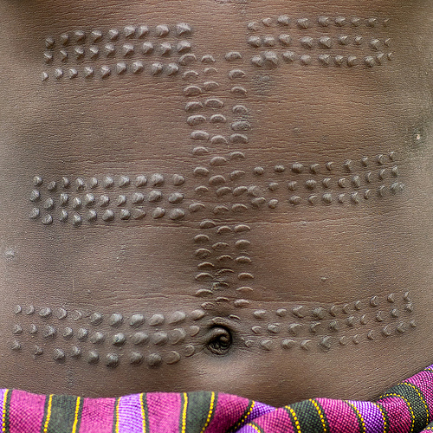
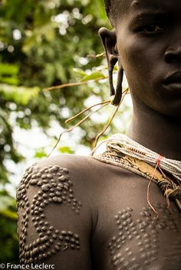
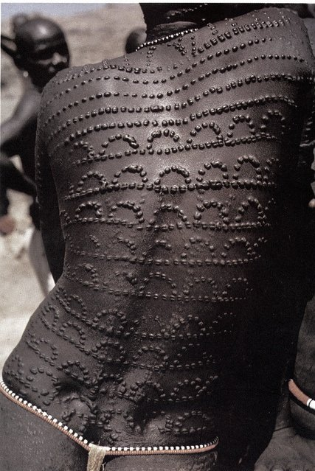
Karo girls in ethiopia
In Ethiopia, the Karo tribe cut the skin of young girls and women in order to make them beautiful.
When a woman has enough scars, she is ready for a husband.

Slide 8
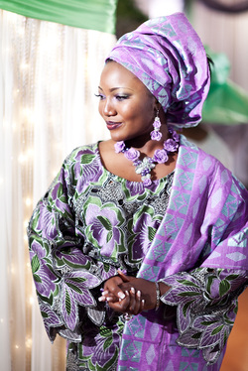
Bigger is better – Mauritania & nigeria
In Western culture, skinny is beautiful.
In African culture, bigger is better!
Skinny women are pitied
Disease
Poverty
Being full figured shows that you have wealth for food
Women are fed as much food as possible
Some families sent their daughters to “fat camps” to feed them over 16,000 calories per day!

Slide 9
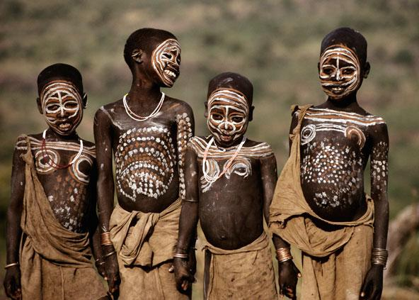
African body Paint
One of the oldest art forms in Africa
“life-affirming, transforming, spontaneous, and a signature of being alive”
Decoration or display and imprinted message
Patterns and designs
Single/married
Social status
Position within the tribe
Oil, clay, chalk, and plant products are used to create colors and textures

Slide 10
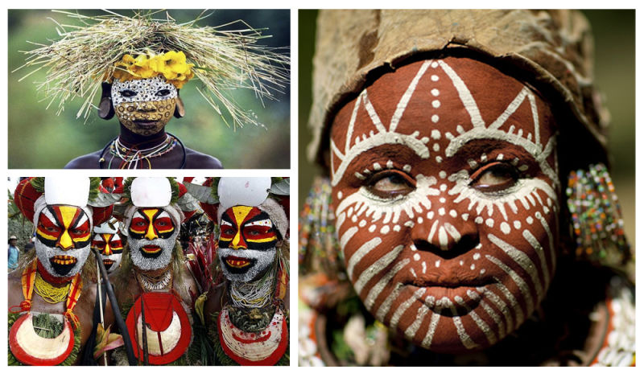

Slide 11
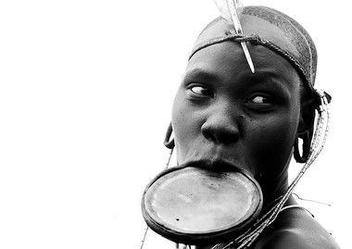
Mursi and Surma – Ethiopia
Lip plating
When a girl reaches puberty, a piercing is placed in her lip
Increasingly larger discs are inserted over a six month span.
Induction into womanhood and suitability for marriage.
Size of plate is how many cattle the parents require for marriage
Lip plates are taken out only few times
Around other women
Sleeping
Eating
Commitment to her culture and husband
If husband dies, the wife stops wearing the lip plate in his honor

Slide 12
What do you think of when you see sharp, dagger-like teeth?

Slide 13
balinese
Tooth filing “Mapandes” or “Metatah”
Filing protruding canine teeth is believed to reduce the uncouth behavior they are said to represent
far more important is the religious substance of the ceremony, which involves ridding the spirit of its six negative traits
lust, greed, anger, drunkenness, confusion and jealousy.
Ceremonies with up to 14 people participating
Ceremonies could cost up to 35 Million Dollars
They do not cry out in pain
When Tooth Filing is finished, the pepper leaf (base) is rubbed on the ends of the teeth, and then the ‘pedanda’ places various other soothing, healing tinctures on the end of the initiate’s tongues.
The coconut shell receptacle of filing debris and saliva is then buried behind the ancestral shrine lest it be occupied by evil spirits.

Slide 14
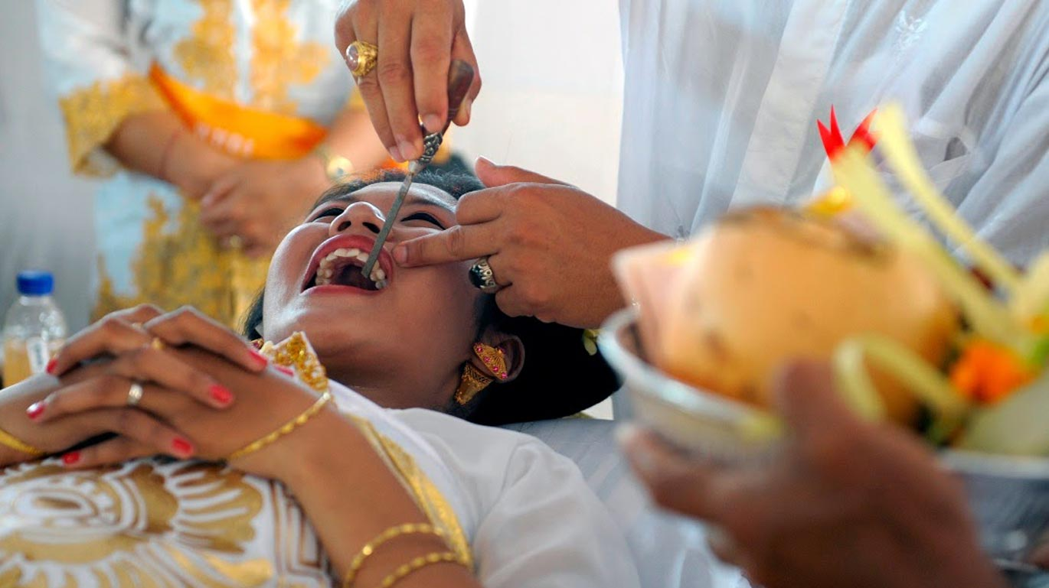

Slide 15
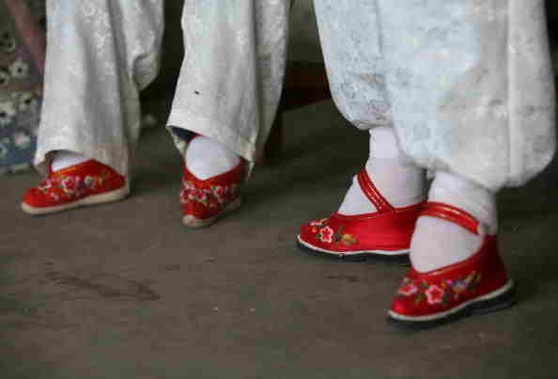
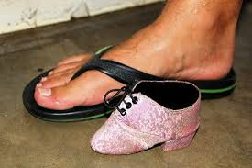
china
Tiny feet are beautiful
Break the feet
Bind the feet
Lifelong pain
Difficulties walking

Slide 16
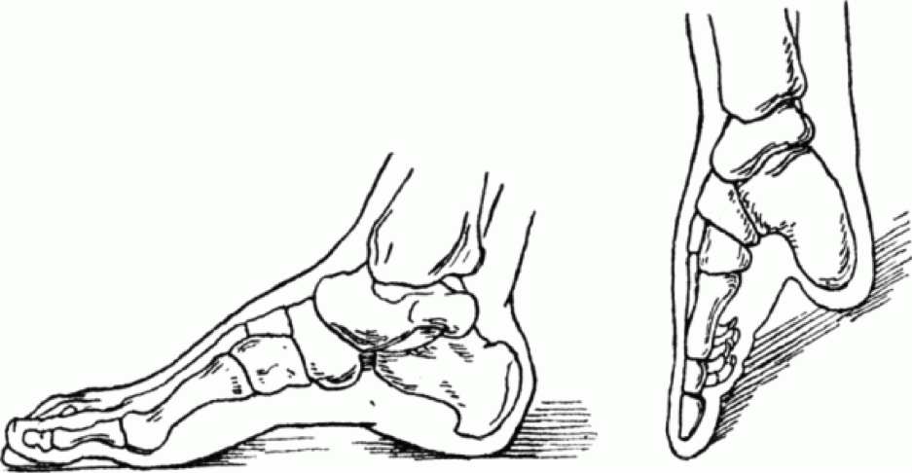
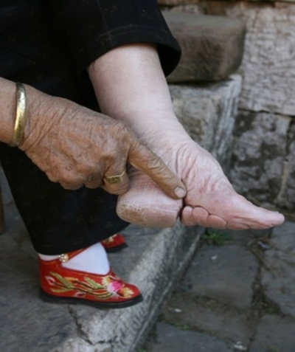
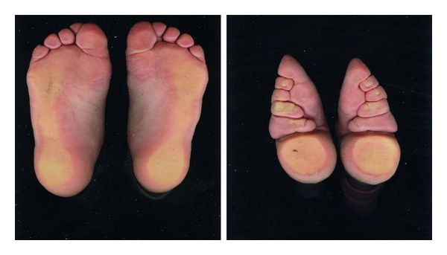

Slide 17
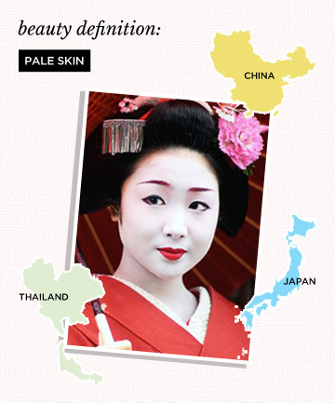
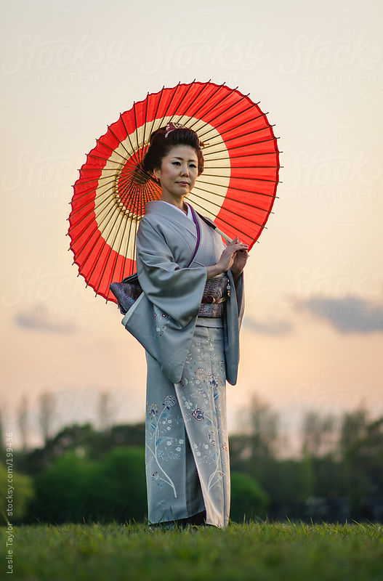
China, japan, thailand
Pale skin is a sign of affluence and attractiveness
Japanese avoid sun at all costs!
Parasols!!
Skin care products are hard to find without whitening agents
(Bleach!)

Slide 18
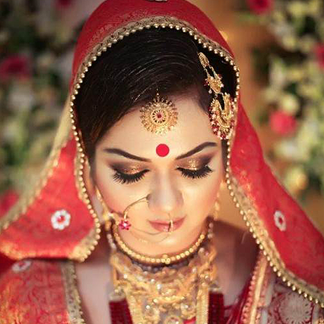
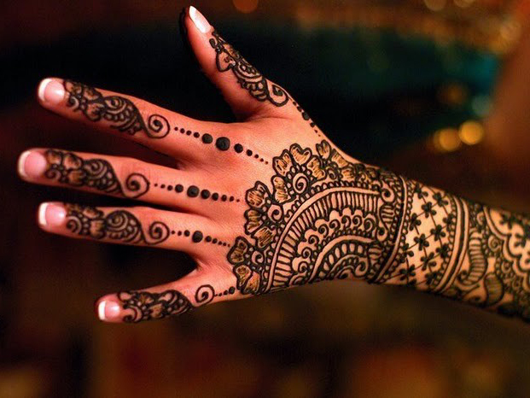
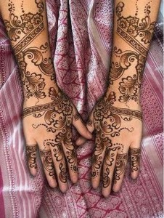
India
Henna
Nose rings
Bindis
“Kumkum”
Decorative mark worn to look more beautiful
Often worn at weddings

Slide 19
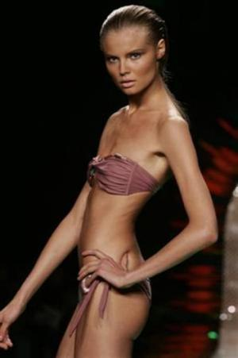
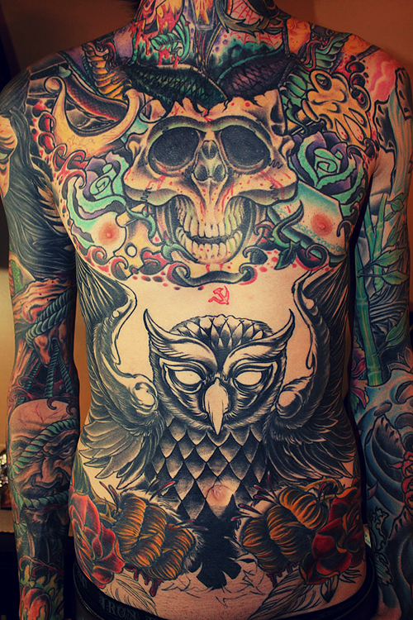
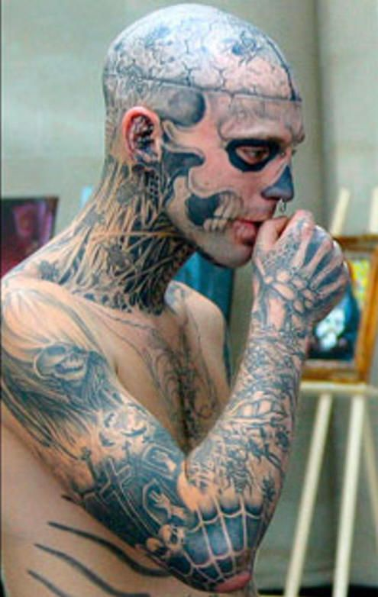
America
Skinny
Piercings
Tattoos

Slide 20
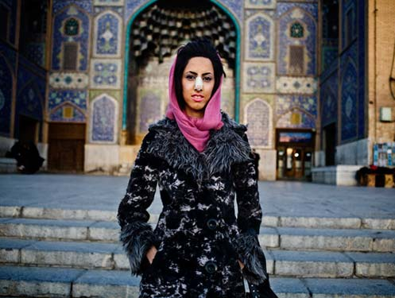
Iran
Rhinoplasty
Iran has the highest rate of nose surgery in the world per capita. According to most estimates, Iranians get four times the amount of nose jobs that Americans do.
Some people believe that the mandatory hijab leaves nothing but the small circle of the face as a canvas for beauty and self-expression, Iranian women have become obsessed with their faces. They want their features to be delicate, symmetrical, and European. Given many young women's willingness to go under the knife and into debt for beauty, nose jobs have become an Iranian rite of passage.
The operation is a marker not just of physical beauty but also of wealth and social priorities.

Slide 21
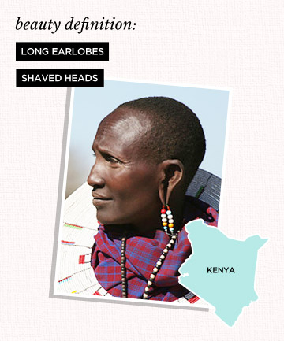
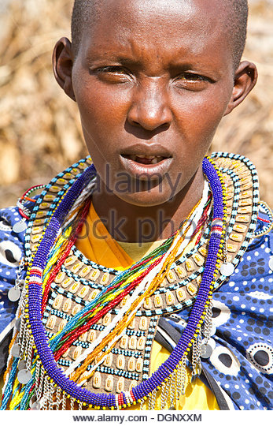
Kenya
Maasai tribe
Most authentic ethnic tribe in Kenya
Long, preserved culture
Traditional way of life
Ear piercing and the stretching of ear lobes with metal hoops are a sign of beauty in men and women
Elephant tusks and twigs are used to pierce the ears
Women shave their heads and remove their two middle teeth on the lower jaw
Medicinal purposes

Slide 22
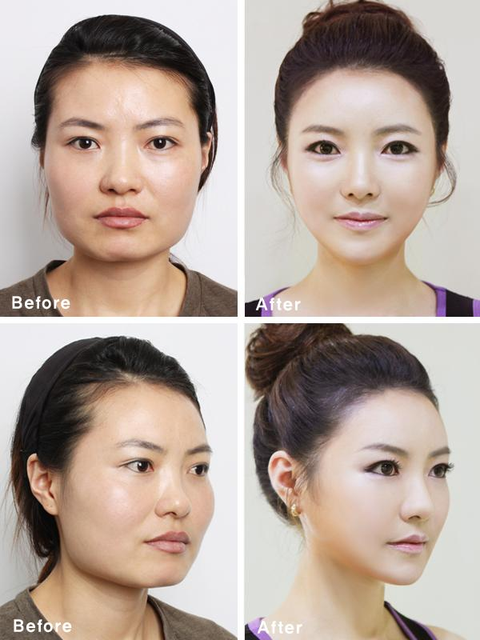
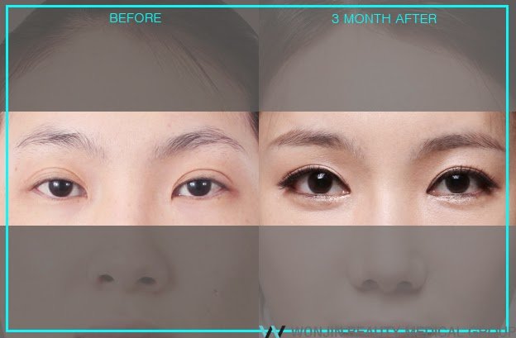
South korea
Wide, round eyes
Many women are going as far as to surgery to achieve this look!

Slide 23
aSSIGNMENT
Which beauty traditions intrigued you?
Which beauty traditions turned you away?
Why do you think that this is?

