Slide 1
Dream On….
Perspectives In Art
Dorchester County Public Schools
North Dorchester High School &
Cambridge-South Dorchester High School

Slide 2
What does the word “dream” mean to you?

Slide 3
Dream Journal:
Over the next 12 days you will be keeping a dream journal
Take notes and pay particular attention to details, descriptions, colors, etc. you remember from your dreams. (The more you can write down, the better!)
Was this a good dream or a nightmare? How did it make you feel?
It would be best to do this as soon as you wake up in the morning so the dreams are fresh in your mind and you can remember them
After Day 12, we will be analyzing specifics of your dreams and researching the symbolism of them

Slide 4
How can a dream be used as inspiration for a piece of art?
Discuss quietly with a peer for five minutes
Class discussion on how dreams can be used for art

Slide 5
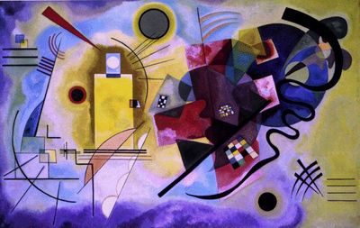
Non-objective Art
Can artwork based on a dream be non-objective art?
Does the work have to portray a sense of reality?
• How could you create an emotional piece of art?
Wassily Kandinsky, “Yellow, Red, Blue”, oil on canvas, 1925

Slide 6
Dreams in Art

Slide 7
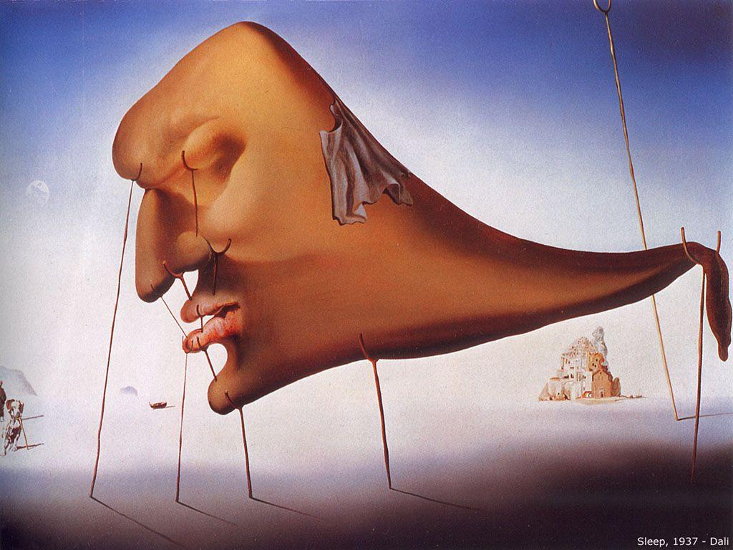
Salvador Dali, “Sleep”, 1937

Slide 8
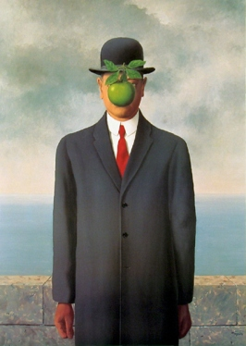
Analyze:
What do you see?
Why do you think the apple is covering the man’s face? Is he hiding something?
Why is he dressed in a suit?
Where is he standing?
Henri Magritte, “The Son of Man”, 1946

Slide 9
“The Son of Man”, 1946
Magritte painted it as a self-portrait. The painting consists of a man in an overcoat and a bowler hat standing in front of a low wall, beyond which is the sea and a cloudy sky. The man's face is largely obscured by a hovering green apple. However, the man's eyes can be seen peeking over the edge of the apple. Another subtle feature is that the man's left arm appears to bend backwards at the elbow.
(http://en.wikipedia.org/wiki/The_Son_of_Man)
Green apple – love, healthy life
Bowler hat –
Cloudy sky –
Suit –
Brick wall –
Hidden face –
Red tie -

Slide 10
Symbolism -
Why do you think artists use symbolism and underlying meaning in their work?
Does this mean that every piece of art has underlying symbolism??
As you view the following slides, what questions come to mind as you make your observations, what speaks your curiosity?
Make a list for each picture viewed

Slide 11
Jacek Yerka, “Dream”, 2011

Slide 12
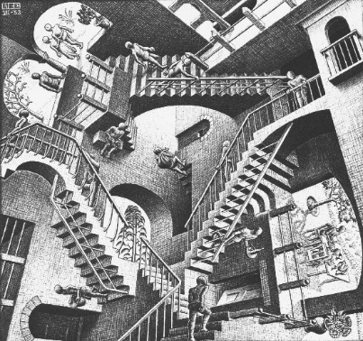
M.C. Escher, “Relativity”, 1953

Slide 13
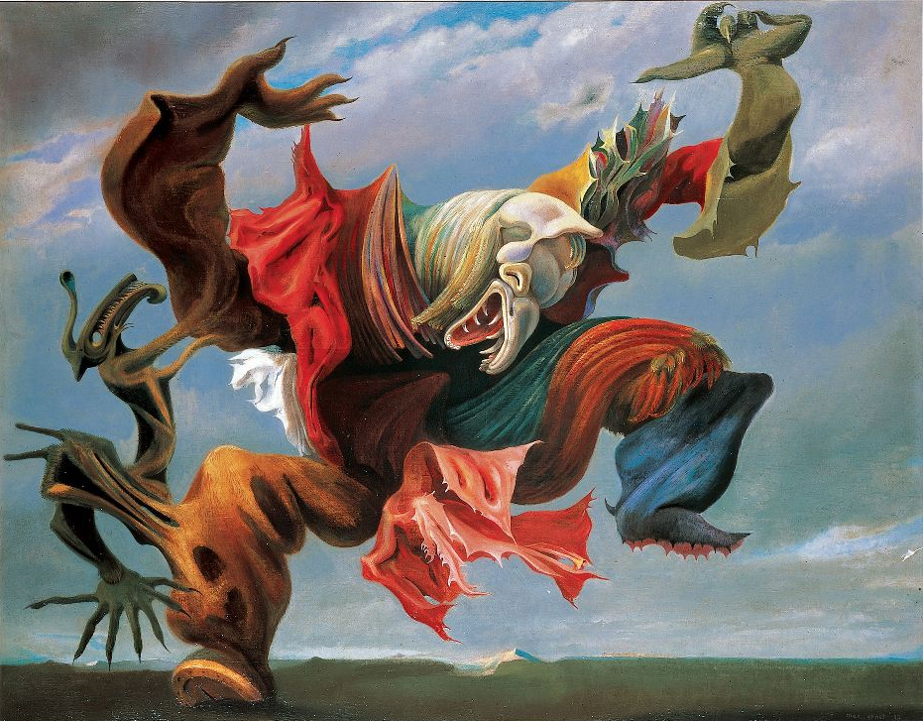
Max Ernst, “L’Ange du Foyer”, 1937, oil on canvas, private collection

Slide 14
Remedios Varo Uranga, “Creation of the Birds”, 1957

Slide 15
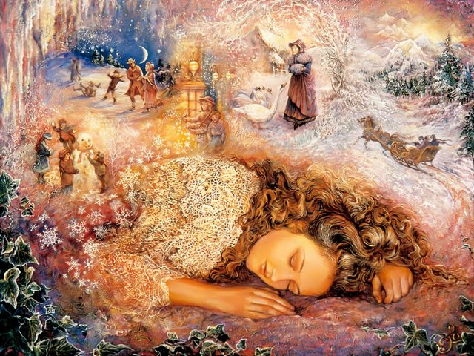
Josephine Wall, “Winter Dreaming”

Slide 16
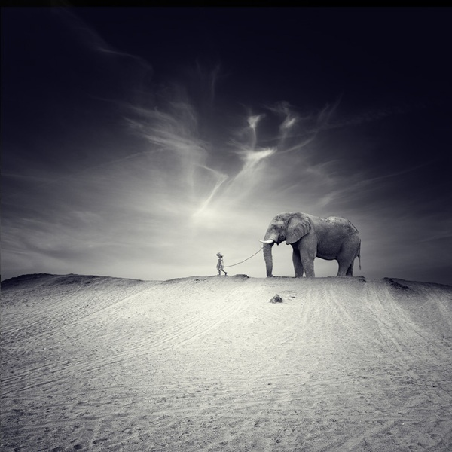
Luis Beltran, "El Gran Viaje" (“The Great Journey”), photograph, 2010

Slide 17
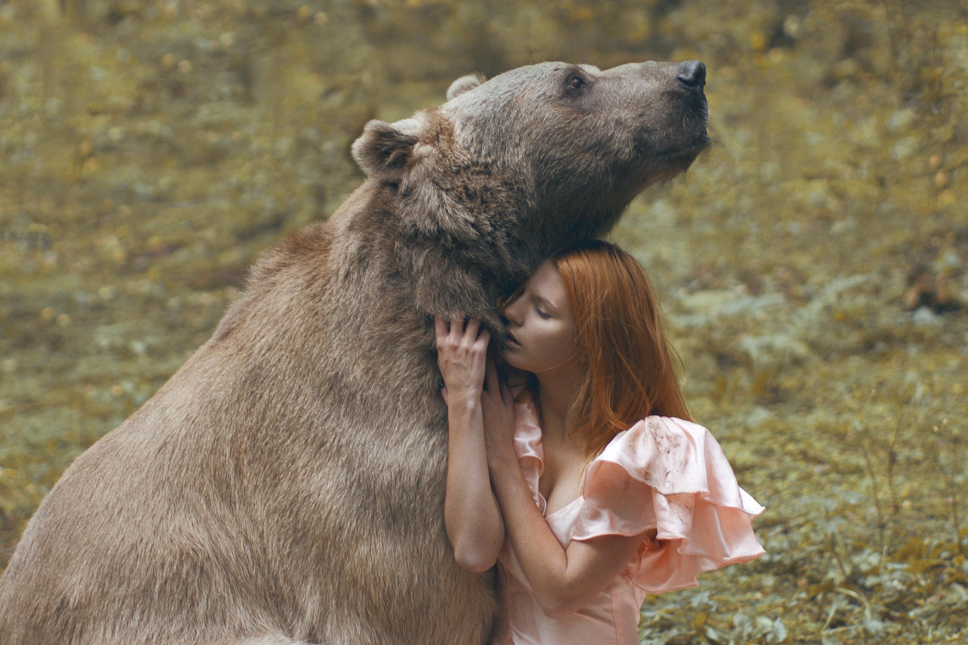
Katerina Plotnikova, “Girl and Bear” photograph

Slide 18
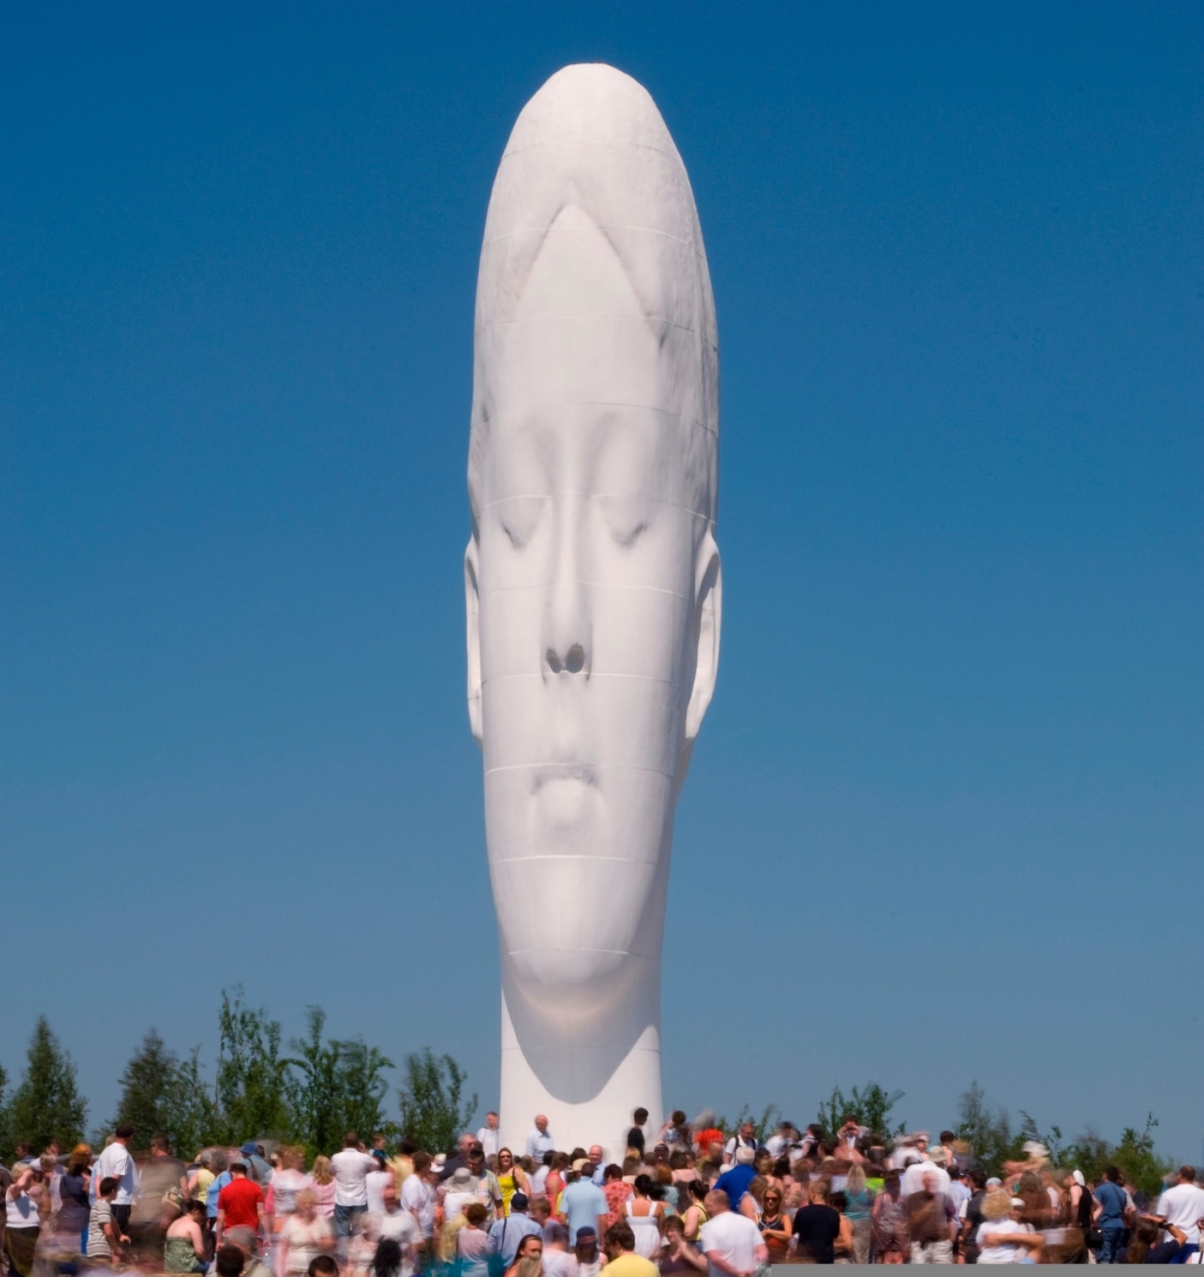
Jaume Plensa, “The Dream Sculpture”, 2009, St. Helens, England

Slide 19
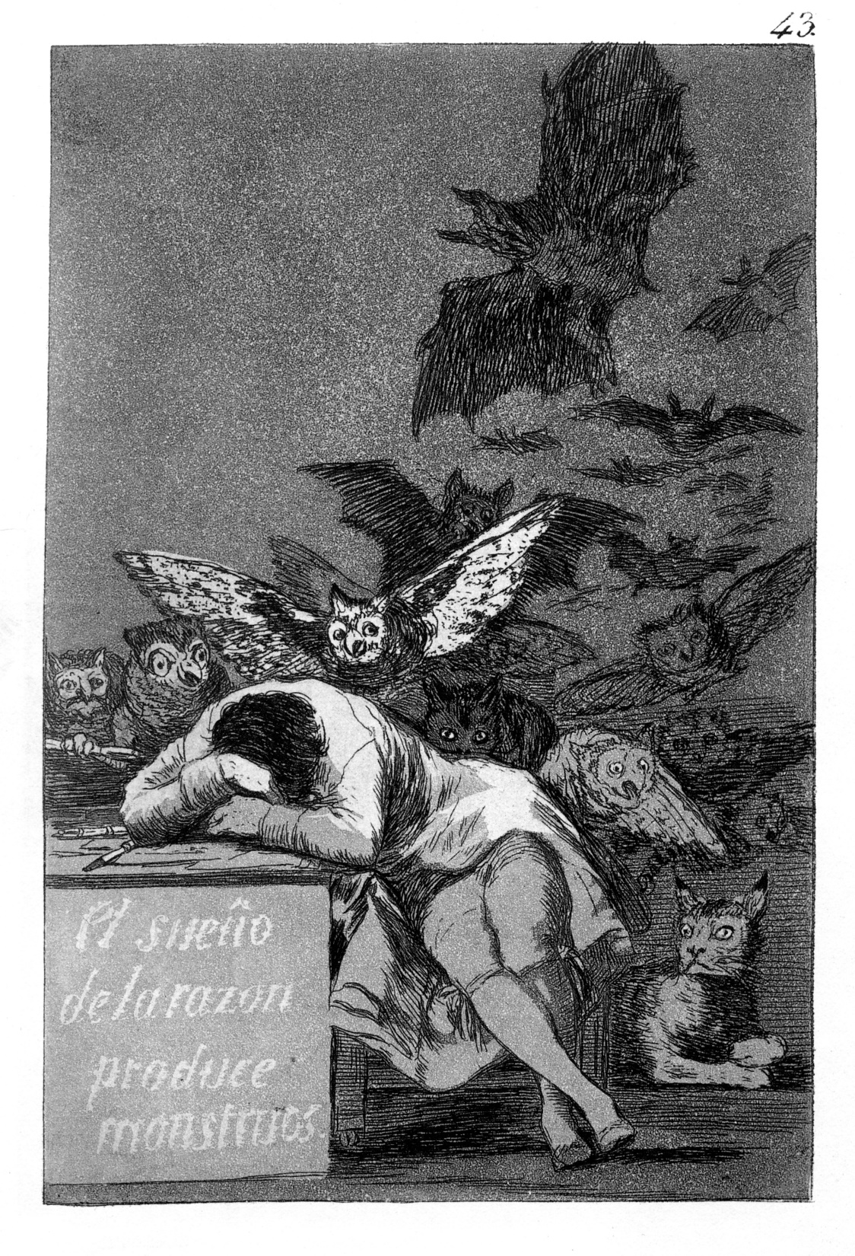
Francisco Goya, “The Sleep of Reason Produces Monsters”, 1799, etching

Slide 20
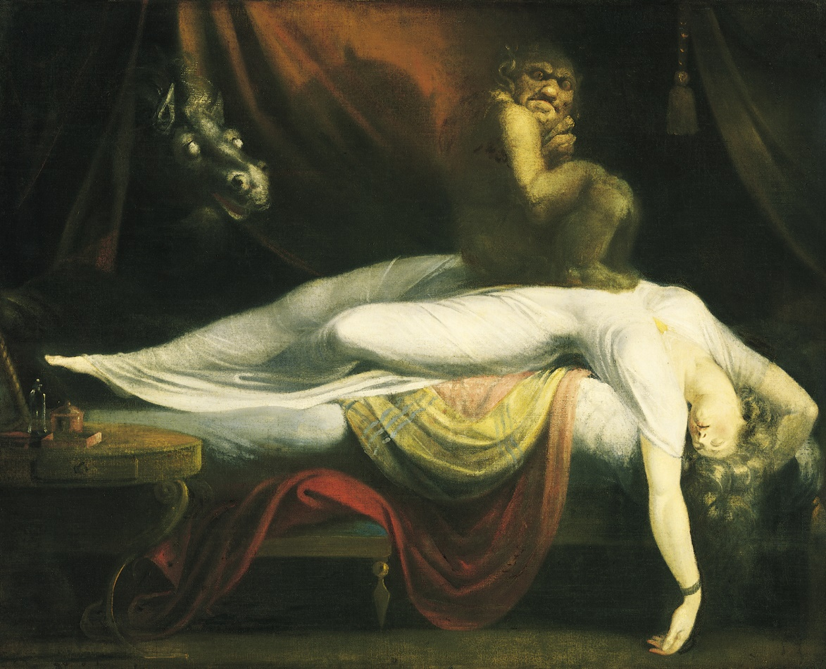
Henry Fuseli, “The Nightmare”, 1781

Slide 21
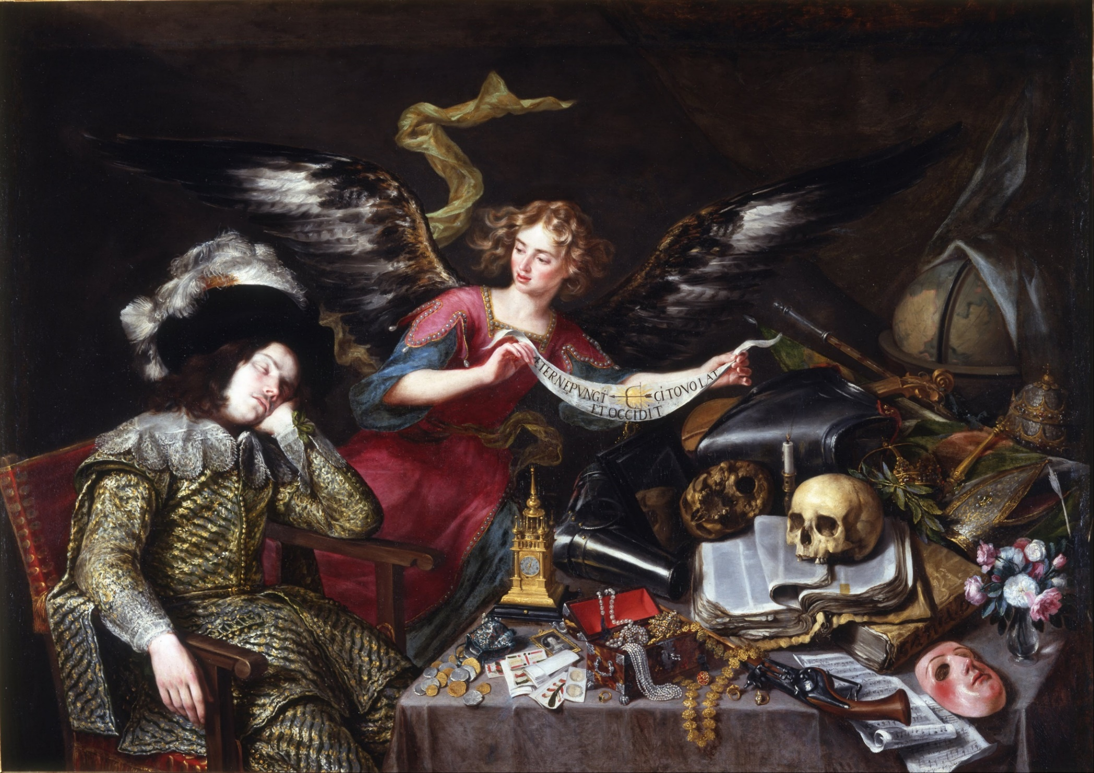
Antonio de Pereda, “The Knight’s Dream”, 1655

Slide 22
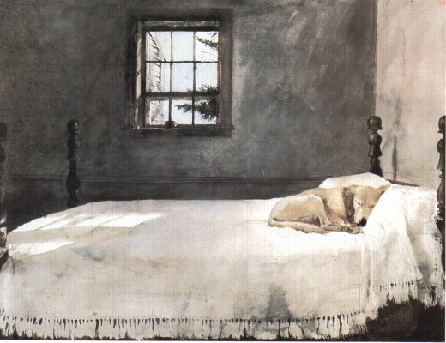
Andrew Wyeth, “Master Bedroom”, 1965

Slide 23
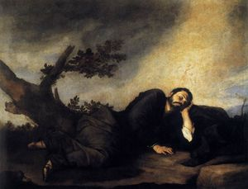
Jusepe de Ribera, “Jacob’s Dream”, oil on canvas, 1639

Slide 24
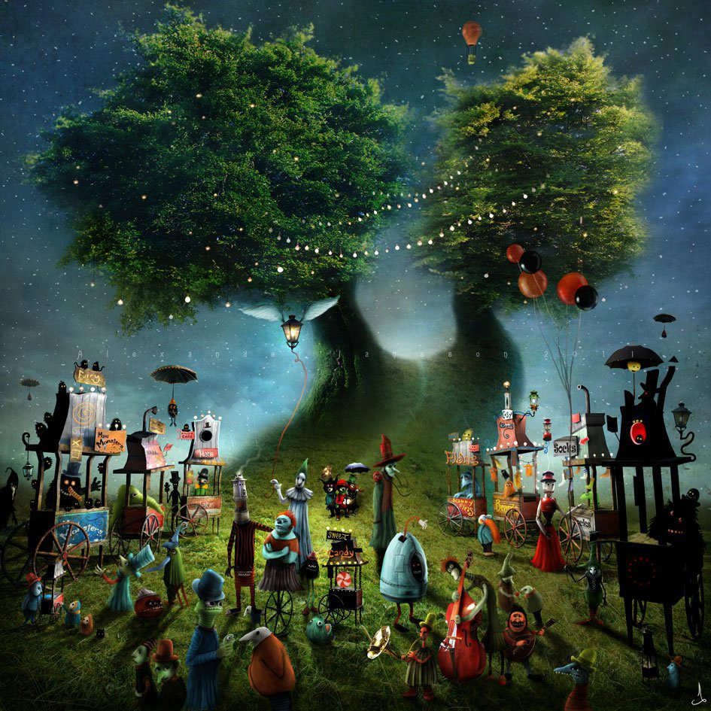
Alexander Jansson, “Whimsical Illustration”

Slide 25
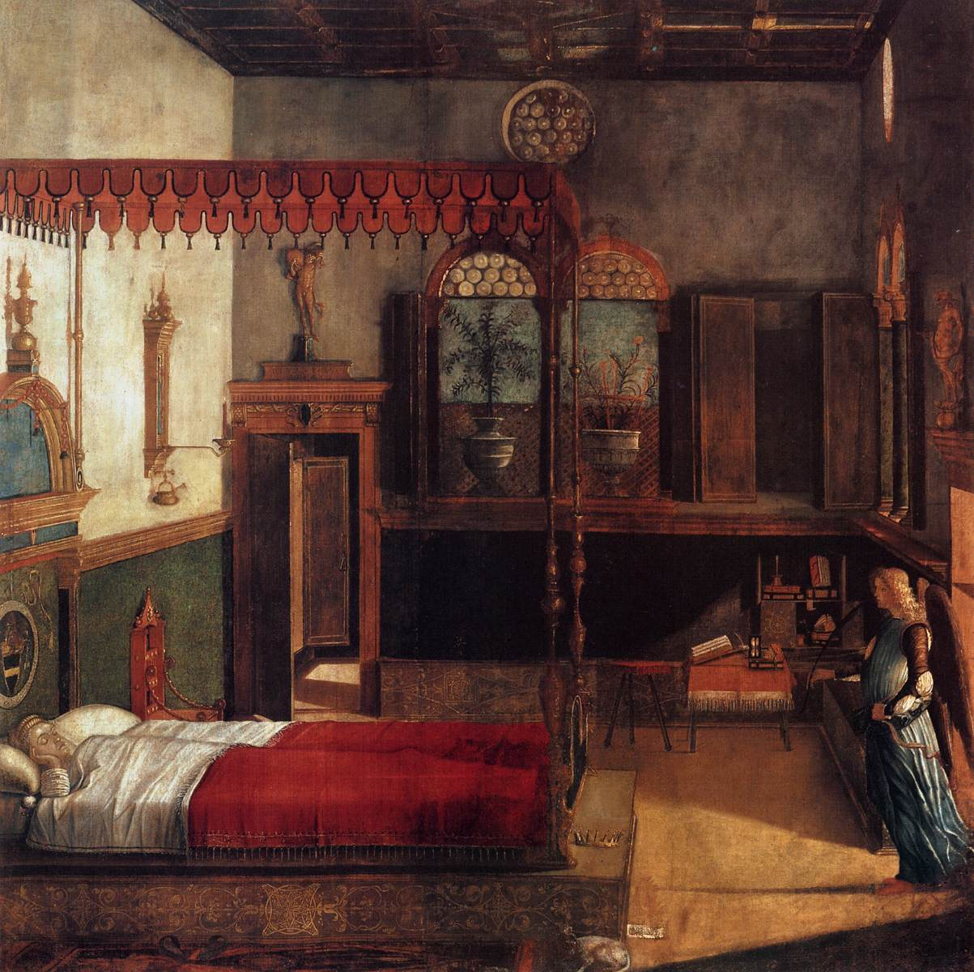
Vittore Carpaccio, “The Dream of Saint Orsola”, tempera on canvas, 1495

Slide 26
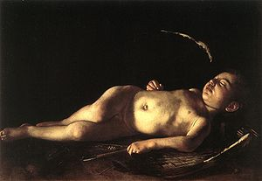
Caravaggio, “Sleeping Cupid”, oil on canvas, 1608

Slide 27
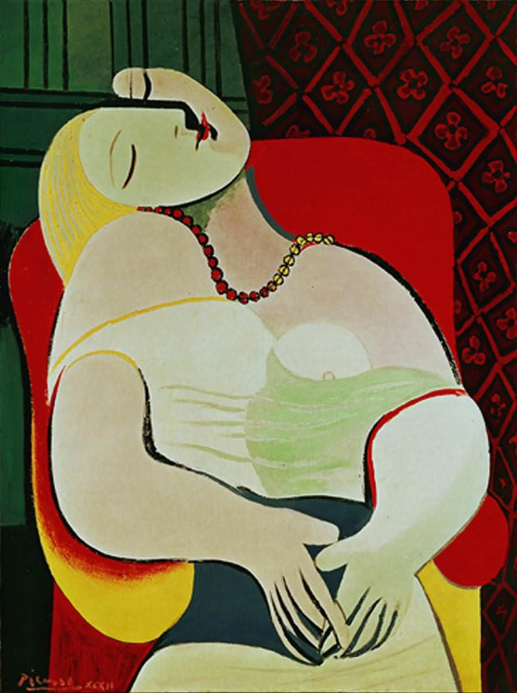
Pablo Picasso, “The Dream”, 1932

Slide 28
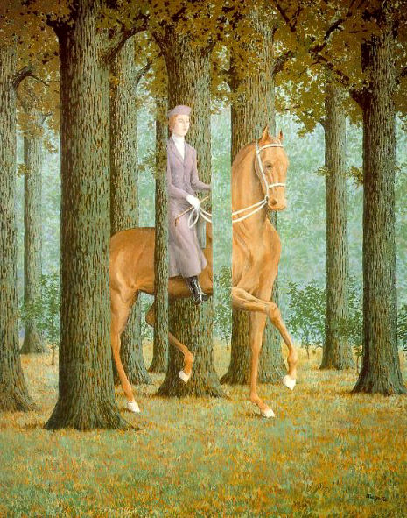
Henri Magritte, “El Cheque en Blanco, (The Blank Check)”, 1965

Slide 29
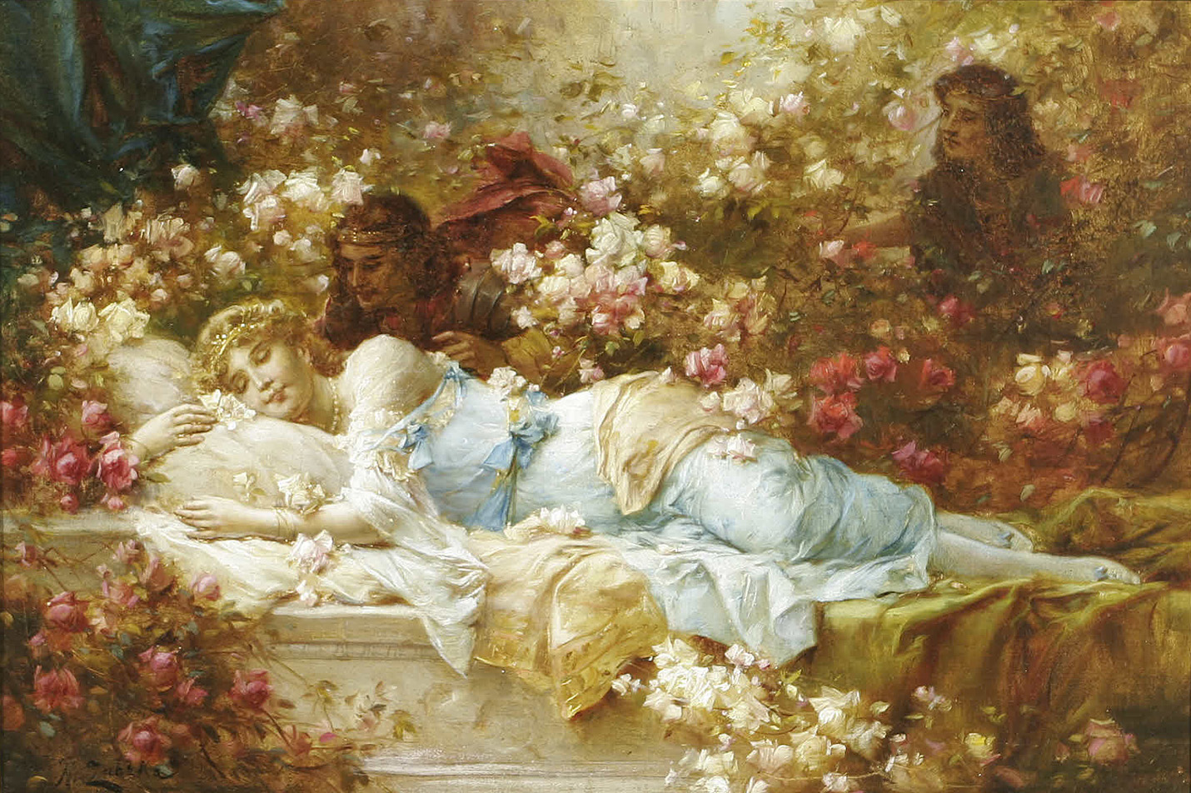
Hans Zatzka, “The Sleeping Beauty”

Slide 30
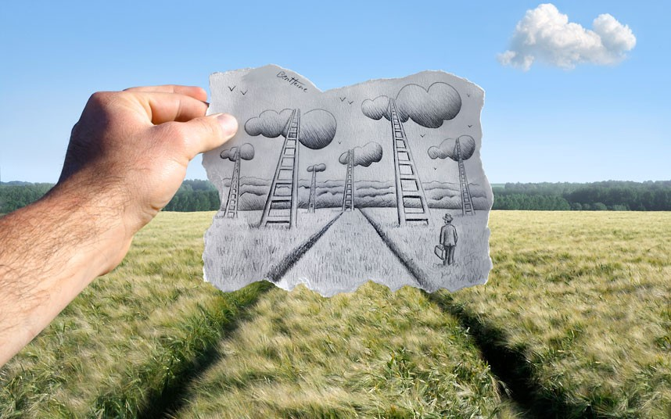
Ben Heine, “Pencil vs. Camera”

Slide 31
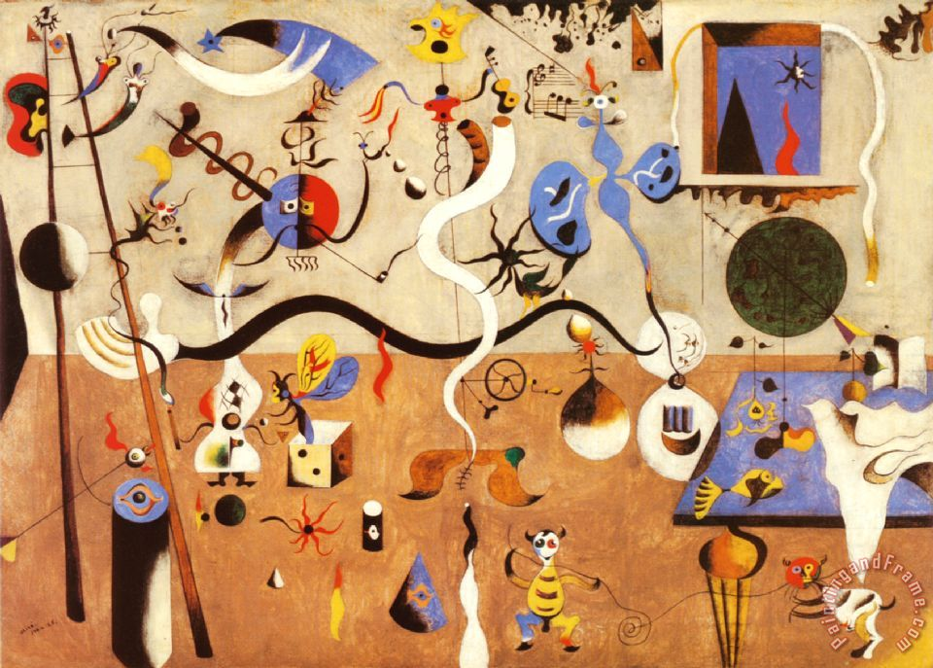
Joan Miró, “Carnival of Harlequin”, oil on canvas, 1924-25

Slide 32
Vladimir Kush, “Sunrise By the Ocean”,

Slide 33
Artwork Inspired by a Personal Dream:
Choose one of the following project options to close our Dream/Other Worlds unit:
Choose one of the dreams depicted in your week-long dream journal
and re-create it using mixed media.
Combining 2-3 dreams you documented in your dream journal, create
a collage using magazine clippings.
Once complete, write an artist statement discussing background information about the specific dream, why you chose it, and how symbolism was incorporated into your art.

