Slide 1
Elements of Art Project
Art I - Senick

Slide 2
Project Overview
Brainstorm & Sketch
Complete worksheet
Create 3 sketches, state the main points, & color your final decision
Explain the idea, materials needed, & the process you plan to do to complete the project
Create a work of art containing all the elements of art using any materials.
Artist Reflection
Describe the content & main idea of your artwork.
Explain the artistic process & materials you used to create your work of art.
Explain usage of the elements of art

Slide 3
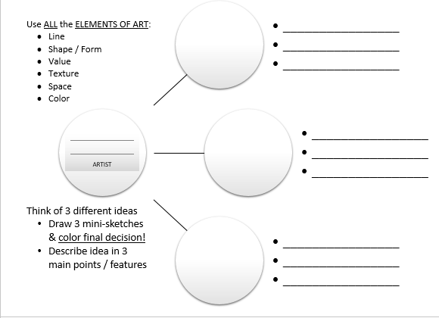
Brainstorm & Sketch
Think of 3 different ideas
Draw 3 mini-sketches & color final decision!
Describe idea in 3 main points / features
Idea & Style
Describe your idea
What is the content?
Describe the style
Materials
You may use any medium / materials for this project, so long as you…
Use it safely
Don’t waste
Clean up after yourself
Process
What steps must you do to complete the project?
Prepping
Creating
Completion

Slide 4
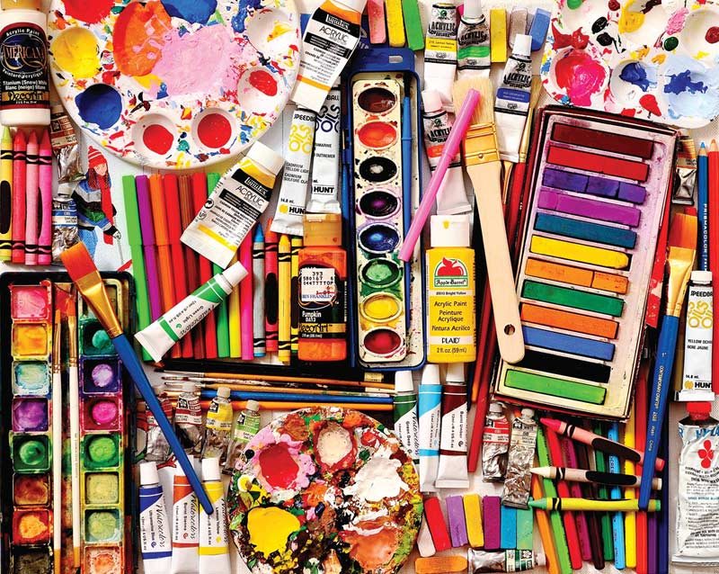
Materials
Gather any materials you may need for this project
You may use any medium / materials for this project, so long as you…
Use it safely
Don’t waste
Clean up after yourself

Slide 5
Create Project
You must use ALL the elements of art
Line
Shape
Form
Space
Texture
Color
Value
You are responsible for setting up & cleaning up after yourself
Take whatever steps you need to in order to complete your project
Put in the effort & make it nice

Slide 6
Artist reflection
Describe the content & main idea of your artwork. (20pts) *paragraph
Explain the artistic process & materials you used to create your work of art. (40pts) *paragraph
Explain your usage of the elements of art in your artwork. (10pts each)
Line
Shape
Form
Value
Texture
Space
Color

