Slide 1
Elements of Art Review
Art I Milito

Slide 2
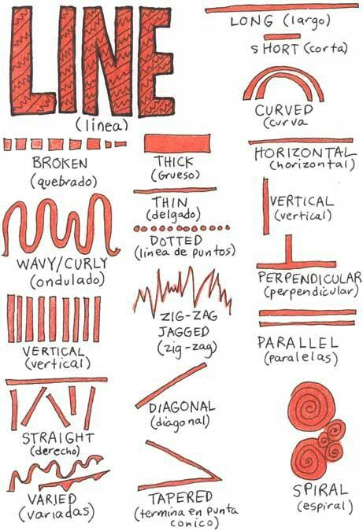
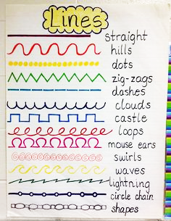
line
A point moving in space
length & direction

Slide 3
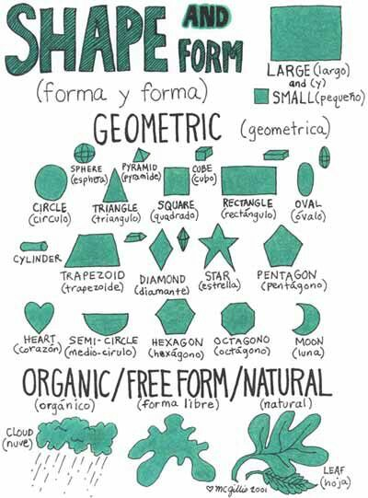
Shape
A 2D contained space
Length & width
Can be geometric or organic

Slide 4
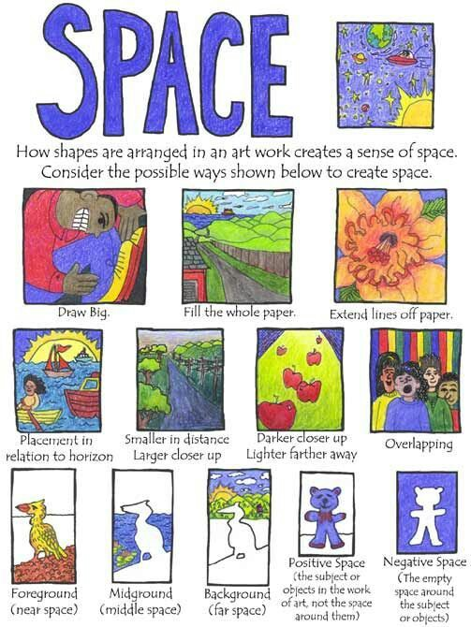
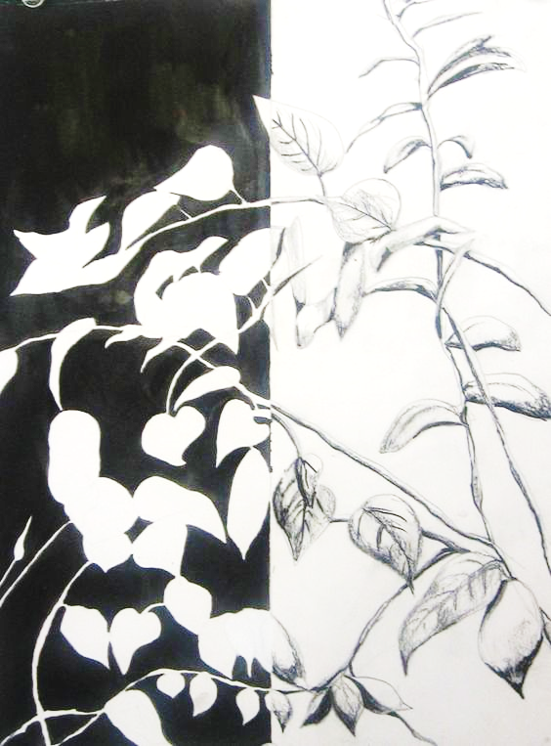
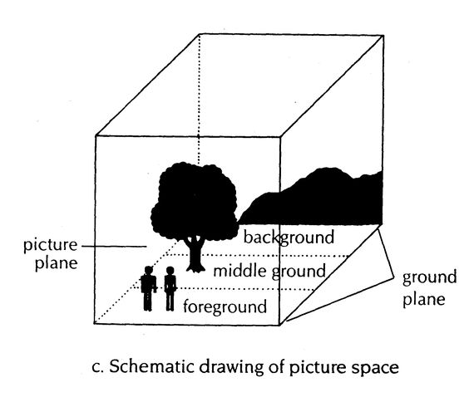
Space
The area around, between, or within objects
Physical space
Positive & negative spaces.

Slide 5
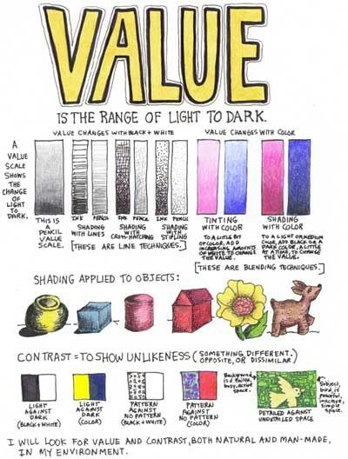
Value
The relative lightness or darkness of an object / area

Slide 6
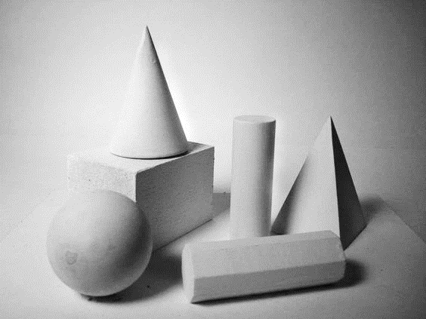
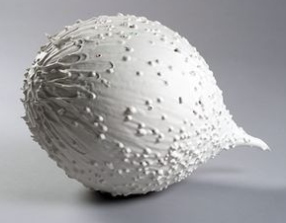
Form
A 3D contained space
Length, width, & depth
Can be geometric or organic
Can be actual or implied

Slide 7
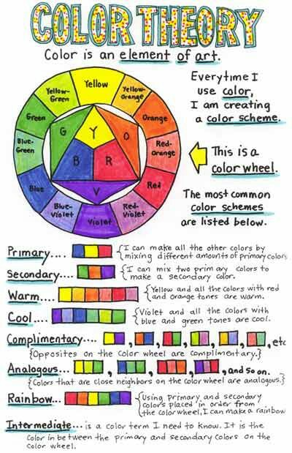
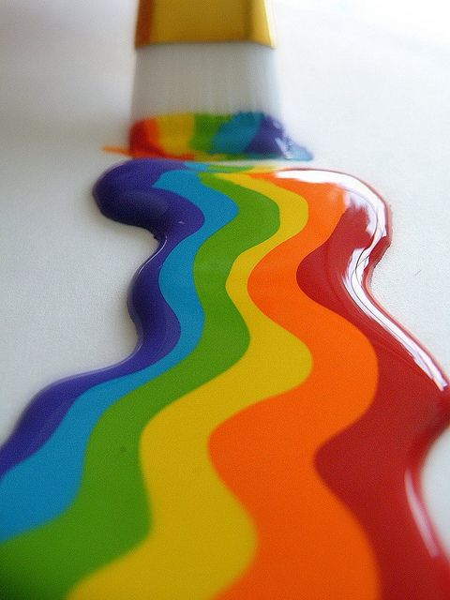
Color
The visible light that is reflected into the eye
Hue, value, & intensity

Slide 8
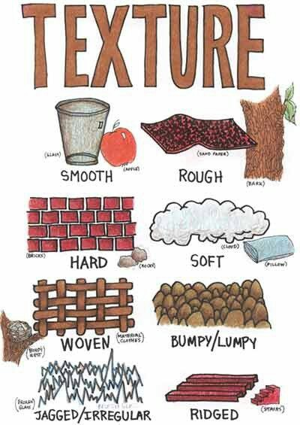
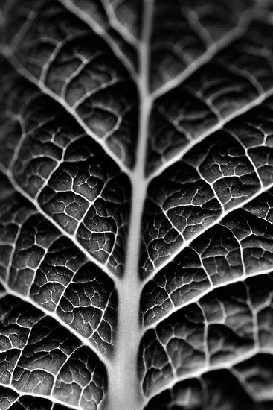
Texture
The way that something feels (actual) or looks like it might feel if it could be touched (implied)
Can be actual or implied

