Slide 1
Portfolio Folder
Art I

Slide 2
What is a Portfolio?
A portfolio is a purposeful collection of student work that exhibits the student's efforts, progress, and achievements in one or more areas of the curriculum.

Slide 3
What will my Portfolio Contain?
Everything!
All of your Final Projects
Any Loose Sketches (Not in your Sketchbook)
This is your Portfolio in this Classroom.
Any work you have in this room must remain inside this folder

Slide 4
What Will be on the Cover?
Name
Class name
Class PD
Elements of Design
Principles of Design

Slide 5
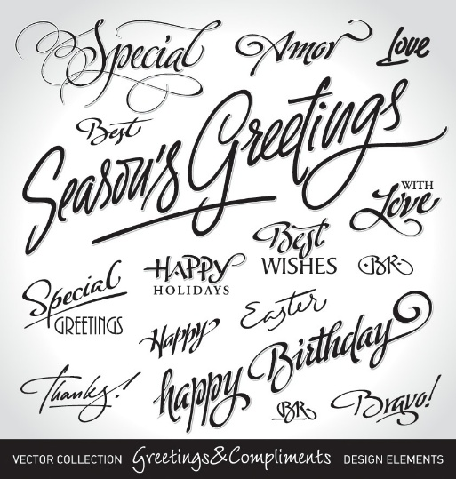
Text
Your Name, Class, and PD
Aesthetically pleasing- meaning that it has a sense of beauty
Legible- Easy to read
Size should be in proportion to the surface so that you do not have to search for it and it is easy to locate.

Slide 6
Representational vs. Non-Representational Art
Nonrepresentational art refers to compositions which do not rely on representation or mimesis to any extent.
Abstract art
Nonfigurative art
Nonobjective art
Nonrepresentational art
Related terms that indicate a departure from reality in the depiction of imagery in art.

Slide 7
Non-Representational Art
Refers to total abstraction, bearing no trace of any reference to anything recognizable. In geometric abstraction, for instance, one is unlikely to find references to naturalistic entities. Figurative art and total abstraction are nearly mutually exclusive, but figurative or representational art often contains at least one element of abstraction.
In the late 19th century, artists began to move toward increasing abstraction as a means of communicating subjective experience more personally and creatively.
Artists such as Kandinsky and Mondrian viewed art as an expression of spirituality.

Slide 8
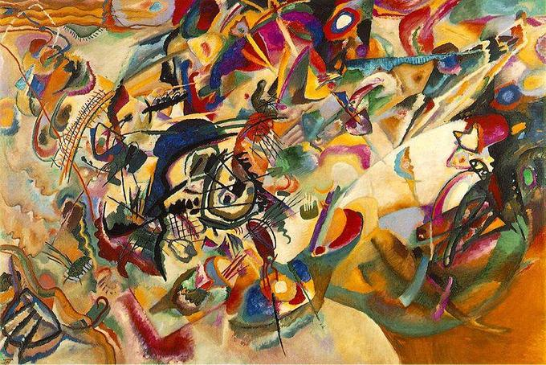
Wassily Kandinsky Composition VII, 1913

Slide 9
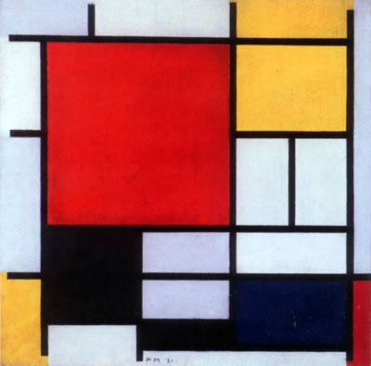
Piet Mondrian Composition with Large Red Plane, Yellow, Black, Gray, and Blue (1921)

Slide 10
Assignment
Look at the handout given to you.
We will be following the directions on our checklist to complete our portfolios.
For example, students may choose to “place three circles on the portfolio” in a line, inside of one another, across the page, etc.
Follow the directions, but the HOW is completely up to you!
4 Sketches to start
Choose one for your portfolio.

Slide 11
The Directions…
Place your name in large letters at the top of the page (the opening)
Place your class/period next to your name
Begin with three circles on the page
Add two straight lines
Place a square on the page
Add two triangles
Draw four wavy lines
Create an organic shape
Overlap a trapezoid with another shape
Draw a zig zag on your page
Draw an oval
Create another organic shape
Draw a line that extends from one side of the portfolio to the other (without going through your name
Draw three geometric shapes of your choosing
Use primary colors to fill all of the geometric shapes
Use secondary colors to fill all of the organic shapes
Use black to outline all of the lines on your page
Use tertiary colors in the background
Add one thing that represents your favorite season of the year

