Slide 1
Handscape

Slide 2
Salvador Dali (1904 – 1989)
Surrealism/Fantasy
Painter, Sculpter, Writer and Filmmaker

Slide 3
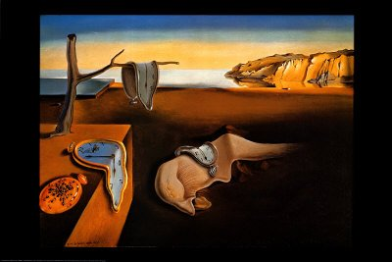
The Persistence of Memory

Slide 4
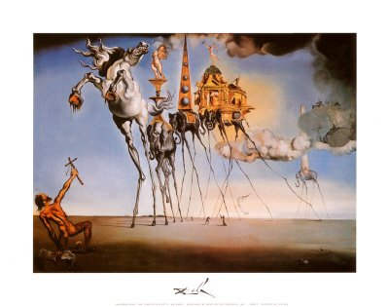
The Temptation of St. Anthony

Slide 5
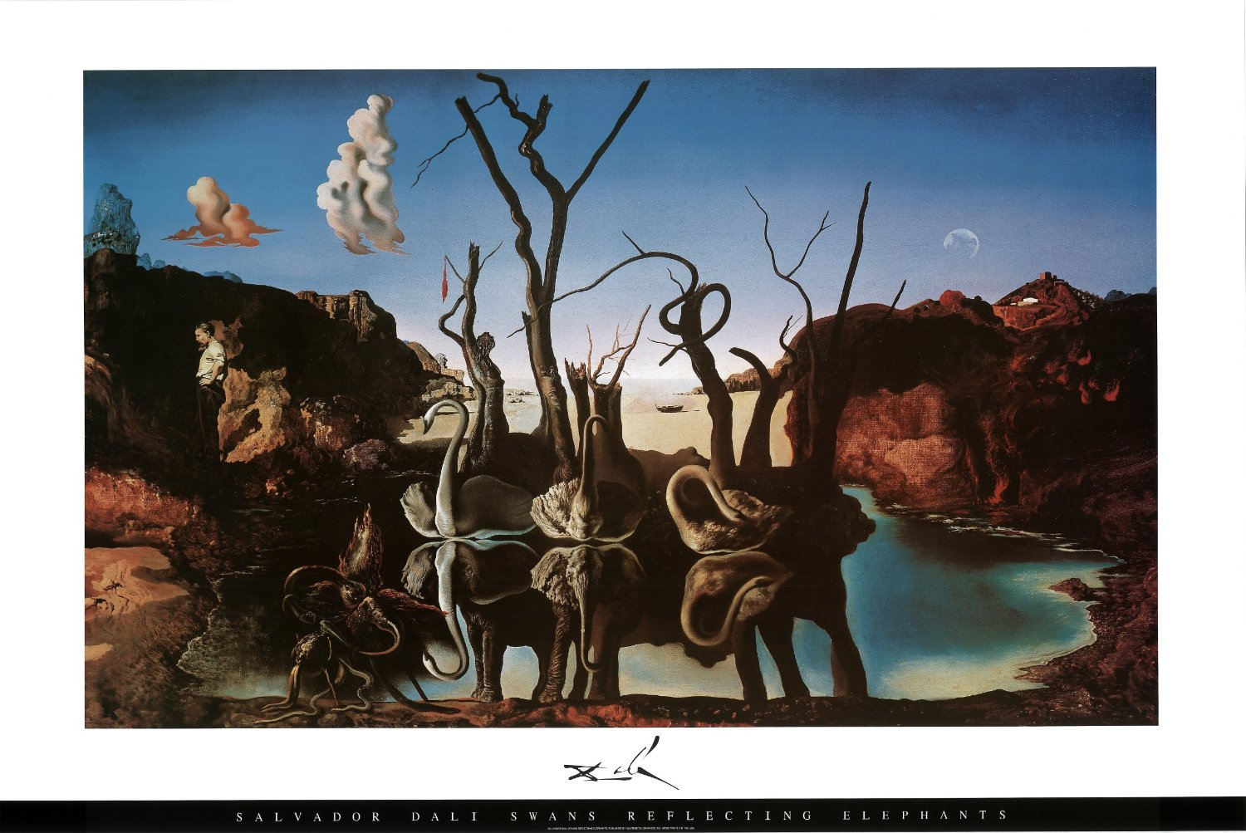
Swans Reflecting Elephants

Slide 6
Rene Magritte (1898 – 1967)
Surrealism/Fantasy
Painter

Slide 7
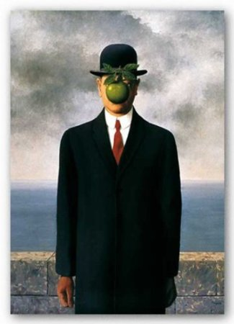
Son of a Man

Slide 8
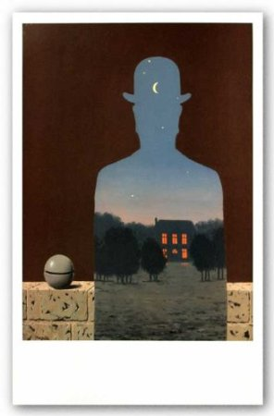
L'heureux Donateur

Slide 9
Student Examples

Slide 10
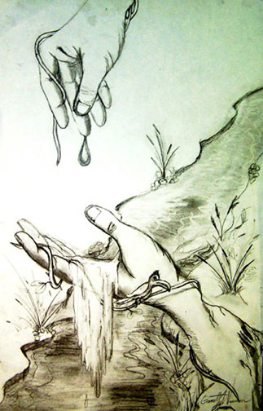

Slide 11
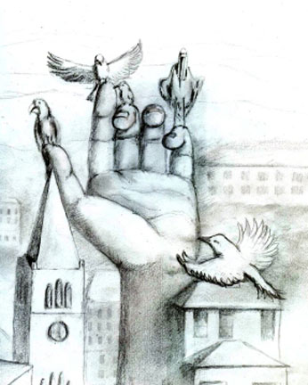

Slide 12
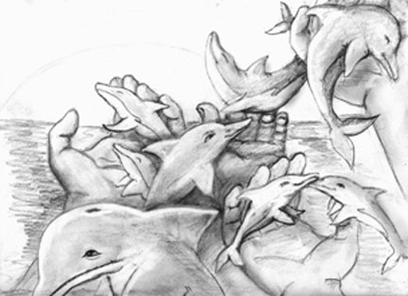

Slide 13
