Slide 1
Metamorphosis
A continued lesson in Movement
Art II - Senick

Slide 2
Think…
Think about a time you thought one thing, but were pleasantly surprised that it was actually something entirely different.
  Was this a place? (A holiday event with family you were sure would go wrong, but everyone got along)
  A person? (Someone you thought was stuck up, but turned out to be one of your best friends)
Share this moment or memory with someone near you.
  You spend 2 minutes sharing, they spend 2 minutes sharing
  Go!

Slide 3
Think…
What are things that change over time?

Slide 4
Think…
What are things that change over time?
  People
  Places
  Seasons
  Weather
  What else did you come up with?
    Clouds… How do clouds change over time?
    Have you ever looked at a cloud and said “Look! I see a cat” and then the wind blows and the cat suddenly turns into an alligator?

Slide 5
Metamorphosis
What does that mean?
  Break down the word
  What part of the word looks familiar to you?
    Morph? > What does it mean to morph?
  A metamorphosis is a transition from one object to another.
    That’s what we’re doing with this project!

Slide 6
List…
In 3 minutes, see how many objects you can list on a sheet of paper.
Do this silently
Person with the most objects listed will get a prize

Slide 7
List…
In 3 minutes, see how many objects you can list on a sheet of paper.
Do this silently
Person with the most objects listed will get a prize
Just kidding.. I only wanted to see how quiet you could be.

Slide 8
Now that you’re fired up!
Let’s review some information quickly:
  Value:
    Name 5 different value shading techniques

Slide 9
Now that you’re fired up!
Let’s review some information quickly:
  Value:
    Name 5 different value shading techniques
      Blending
      Stippling/Pointellism
      Squiggles
      Hatching
      Cross-Hatching

Slide 10
Let’s review:
Hatching is lines in HOW MANY directions?
Cross-Hatching is lines in HOW MANY directions?
Squiggles look like…
Blending is…
Stippling/Pointellism is done with…

Slide 11
For this project
Complete the activity on the review of value shading techniques
  Teacher says/does
  Teacher says/student does
Choose two of your objects that you listed from before
On the next slide, you will see what we are doing with both of these concepts to create your next project.

Slide 12
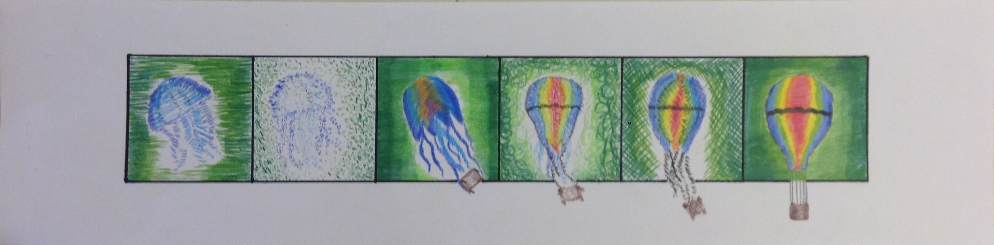
Metamorphosis
With your two objects, you will show a transformation from one object into the other. Remember: Simple is easy, but complex shows growth.
Notice the addition of value shading techniques with colored pencil…

Slide 13
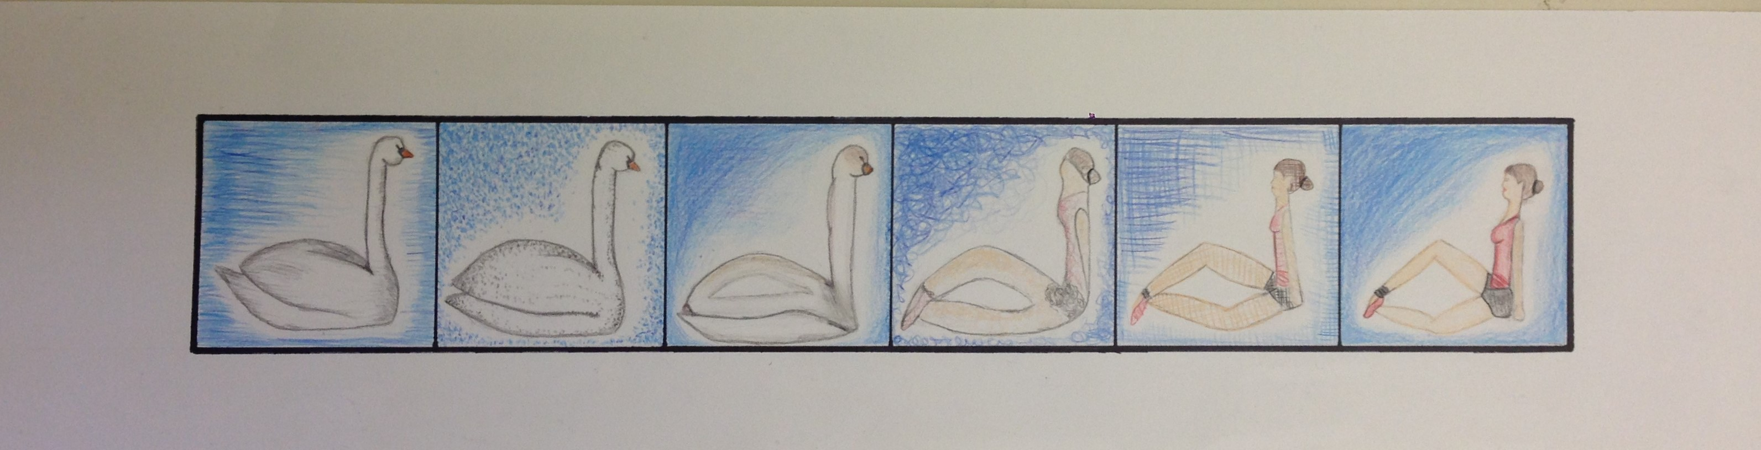
In the first box, the student used hatching. Second box was pointillism. Third box is blended smooth. Box four is done with squiggles. In the fifth box, the student used cross-hatching. The last box was up to the student on what technique they wanted to use.
These specific instructions will be how you sketch and implement your final design into your project.

Slide 14
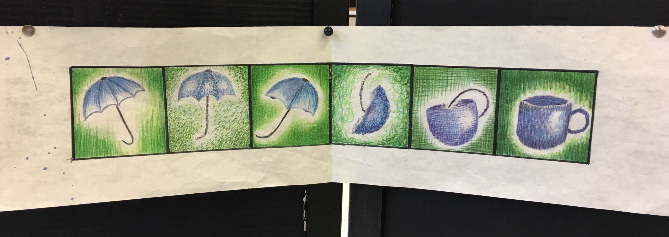
One more example… Mrs. Senick’s:
Notice how the object changes, as does the position of the object to show movement within the artwork!

Slide 15
Your task:
Complete the value shading techniques activity - FORMATIVE
Complete the sketch page activity at the top - FORMATIVE
  Choose two images and show how one image will transition into the other
  There are examples of this in the lesson plan drawer for Mr. Johnson to show you
Complete the bottom of the sketch page activity – FORMATIVE
  You MUST use the correct value shading technique in the correct box
  You MUST plan out your colors accordingly with the bottom half of your sketches.
    Show depth: Instead of just BLUE, use sky blue, blue, navy blue, and blue-green to show details/highlights/shadows of the object AND background

Slide 16
Once the prep work is done:
You will receive a sheet of paper that is 24” x 6”
Demonstrations will be done on how to create a mat on your paper in order to complete the assignment
The mat is there to help your artwork look professional
You must complete this in pencil and have it checked before moving on – SUMMATIVE
Once your grade is in for measuring the final paper:
  Begin drawing your image (same as you did at the top of the sketch page)
  Begin filling in your images using the same exact directions as on your sketch page
    Use colored pencil
  You will NOT outline ANY boxes until you are COMPELTELY finished with the additions of color

Slide 17
How to measure the paper:
Measure and mark every 3” along both of those lines you drew 1 ½” down and up your page. This will create 8 squares!
There will be 1 ½” at the top and bottom.
This leaves 3” In the middle
The first and eighth squares will be left empty because those are your margins. Your first object will start in “box #2” if you haven’t erased the lines yet.

Slide 18
Next
Begin drawing your first object (the umbrella) in the first actual box (not the margin)
In the last actual box (not the margin), draw your second image (the teacup)
In box 2, your first object will look less detailed, maybe the shape changes a bit
In box 5, your second object will look less detailed, maybe the shape changes a bit
In box 3, your object will look completely morphed from the original object and nothing like the second object, but should have some details that show the object’s transition.
In box 4, it will be the same, but with more details that show characteristics of object 2 instead of object 1
See my example for reference. I will make it very large on the next slide.

Slide 19
Box 1: Full umbrella with details.
Box 2: Umbrella-like, less details
Box 3: Umbrella characteristics, not a lot of detail
Box 4: Still has characteristics of umbrella, but more of a cup
Box 5: Cup-like, missing some details
Box 6: Full cup with details.
Check out the depth of color with different greens & yellow

Slide 20
As you work:
You will have daily grades.
So far – Grades are Formative unless stated otherwise
  Value shading review sheet
  Sketching page (top)
  Sketching page (bottom – in color, following directions)
  Measuring final paper – SUMMATIVE
  Drawing your metamorphosis in your final paper
For the rest of the project: Stay on pace with the class/grades – All Formatives
  Day 1: complete box 1 and begin box 2
  Day 2: complete box 3 and continue box 2
  Day 3: complete box 4 and finish box 2 – 2 boxes, 2 grades
  Day 4: complete box 5 and 6
  Day 5: outline your boxes in sharpie and with marker – Pick UP your ruler, do not slide it!

Slide 21
Outlining in black:
You will use your ruler and a black sharpie marker (not the pen one)
Lay your ruler down and follow along the line
WAIT 5 SECONDS
PICK UP YOUR RULER
  Do NOT slide your ruler!
  Your lines will smear
  Your mat will be ruined
  You do not get white out for this if you don’t follow directions!
Continue the process for the entire outside of the box and between each box
Take. Your. Time.
When finished, name on the back and complete your self reflection rubric & Artist statement. Place both on the countertop.

