Slide 1
Myths
Ms. Kolendowicz
Perspectives in Art

Slide 2
Why would artists want to capture a myth as a subject of their art?
What is a myth?

Slide 3
Myths
Myths are stories that explain why the world is the way it is. All cultures have them. Throughout history, artists have been inspired by myths and legends and have given them visual form. Sometimes these works of art are the only surviving record of what particular cultures believed and valued. But even where written records or oral traditions exist, art adds to our understanding of myths and legends.
http://archive.artsmia.org/world-myths/

Slide 4
How have Myths played a part in art?
Many myths are such compelling stories that artists have turned to them again and again, reinterpreting them from the vantage point of their own experience and imagination.
a work of art can trigger a story
Regardless of why or how art was created, each image contributes an added dimension to our understanding or interpretation of that myth
Many images represent myths that explain a practice, belief, institution, or natural phenomenon
Hero myths, tales of adventure filled with fantastic beings and superhuman feats
http://archive.artsmia.org/world-myths/MythCurriculum.pdf

Slide 5
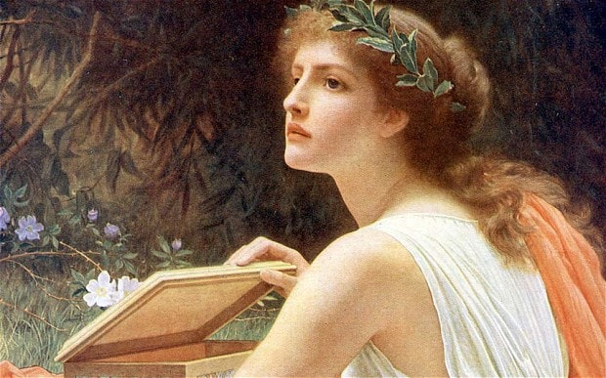
The myth of Pandora’s Box
Read “The Myth of Pandora’s Box” silently to yourself
When you are finished, on the back
of your handout –
Write down two questions you have
about the myth
- List the main characters of the myth

Slide 6
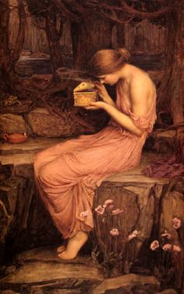
Pandora’s Box
Does this image look familiar?
What were the major events that took place in this myth?
Have these events been captured in this image?
John William Waterhouse, 1903

Slide 7
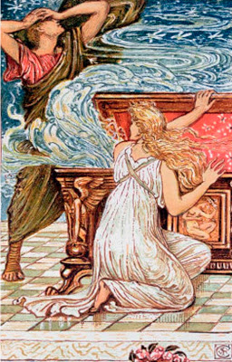
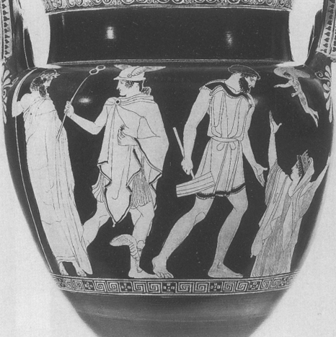
Gariot Paul Cesaire
Odilon Redon

Slide 8
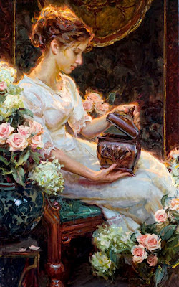
John William Waterhouse
Daniel F. Gerhartz

Slide 9
Religions & Myths
Though there are similarities among most religious mythologies, there are also contrasts. Many mythologies focus on explanations of the universe, natural phenomena, or other themes of human existence, often ascribing to one or more deities or other supernatural forces. However, some religions have very few of this kind of story of cosmic explanation.
The relationship between religion and myth depends on what definition of "myth" one uses.
Robert Graves's definition, a religion's traditional stories are "myths" if and only if one does not belong to the religion in question.
Segal's definition, all religious stories are myths—but simply because nearly all stories are myths.
The folklorists' definition, all myths are religious (or "sacred") stories, but not all religious stories are myths: religious stories that involve the creation of the world (e.g., the stories in Genesis) are myths; however, religious stories that don't explain how things came to be in their present form (e.g., hagiographies of famous saints) are not myths.
https://en.wikipedia.org/wiki/Religion_and_mythology

Slide 10
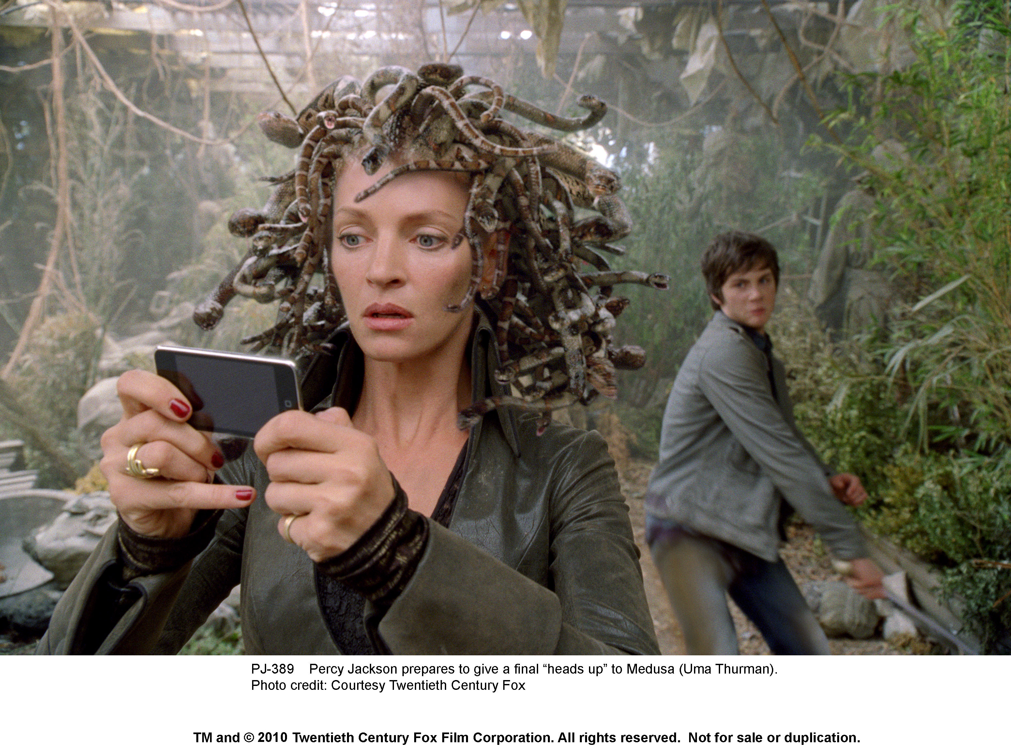
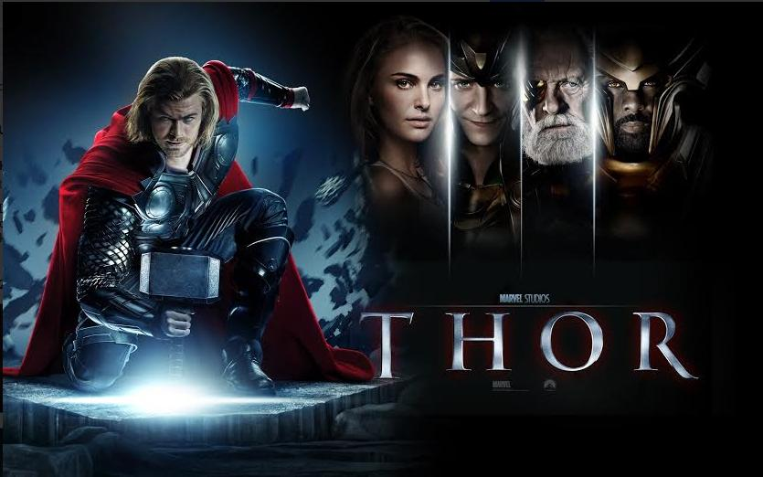
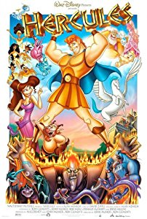
Mythology in the 21st Century

