Slide 1
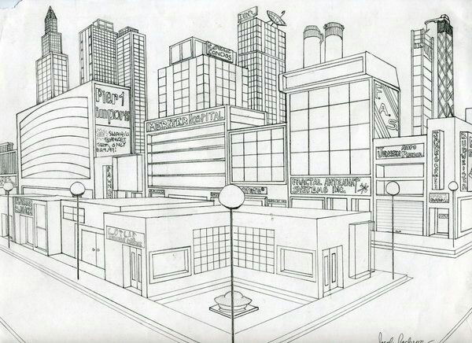
Rhythm of the City 2 Point Perspective Cityscape
Art II - Senick

Slide 2
Objectives:
SWBAT / I CAN…
X

Slide 3
Cityscape
A kind of landscape that features man made structures & the urban environment
Features sky, buildings, & streets

Slide 4
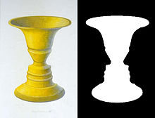
Space
An element of art referring to the area in, around, or within, objects
Can refer to physical space or positive & negative space

Slide 5
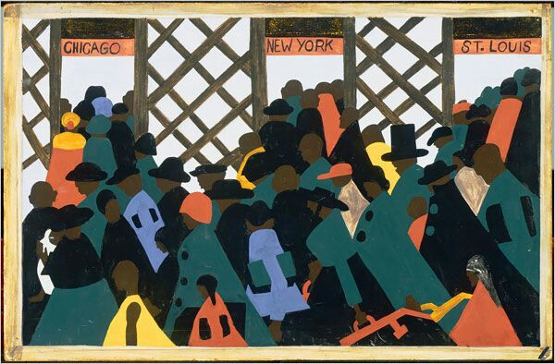
Rhythm
A principle of art that refers to the careful placement of repeated elements to create a visual tempo or beat within a work of art

Slide 6
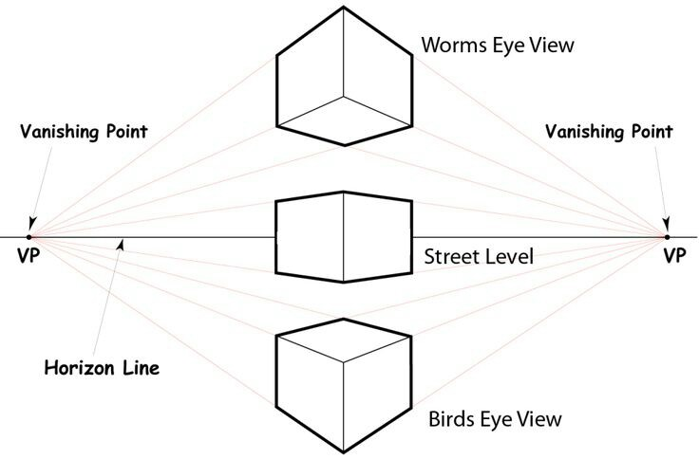
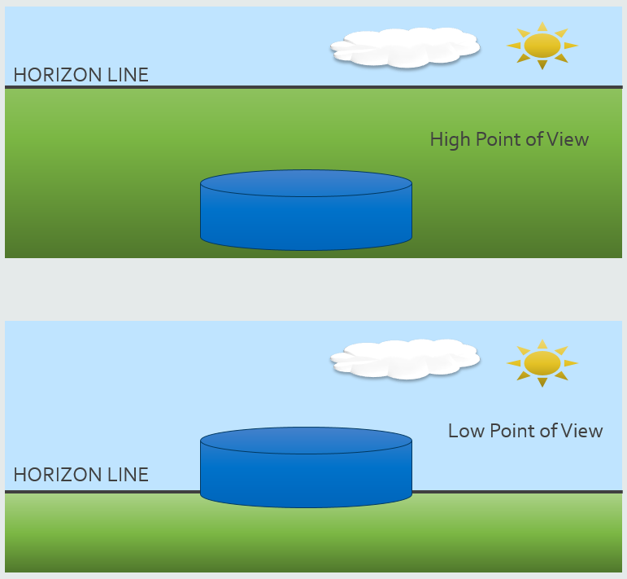
Perspective
Point of view; the view from which the viewer sees, shows a sense of depth
High (Birds Eye View)
Looks down from above
Ground shows
High horizon line
Low (Worms Eye View)
Looks up from below
Sky shows
Low horizon line

Slide 7
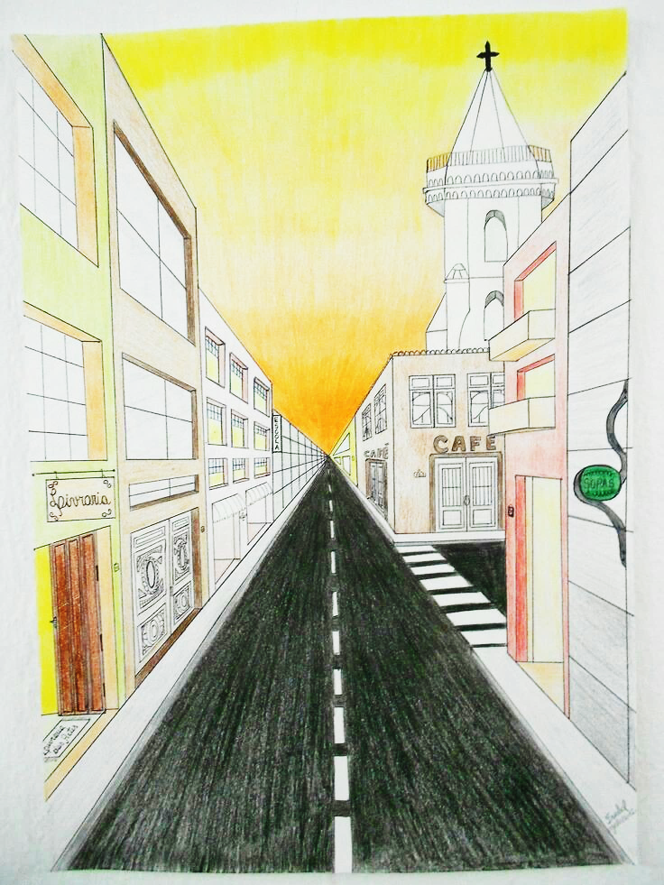
One Point Perspective
A 3D drawing method where all of the orthogonal lines recede into a single vanishing point along the horizon line

Slide 8
Creating One Point Perspective
Horizon Line
The line where the sky appears to touch the ground
Background of the picture plane
Imaginary line
Vanishing Point
The point on the horizon line where all lines converge together and appear to vanish
They do not actually vanish, this is an illusion artists create to trick the eye into believing there is a 3D space on a 2D surface.

Slide 9
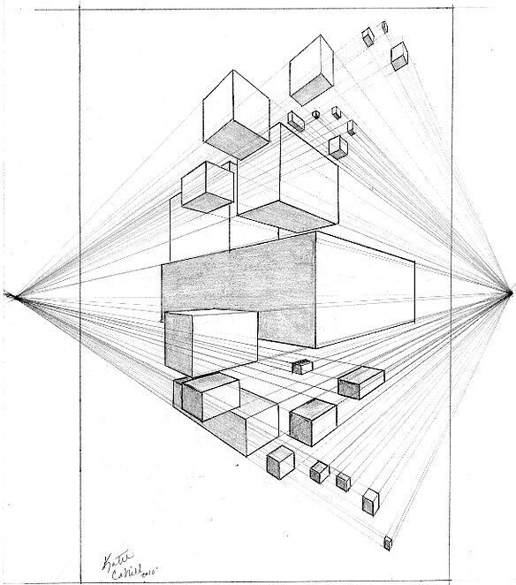
Orthogonal Lines
The diagonal lines that recede into the vanishing point
Orthogonal Lines

Slide 10
Verticals and Horizontals
Front side:
All vertical lines will remain vertical
How can you ensure you are creating a vertical line? Line up the edge of your ruler with the edge of your page
All horizontal lines will remain horizontal
Ensure you are creating a horizontal line by measuring and marking down the page the same amount, then connecting the lines
Perspective Side
All vertical lines will remain vertical
Use the same method to ensure your vertical lines are straight
If your lines are not vertical, your building will appear tilted
All horizontal lines will become orthogonal lines and will appear to tilt back to the vanishing point.
All horizontal lines MUST go to the vanishing point!

Slide 11
1 Point Perspective Project
Clock Tower
You will be creating a clock tower to demonstrate your knowledge of one point perspective
We will work on the perspective side together, so don’t rush
Sketch 2 ideas for your clock tower in your sketchbooks.
Due at the end of class
Requirements:
Your clock tower MUST contain AT LEAST the following items:
Door/Doorframe
Windows/Window frames
Clock (Digital or analog)
A roof or dome
Details
Make it interesting; add bricks or stairs

Slide 12
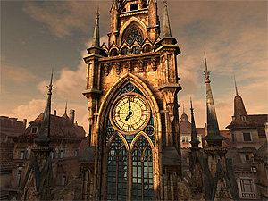
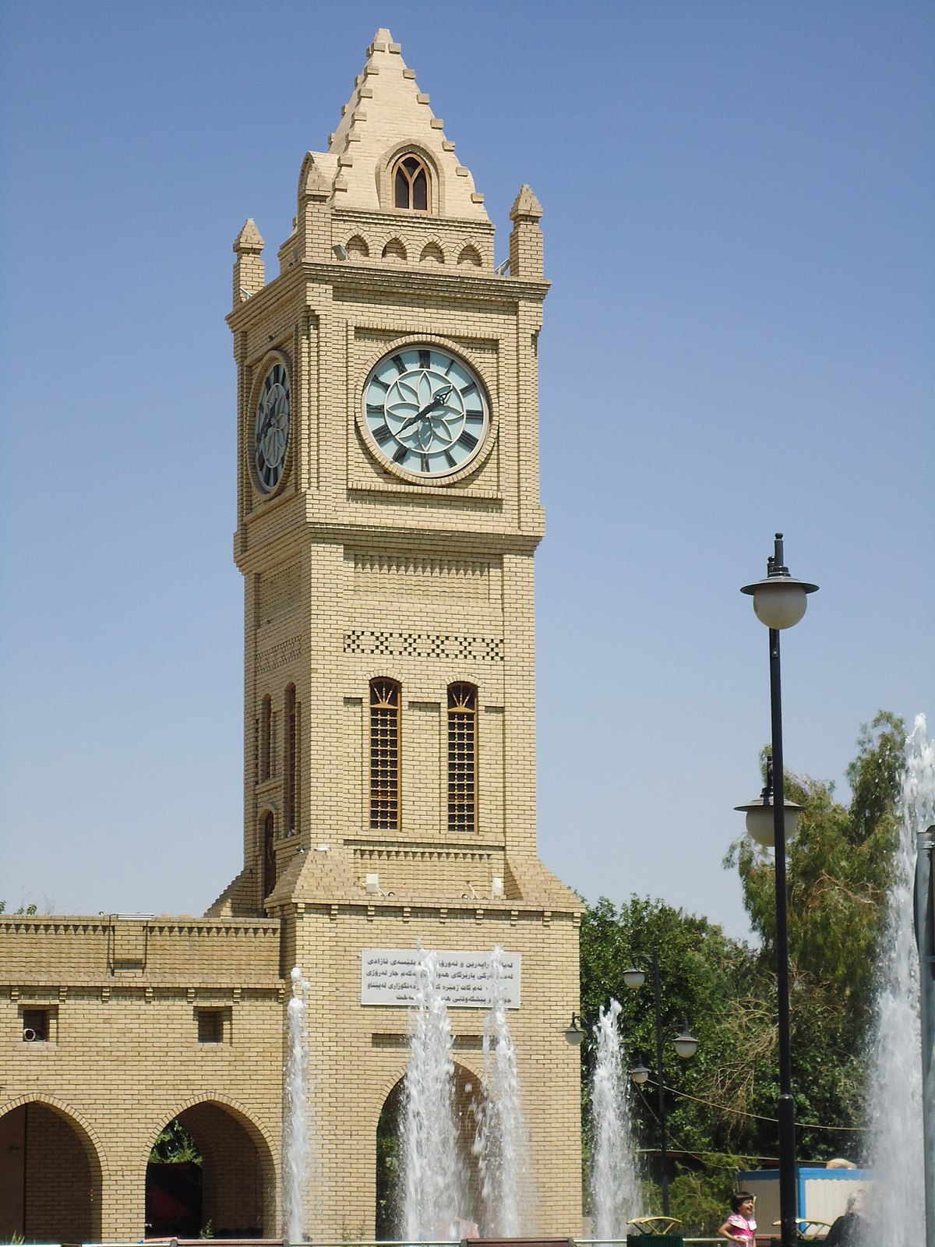
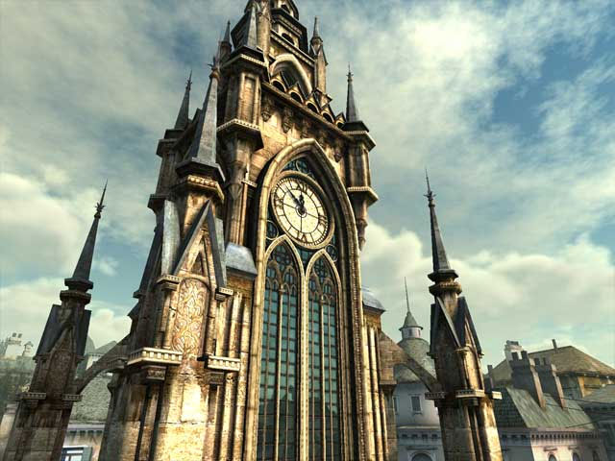
Examples

Slide 13
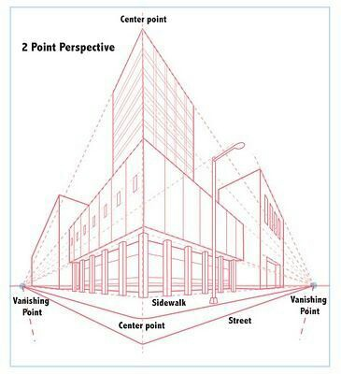
Two Point Perspective
A 3D drawing method where all of the orthogonal lines recede into one of two vanishing points along the horizon line

Slide 14
1pt
2pt
________________________________________________________________________________________________________________________________________________________________________________________________________________________________________________________________________________________________________________________________________________________________________________________________________________________________________________

Slide 15
Creative Process
Plan & Practice
Create
Present & Reflect
Practice 2 pt. perspective cubes
Draw 2 a cityscape in 2 pt. perspective
Add details, value, & color
Add at least 5 buildings with windows & doors
Artist’s statement
City gallery walk (art critique of cityscapes)

Slide 16
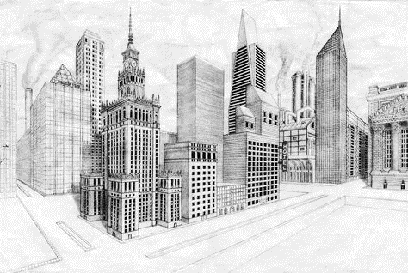
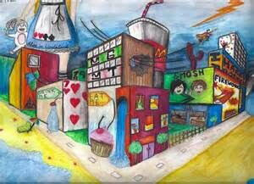
2 Point Perspective Cityscape

Slide 17
Point of View
Before you begin figure out the placement of your horizon line
Move your horizon line down on the plane to show more sky & create a lower point of view (looking up)
Move your horizon line up on the plane to show more ground & create a higher point of view (looking down)

Slide 18
Drawing in 2 Point Perspective
Begin by drawing a horizon line all the way across your paper
Draw 2 vanishing points near the edges of the paper on the horizon line
Horizon Line
Vanishing Point
VP 1
VP 2

Slide 19
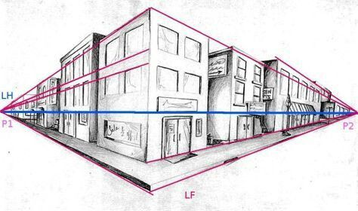
Center Line
Draw your center line
(where your corner will be)
All of your horizontal / orthogonal lines on the left of this point will recede to the left vanishing point & vice versa for the right
Doesn’t necessarily need to be in the center of your drawing, but will be a focal point & a point of reference
Determine where / how large your street & sidewalk will be & where your buildings will begin

Slide 20
Building Size
Begin determining how tall & wide each of your buildings as well as the overall shape
Work from the center to the vanishing points
Remember all of your vertical lines remain vertical, your horizontal / orthogonal lines now all recede a vanishing point

Slide 21
Windows & Doors
Create windows & doors on all of your buildings
Remember that orthogonal lines recede to the vanishing point

Slide 22
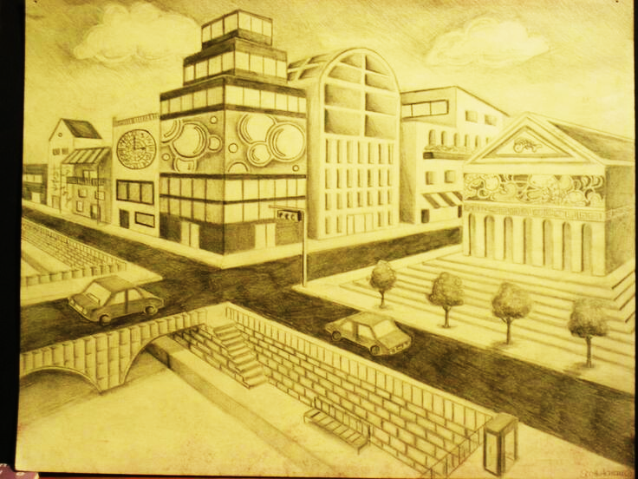
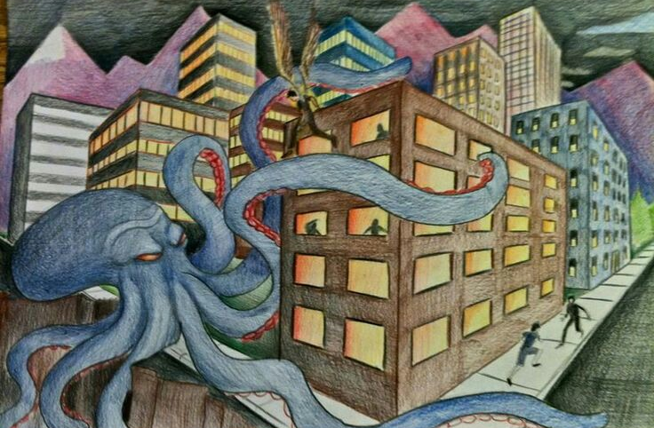
Details
Add any additional details to your cityscape
Trees / Bushes
Lamp Poles / Benches
Cars / People
Etc.

Slide 23
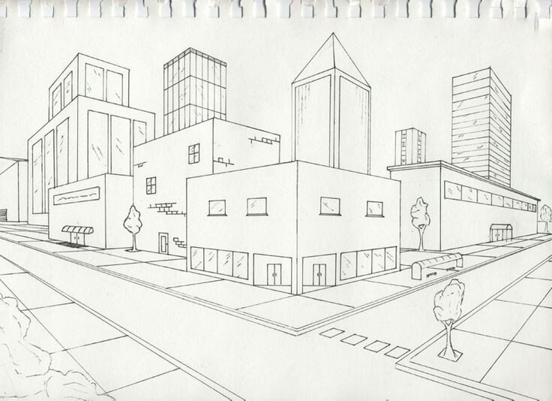
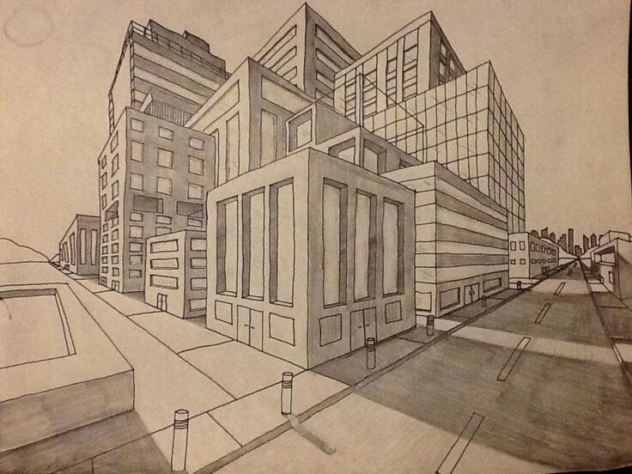
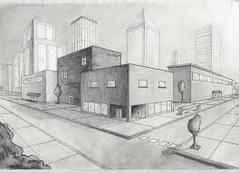
Value & Color
Add value & color to the entire cityscape
Show light/dark areas & shadows
Add color to all areas

