Slide 1
Pop art
Art II – Mrs. Senick

Slide 2
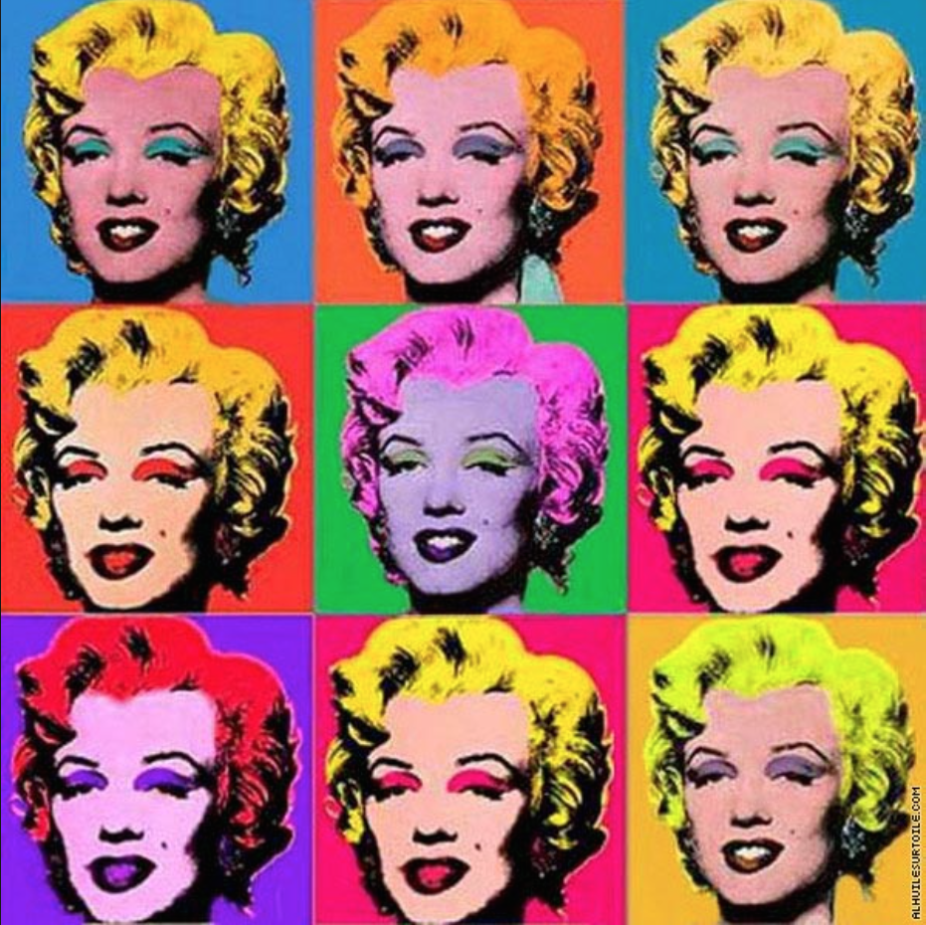
What is pop art?
1955 – 1970
References subject matter from POP culture
Art was no longer a “high class commodity”, it was designed for mass viewing
Subjects were recognizable objects/images

Slide 3
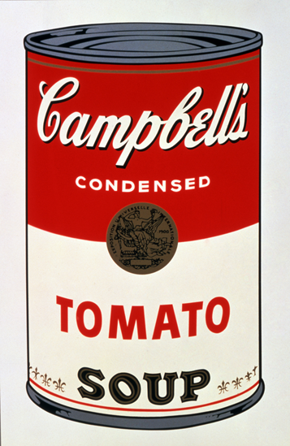
characteristics
Mass produced, industrialized images
Pop culture & icons
Celebrities, brands, logos
Glamourized commonplace objects/people/actions
Cambell’s soup cans
Using the telephone
Featured:
Advertising art
Comic books
Bold and Limited color pallets
Simplistic designs

Slide 4
Where did it come from?
Post WWII
After the Abstract Impressionism movement
Where the subject was unclear/ambiguous
American economy is booming
Mass produced manufacturing
Celebrity and Pop Icon Media Coverage
Commercial advertisements

Slide 5
Now that you’ve researched, and we’ve discussed… let’s make art!

Slide 6
But first.. You need to know a few more things!

Slide 7
Here’s the task
You are going to travel back in time to the 1960’s as a photojournalist for the TIME Magazine and relive the era.
You will need to talk to different people, artists, and other important characters during this time period, in order to understand the historical and cultural events that took place in the 60’s.
During your visit, you will also need to interview a few artists who belonged to the Pop Art Movement

Slide 8
Are you ready?
Here’s what you need to do… I would write this down!

Slide 9
6 steps
1. Look at some artists who are part of the Pop Art Movement
We did this on our WebQuest (see? We’re already movin’ and groovin’)
2. Interview an artist from the Pop Art Movement
3. List the time/era of the Pop Art Movement
4. Fine one historical movement that contributed to the Pop Art Movement
5. Find one cultural movement that contributed to the Pop Art Movement
6. After you research Pop Art, create an artwork reflecting the movement/artist to be displayed in TIME Magazine, along with an article about the artist you interviewed.

Slide 10
The process (Part 1)
Look at the following artworks by some of the Leading Pop Artists of the 60’s. In your sketchbook, explain 3-5 characteristics of each artist’s work
Andy Warhol
Roy Lichtenstein
Jasper Johns

Slide 11
The process (part 2)
After reviewing the artworks from the previous question, look back at Roy Lichtenstein. You will need to…
List 3 things that his artworks have in common
Interview Roy (provided)
Fill out the Interview Sheet to help you write your article for TIME Magazine

Slide 12
The process (part 3 - 6)
When was the start of the Pop Art Movement?
Why did Pop Art happen?
Find a cultural movement during the 1950’s or 1960’s that could have led to Pop Art and include it in your magazine article
Find a historical event that happened during the Pop Art Movement
Examples: End of Cold War, Moon Landing, etc
Write an article for TIME Magazine using all of the information you found in the previous task. Use a sheet of lined paper.

Slide 13
But where is the art?
You must create your OWN artwork that reflects the movement and artist you learned about to be displayed with your article. You should do this on the drawing paper provided.
Use your pencil to draw it out.
Use marker to fill it in.
Pay attention to craftsmanship
Aka coloring inside of the lines. Smooth edges. Etc.

Slide 14
So what’s the grade?
Your artwork will be turned in WITH your article that you’ve written.
All of this will be graded together.

Slide 15
 | Poor – 0 to 5 | Average – 6 to 10 | Good – 11 to 15 | Excellent – 16 to 20
3-5 Characteristics of 3 artists from the Pop Art Movement | Did not include any characteristics | Included less than 3 characteristics or did not provide detail | Included 3-5 characteristics but they were not detailed | Included 3-5 characteristics Gave detailed responses
Interview on Lichtenstein and characteristics of his work | Did not complete interview… did not list characteristics of the artist’s work | Completed the interview but did not include characteristics or visa versa | Completed the interview and listed characteristics but did not give detailed responses | Completed the interview and listed characteristics. Provided detailed responses to both
When the Pop Art Movement happened - Cultural/Historical events | Did not include all items: time/era, cultural event, historical event | Only included 1-2 items: time/era, cultural event, historical event | Included all 3 items but did not give detailed/correct responses | Included all 3 items and gave correct, detailed responses
Magazine article for TIME Magazine | Did not complete the article at all | Did not complete the article in it’s entirety | Completed most or all of the article but did not include all of the required information | Completed the entire article and included all required information
Original artwork for TIME Magazine | Did not create an artwork | Did not finish creating an artwork | Finished the artwork but it did not reference a pop artist/poor recreation | Created an artwork that referenced a pop artist Well crafted

