Slide 1
Self -Portrait
Mrs. Senick
Perspectives in Art

Slide 2
WARM-UP
“Get Real”
Each student will receive 5 small papers
in 5 different colors:
- orange
- green
- red
- blue
- gray

Slide 3
WARM-UP Get Real
Orange- Think about five material items/personal possessions that you value the most. Write down one answer per piece of paper.
Green- Write down the five people that are most important to you. They can be family members, friends, mentors, professors, etc. Only ONE person per paper (ie. Can't say “parents,” “friends,” etc.)
Red- Think about five memories that you always want to have and write them down. These memories can be good or they can be a tough memory that you have learned from. However you may want to define them. Things that made you the person you are today.
Blue- Think about five goals that you find important to set for your future. Write them down.
Gray- Write down five places that are important to you. It could be your hometown, favorite place, your high school, the home you grew up in; just any physical place.

Slide 4
WARM-UP Get Real
Take a few minutes to look over these values that you have in front of you and think about why they are important to you. Think about the good times and the tough times that’s come along with some of these.
Now that you have thought about these values take seven away. When you take these away, that means that they are no longer a part of your life (i.e. you never met that person, went to that place, have possession of that item, or are not working towards that goal).
Take six more away.
Take five more away.
Take two more away. This should leave you with your top five values in life. The top five things that influence who you are on a day to day basis.

Slide 5
Debriefing to Warm-Up…Get Real
What values are you left with? | How will these values that you wrote down affect your life? Future?
Why are they important to you? | Do you think in life, you may have to make such difficult choices?
Did you find this exercises to be easy? | Do you think you will make the same choices as today?
What values did you find easiest to eliminate? | What pressures in life could make you choose between things in your life?
What did you learn from this activity? About yourself? | Is what is important to you today the same as 5, 10, 20 years ago?

Slide 6
Think About It →
How could you incorporate these values into a self-portrait of yourself??

Slide 7
Objective -
SWBAT reflect on class discussions of portraits and create a self-portrait depicting themselves in a realistic way or a style of expressionism and develop an artist statement to accompany their work.

Slide 8
How is it different for an artist to create a self-portrait rather than a portrait of someone else?

Slide 9
Self-Portrait
Students will create a self-portrait
“How you see yourself” or
“How you want others to perceive you”
Can be a realistic representation or a style of expression
2 annotated brainstorm sketches
An artist statement will accompany your artwork
How you view yourself
Why you depicted yourself in the manner you created
What elements & principles of art are incorporated into your composition?
Discuss areas of importance in your piece

Slide 10
Self-Portraits Medium
You may create your self-portrait using any medium you choose
Examples (but are not limited to) –
Graphite pencil
Painting
Collage
Colored Pencils
Oil Pastel
Chalk Pastel
Pen & Ink

Slide 11
Criterion | Excellent Work | Good Work | Average Work | Needs More Work
Originality & Creativity | (25) Artwork is unique and imaginative. Emerging student “voice” is predominant. | (20) Artwork is unique and imaginative. Emerging student “voice” is consistent throughout the piece. | (15) Artwork is unique and shows some imagination. Emerging student “voice” is somewhat visible. | (10) Artwork shows little imagination. Student “voice” is non-visible throughout overall work.
Craftsmanship & Skill | (25) Quality of work is excellent. Materials were used effectively. Project directions were all met. Use of entire paper area was used. | (20) Quality of work is good. Materials were used effectively. Project directions were almost all met. Use of 80% of paper area was used. | (15) Quality of work is mediocre. Materials were acceptably used. Project directions were barely met. Use of 70% of paper area was used. | (10) Quality of work was poor. Work shows awkward use of materials. Directions were not followed. Use of 50% or less of paper area was used.
Complexity & Aesthetics | (25) Work shows excellent design to form a highly complex piece. Many areas draw interest. Decision-making and planning is evident. Project objective was met. Composition shows a great deal of elements & principles of design incorporated into work. | (23) Work shows a good design to form a moderately complex piece. Some areas draw interest. Some decision-making and planning was used. Project objective was mostly met. Composition shows a good amount of elements & principles of design incorporated into work. | (18) Work shows a medium-low level of creativity with too few details. Design has some areas to draw interest to the viewer. Planning was minimal. Project objectives were partially met. Composition shows an average amount of elements & principles of design incorporated into work. | (10) Work shows a low-level of complexity. Work was overly simple and has little to draw interest to a viewer. Very little planning was done. Project objectives were not met. Composition shows very little / no elements & principles of design incorporated into work.
Finishing & Effort | (25) Student put forth their best effort with minimal time wasted. Overall work was accomplished with patience, efficiency, and neatness. | (20) Student put forth a good amount of effort with minimal time wasted. Student worked efficiently and neatly. | (15) Student put forth some effort, with some time or materials wasted. Work needs just a few more touch-ups or details. | (10) Student put forth little effort, wasting class time and/or materials. Overall work is greatly undeveloped.

Slide 12
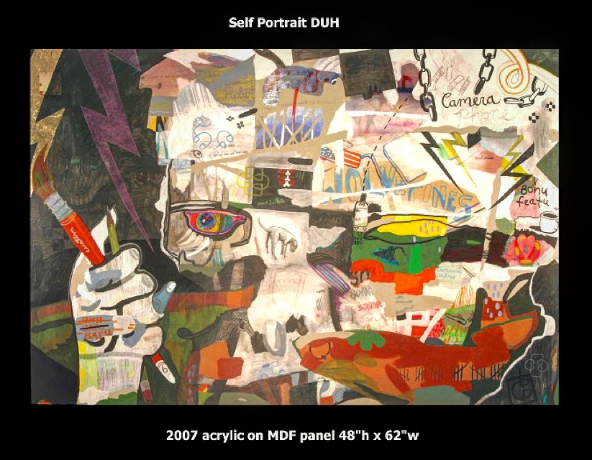
Self-Portrait Examples -

Slide 13
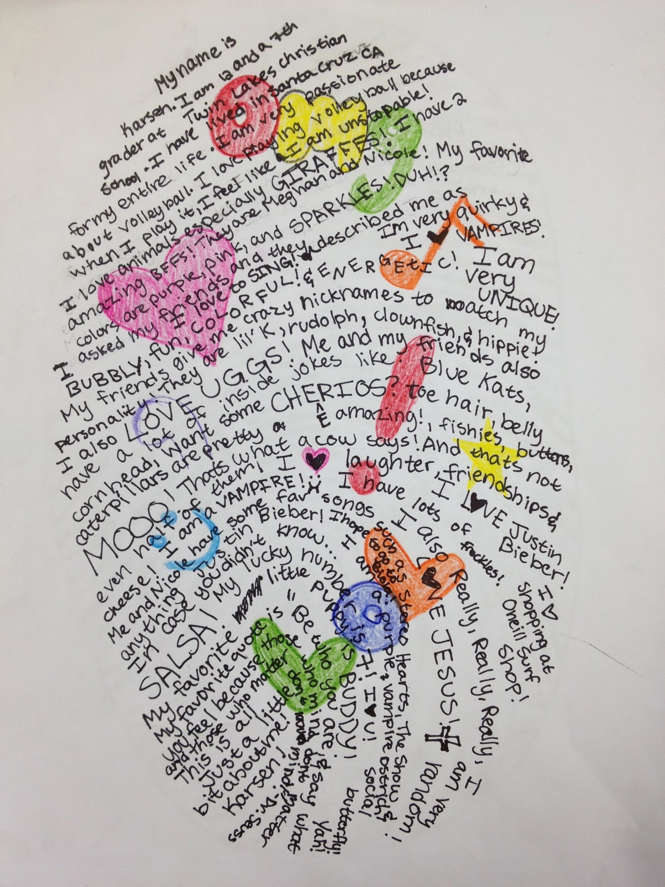
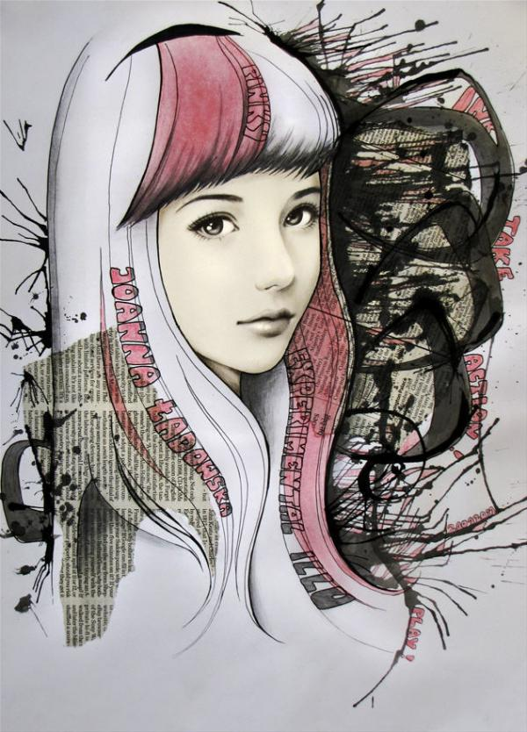
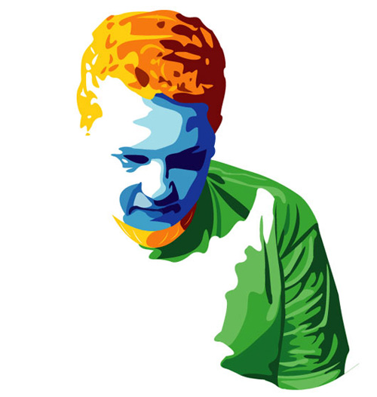
Vector Self-Portrait
Joanna Ladowska, mixed media

