Slide 1
Shape Balance
Art 1
Mrs. Senick
Lesson 4

Slide 2
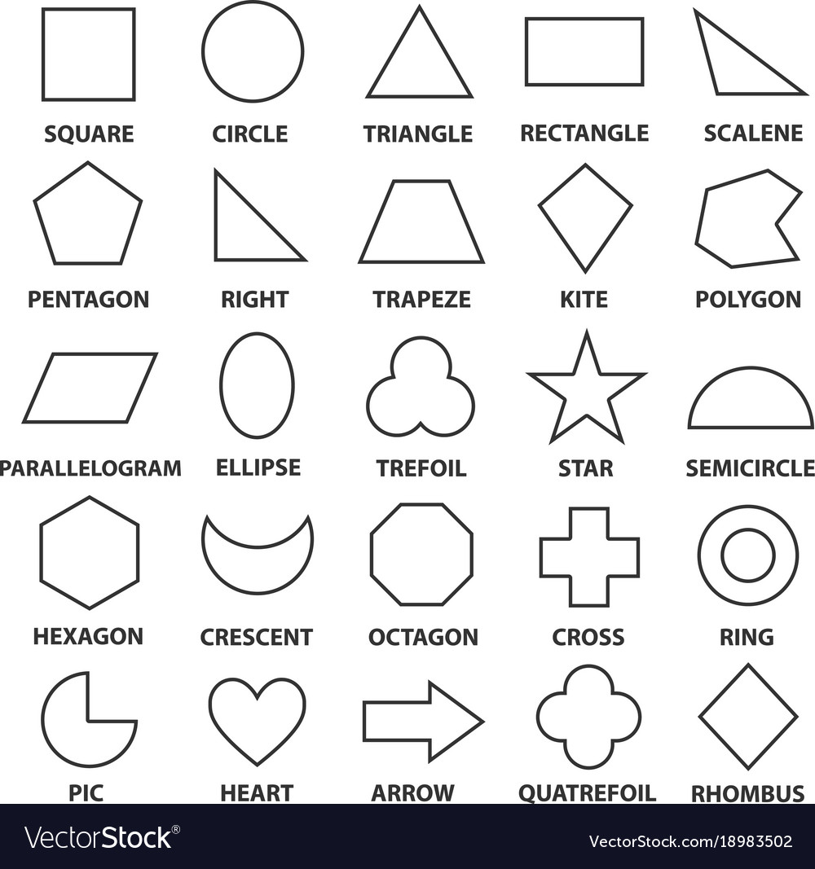
shapes
Shapes can be either geometric or organic
What is a geometric shape?
What is an organic shape?
How do you know the difference?

Slide 3
Geometric vs organic shapes
A geometric shape is a shape that has perfect, uniform measurements and don’t often appear in nature
These shapes are referred to by their name
An organic shape is a shape that is associated with things from the natural world, like plants and animals
These shapes do not have a name (a paint or ink spatter for example)

Slide 4
practice
Draw a landscape using only geometric shapes on the left
Draw a landscape using only organic shapes on the right

Slide 5
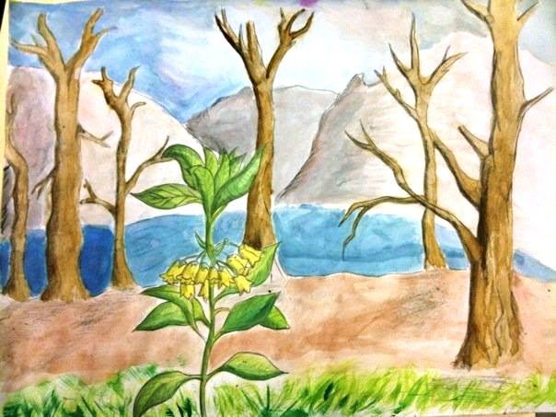
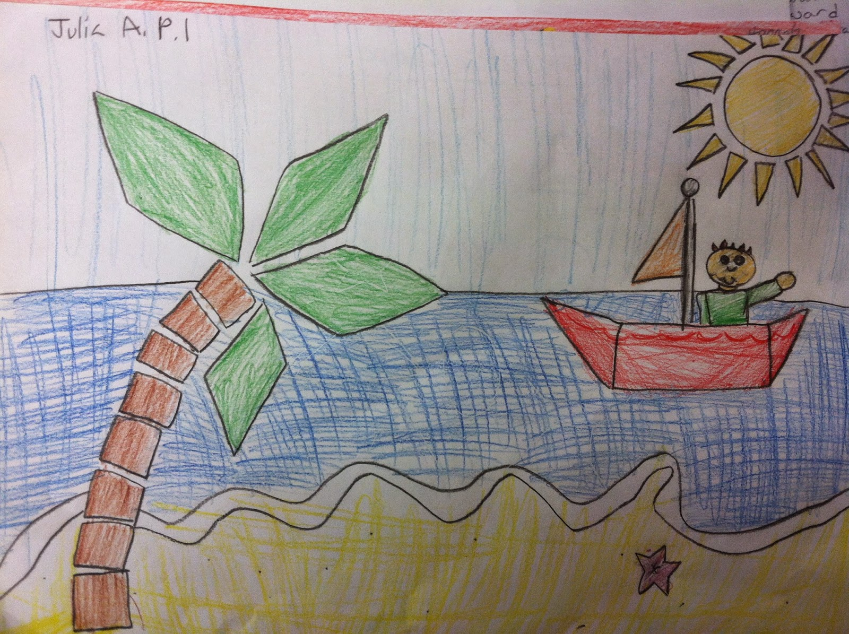
Result…
Geometric vs. Organic

Slide 6
balance
Balance in art is defined as the equal distribution of visual weight in a composition.
All of the elements of art in that composition look stable or have a feeling of balance (one side is not heavier than the other)
It’s how the artist develops the composition through the arrangement or placement of objects or elements on the picture plane.
The artist’s goal is to create a sense of equilibrium, though he may intentionally create an unbalanced piece to send a certain message as well.

Slide 7
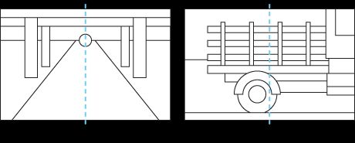
In order to create balance…
The artist must first find the central axis line
This line is imaginary, but it divides the composition in half either vertically or horizontally.
Objects placed on either side of the axis line can either be repeated exactly the same (mirror image) or unequally but with visual weight.

Slide 8
Types of balance
Asymmetrical Balance
The two sides are not identical, but differ from one another. However, the elements are arranged so that there is a sense of balance.
Symmetrical Balance
Radial Balance
Balance that is achieved by arranging elements on either side of the center of a composition in an equally weighted manner.
Can be thought of as 50/50 balance or like a mirror image.
The image would look the same on either side of the center
A visual balance based on a circle with its design extending from center.
A star
The iris around each pupil of your eyes
A wheel with spokes
A daisy (among many flowers and other plant forms) are examples of radial balance.

Slide 9
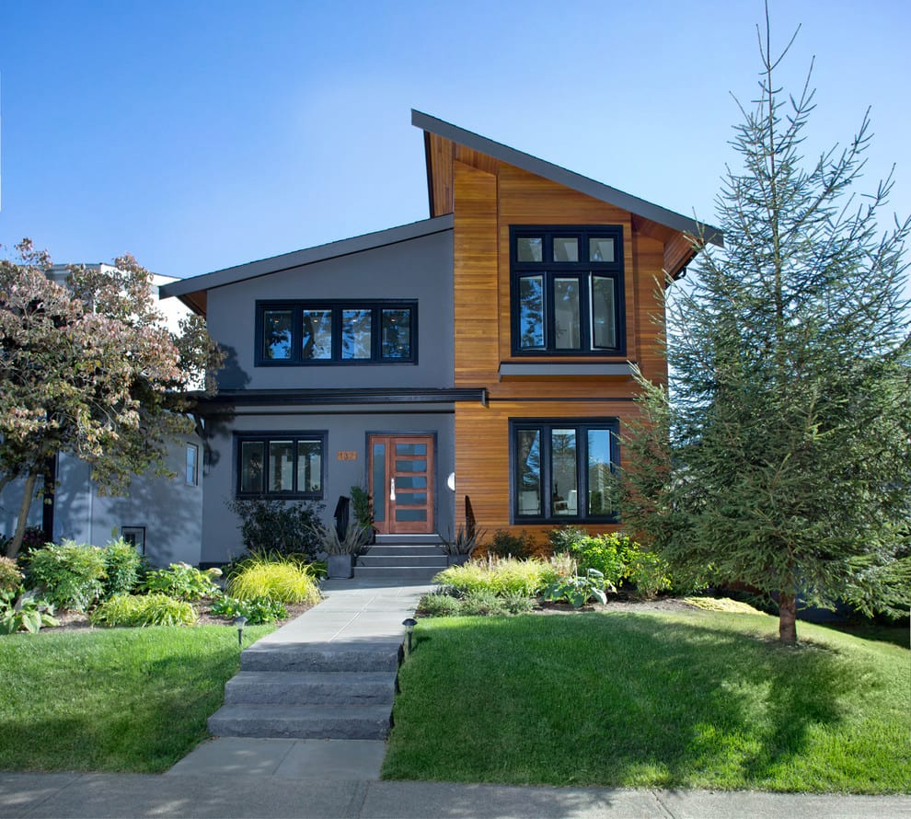
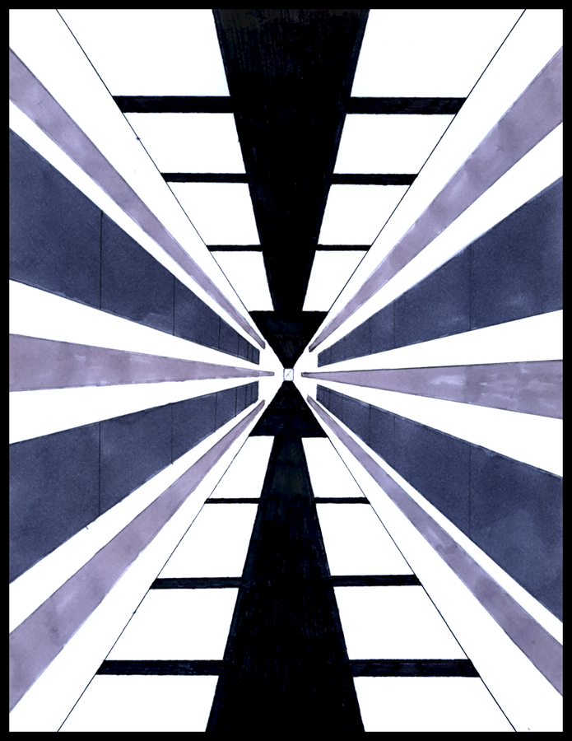
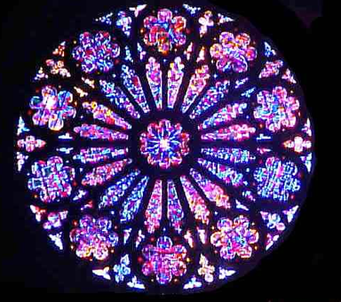
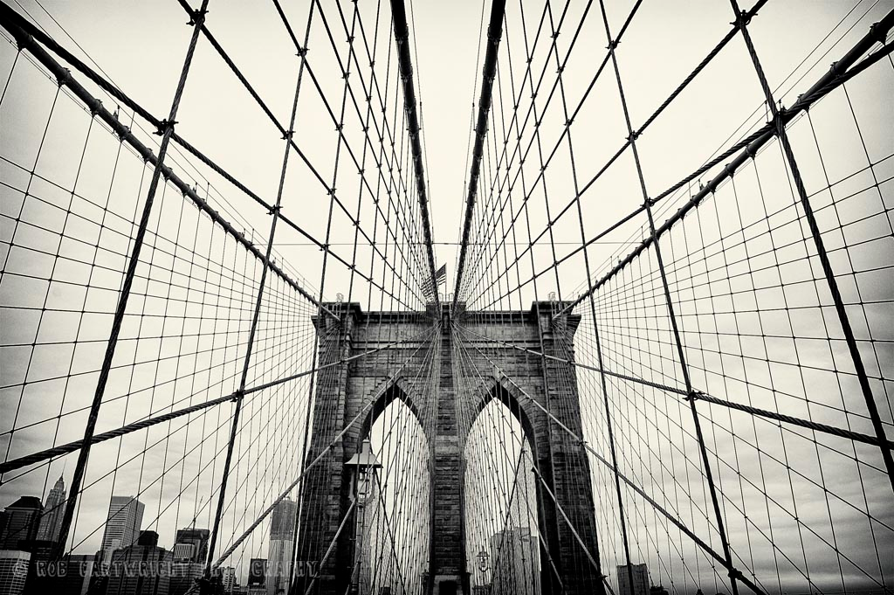
Types of Balance

Slide 10
Practice…
Create three different sketches in your sketchbook
One must be symmetrical
One must be asymmetrical
One must be radial
They can be realistic or abstract
This is a formative grade

Slide 11
The assignment
Choose one of your sketches and transfer it to your final paper.
Your image must take up the entire paper!
The medium you choose to use is up to you, but YOU are responsible for those materials
If you’re using markers, the caps need to go back on
Colored pencils? Put them back by their color
Paint? Wash out the brushes with soap and water, put the paint in the trash can (when completely finished) and wash out the palette entirely
You will have 5 class periods to finish this assignment. Take your time, pace yourself.

