Slide 1
Surrealism

Slide 2
Surrealism
1924 - late 1966 (The Great Depression)
Avant-garde movement which sought to release the creative potential of the unconscious mind
Based off of Freudism (dreams & what they mean)
Surrealism used the element of surprise
Artists explored dreams as a vivid form of reality
Surrealism will make you think about symbolism to be able to explain the art

Slide 3
Leading Artists
Salvador Dali
René Magritte
Max Ernst
Vladimir Kush

Slide 4
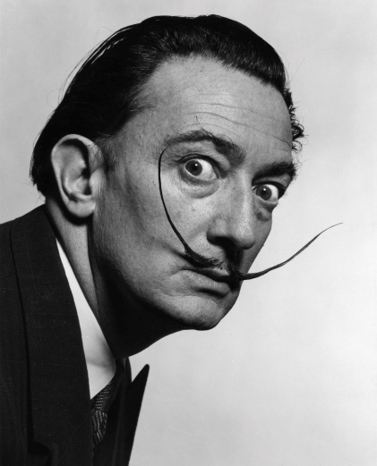
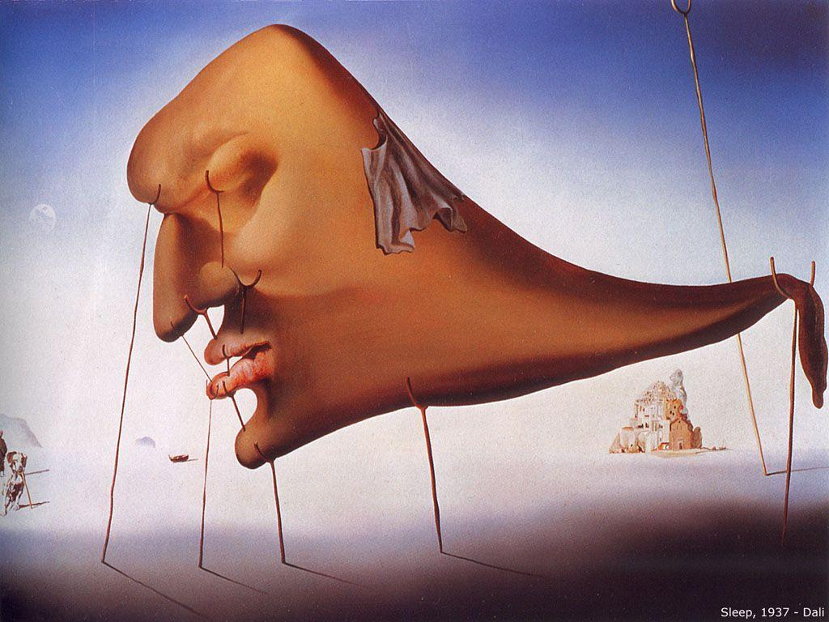
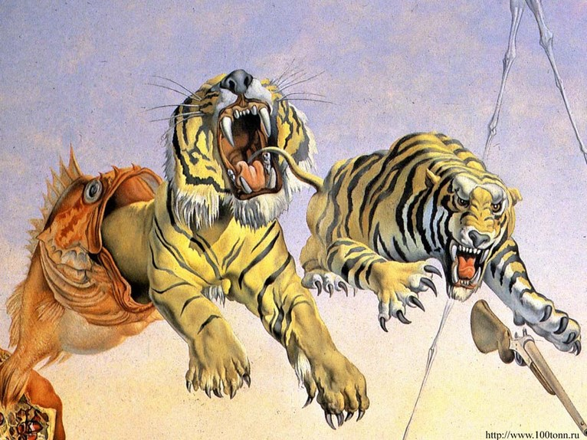
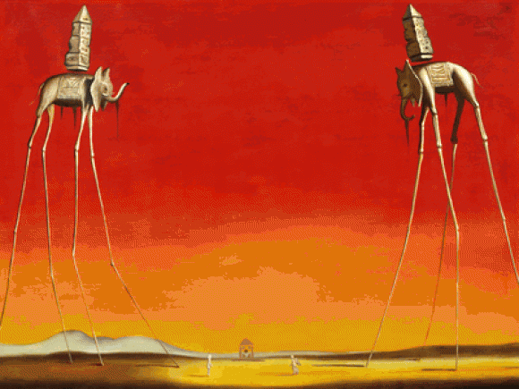
Salvador Dali
May 11, 1904 – January 23, 1989
“Sleep”, 1937
“Gala and the Tigers”, 1944
“The Elephants”, 1948
Notes:
“Gala and the Tigers” - The bayonet, as a symbol of the stinging bee, may thus represent the woman's abrupt awakening from her otherwise peaceful dream.
“Sleep” - The sort of monstrous-looking head is delicately, precariously balanced on different-sized crutches, suggesting that sleep itself must be in precise balance in order for it to yield the dreams Dali might then transfer into his surrealist visions.
“Sleep” is virtually a visual rendering of the body's collapse into sleep, as if it was a collapse into a separate condition of being. Against a deep blue summer sky, a huge disembodied head with eyes dissolved in sleep, hangs suspended over an almost bare landscape. The head is "soft", vulnerable and distorted. And what should be a neck tapers away to drop limply over a crutch. A dog appears on the left, its head in a crutch too, as if half asleep itself.
The head is supported above land by a series of wooden crutches. The mouth, nose and also eyes are all held in place by the crutches, suggesting that the head might collapse if they were removed.
“The Elephants” - There are various cultural depictions of elephants, where they are often viewed as symbols of strength, dominance and power due to their bulk and weight. Dalí enhances the appearance of strength and weight by depicting the elephants carrying massive obelisks on their backs, however, on close inspection it can be seen that these weights are floating.

Slide 5
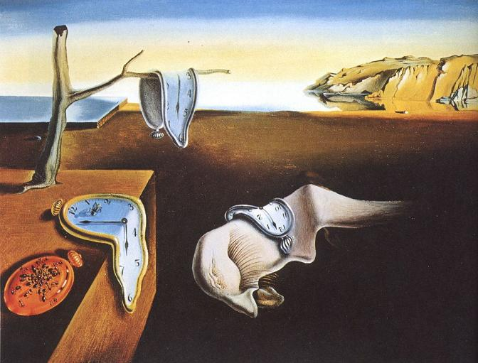
“The Persistence of Memory”, 1931
This painting of soft, melting pocket watches is interpreted as the watches
are a rejection of the assumption that time is rigid or deterministic.
This idea is supported by other images shown in the painting, such as the
expanding landscape and other limp watches shown being devoured by ants.

Slide 6
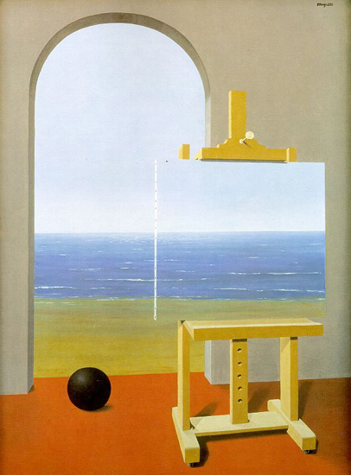
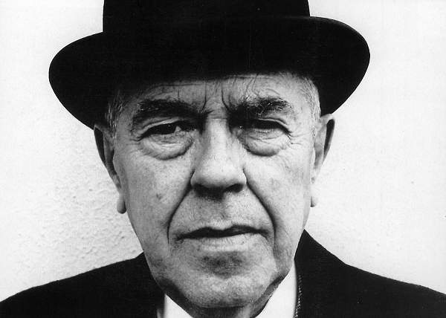
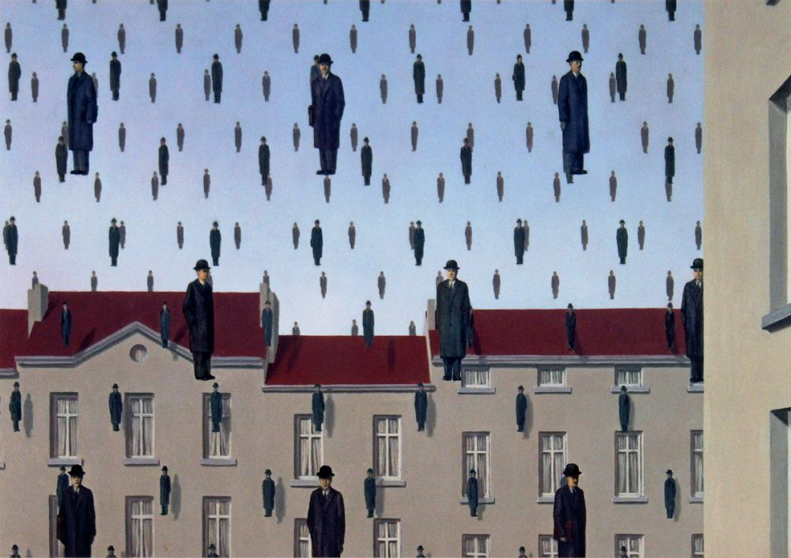
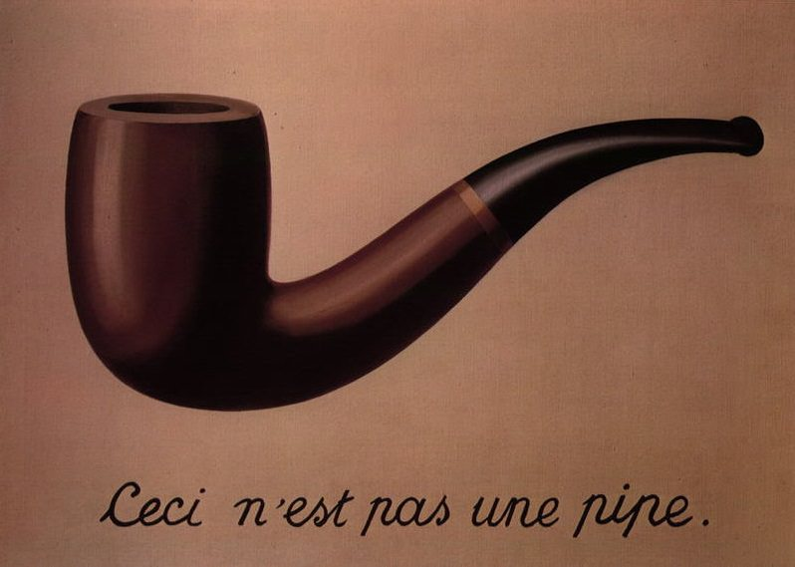
René Magritte
November 21, 1898 – August 15, 1967
“The Human Condition”, 1935
“Golconda”, 1953
“The Treachery of Images”, 1928-29
Notes:
“Golconda” - The piece depicts a scene of nearly identical men dressed in dark overcoats and bowler hats, who seem to be drops of heavy rain (or to be floating like helium balloons, though there is no actual indication of motion), against a backdrop of buildings and blue sky. The men are spaced in rhombic grids facing the viewpoint and receding back in grid layers.
One interpretation is that Magritte is demonstrating the line between individuality and group association, and how it is blurred. All of these men are dressed the same, have the same bodily features and are all floating/falling. This leaves us to look at the men as a group. Whereas if we look at each person, we can predict that they may be completely different from another figure.
“The Human Condition” – One of Magritte's most common artistic devices was the use of objects to hide what lies behind them
Magritte had this to say of his 1933 work:
In front of a window seen from inside a room, I placed a painting representing exactly that portion of the landscape covered by the painting. Thus, the tree in the picture hid the tree behind it, outside the room. For the spectator, it was both inside the room within the painting and outside in the real landscape.
“The Treachery of Images” - His statement is taken to mean that the painting itself is not a pipe. The painting is merely an image of a pipe. Hence, the description, "this is not a pipe."

Slide 7
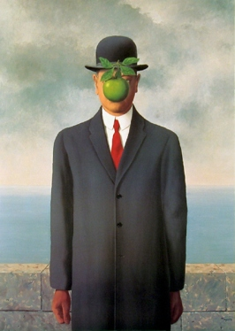
“The Son of Man”, 1946
Magritte painted it as a self-portrait. The painting consists of a man in an overcoat and a bowler hat standing in front of a low wall, beyond which is the sea and a cloudy sky. The man's face is largely obscured by a hovering green apple. However, the man's eyes can be seen peeking over the edge of the apple. Another subtle feature is that the man's left arm appears to bend backwards at the elbow.
About the painting, Magritte said:
“At least it hides the face partly. Well, so you have the apparent face, the apple, hiding the visible but hidden, the face of the person. It's something that happens constantly. Everything we see hides another thing, we always want to see what is hidden by what we see. There is an interest in that which is hidden and which the visible does not show us. This interest can take the form of a quite intense feeling, a sort of conflict, one might say, between the visible that is hidden and the visible that is present.”
http://en.wikipedia.org/wiki/The_Son_of_Man

Slide 8
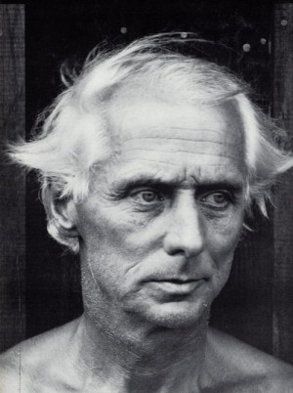
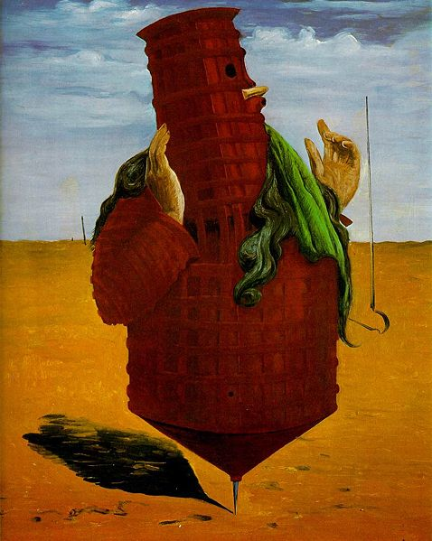
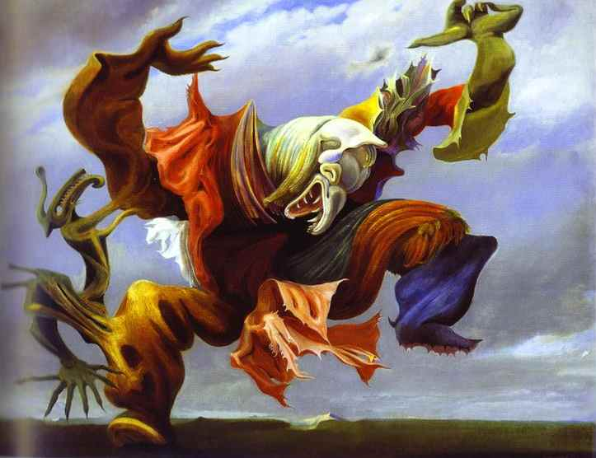
Max Ernst
April 2, 1891 – April 1, 1976
L'Ange du Foyer, 1937
“Ubu Imperator”, 1923
Notes:
Ernst portrays a vivid creature in a moment of joyous expression. Seemingly alive and grinning, the individual bursts with color, leading with a determined gape of his mouth and pleasant squint of his eyes, and showing no regard for how he may appear. By human standards, he is in some ways horrifying yet ultimately fascinating. He embodies movement and attention-getting displays yet cannot avoid aesthetic imperfections that may be perfect for him, but uncomfortable for others. L'Ange du Foyer is roughly translated to mean, "The Angel of the Home (or Hearth)" and is a poignant way of defining the aforementioned man. In some ways--and if taken literally--this angel could easily watch over someone's home with success. Yet for the home owner, this angel could be a bit too much to take.
The red “Ubu Imperator” marked the entry of Ernst in the articulated stage of surrealism by his use of a literary narrative that was sometimes personal, sometimes political. In this seminal work a spinning top, a red carcass with iron reinforcement, and human hands express an astonishing image of the Ubu Father, a grotesque symbol of authority invented by Alfred Jarry.

Slide 9
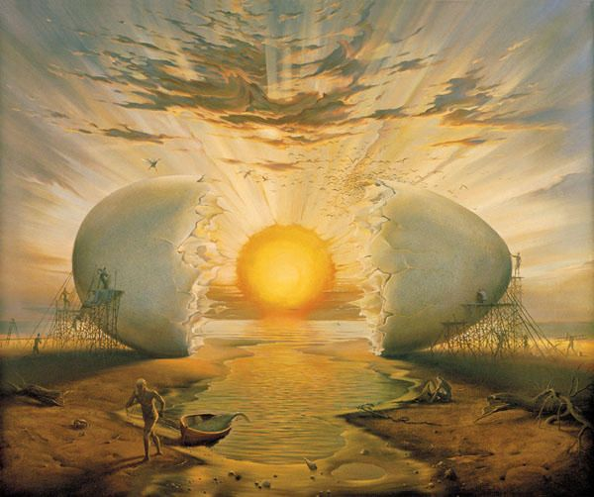
Vladimir Kush
African Sonata

Slide 10
