Slide 1
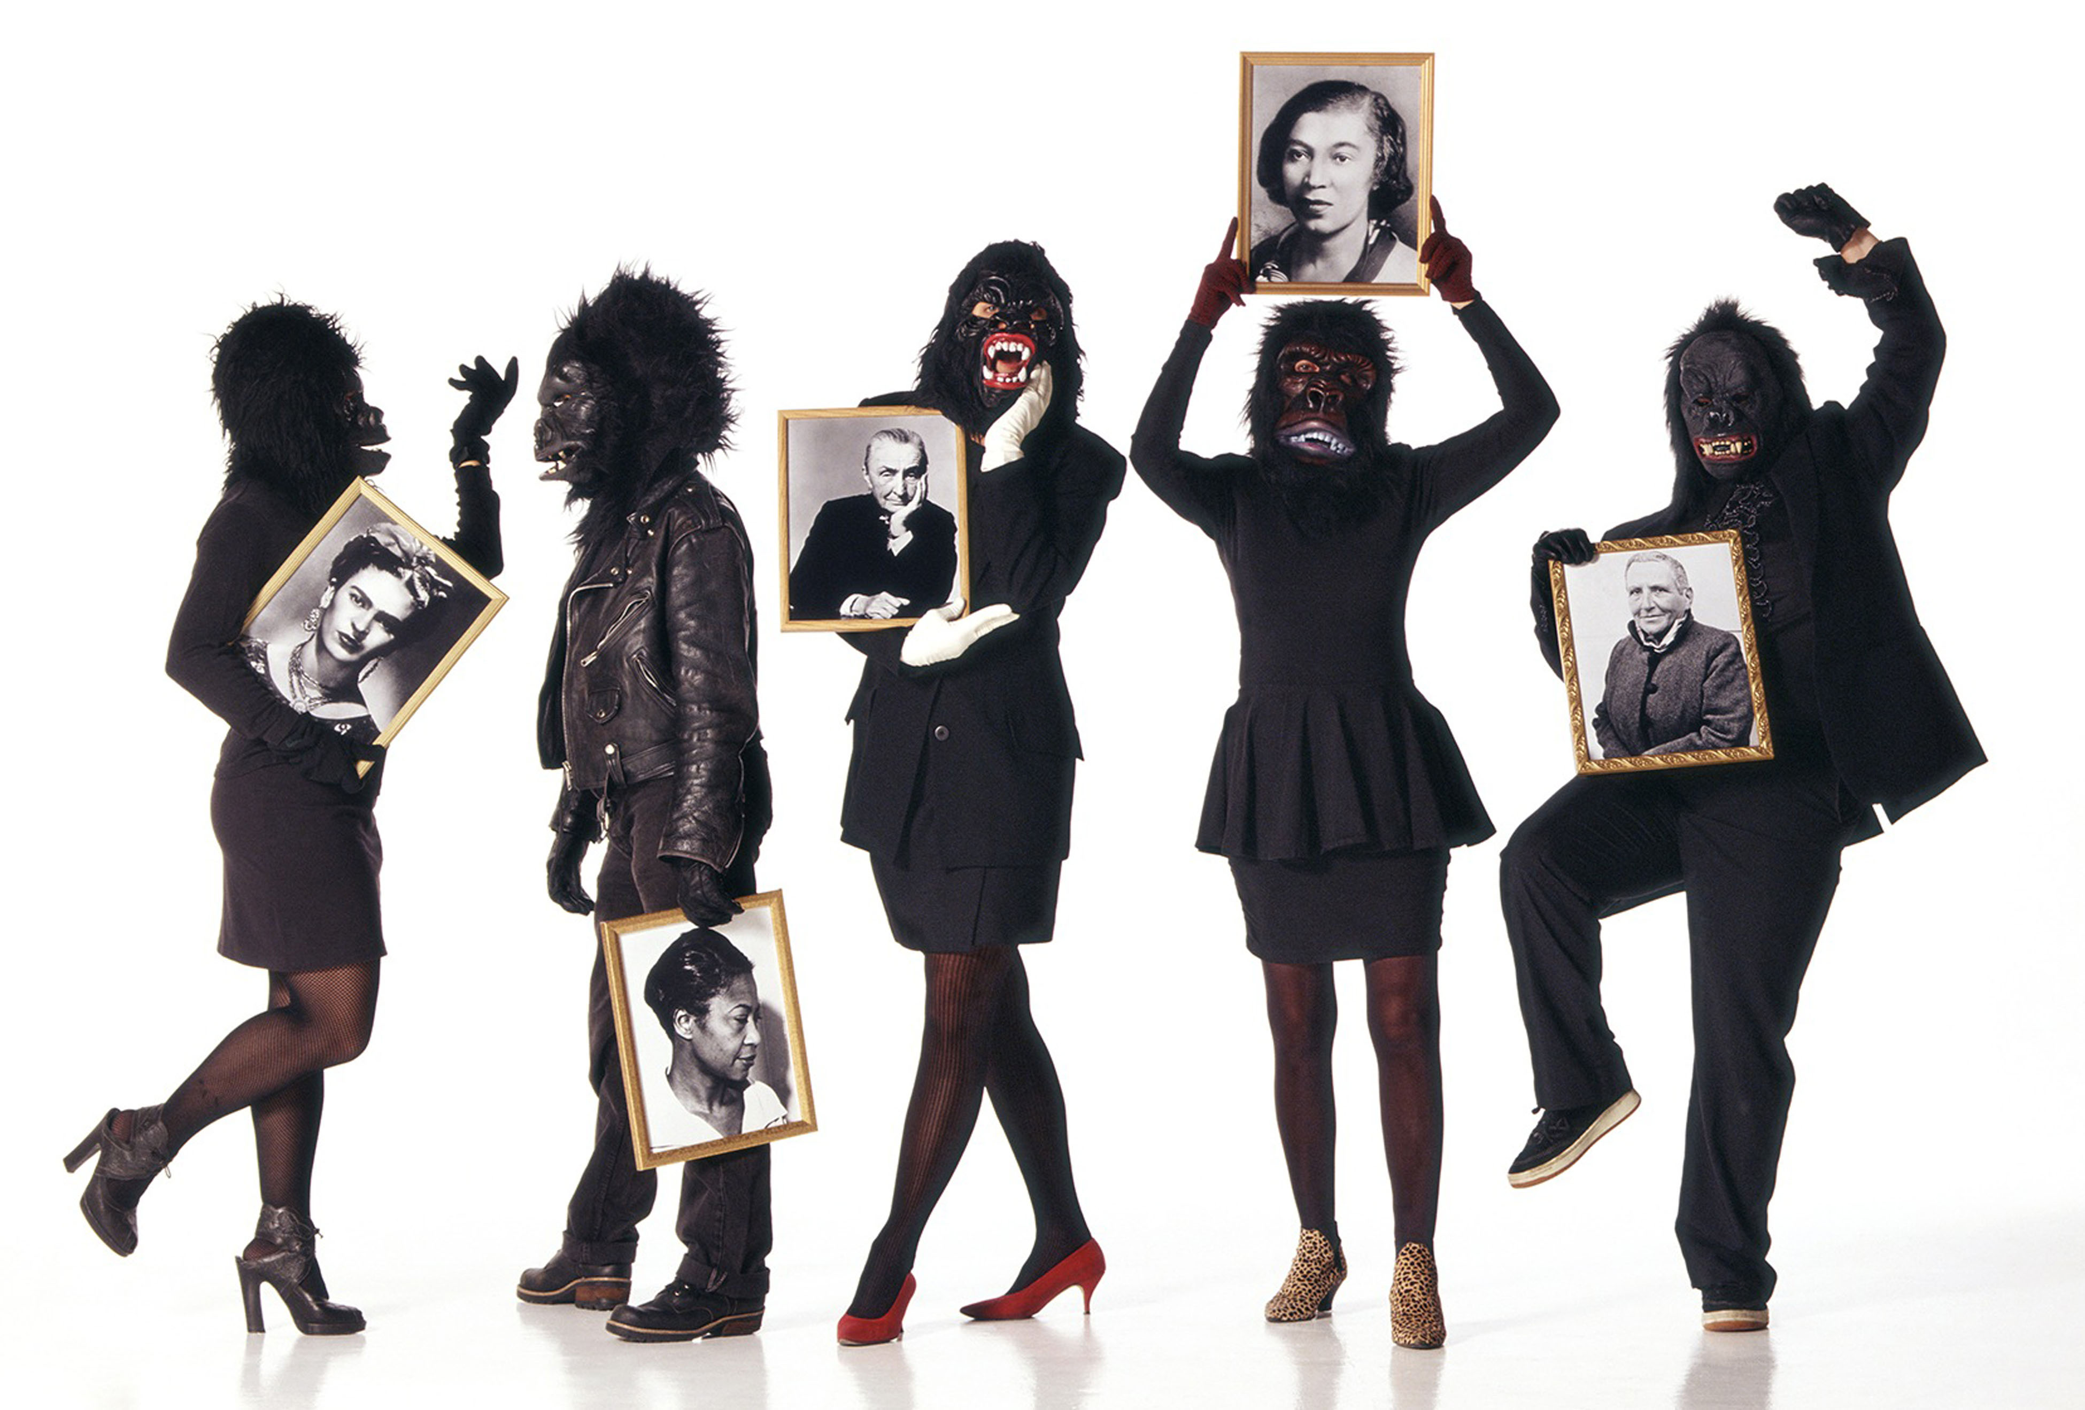
The Guerrilla Girls
Mrs. Senick
Perspectives in Art
Art HERStory

Slide 2
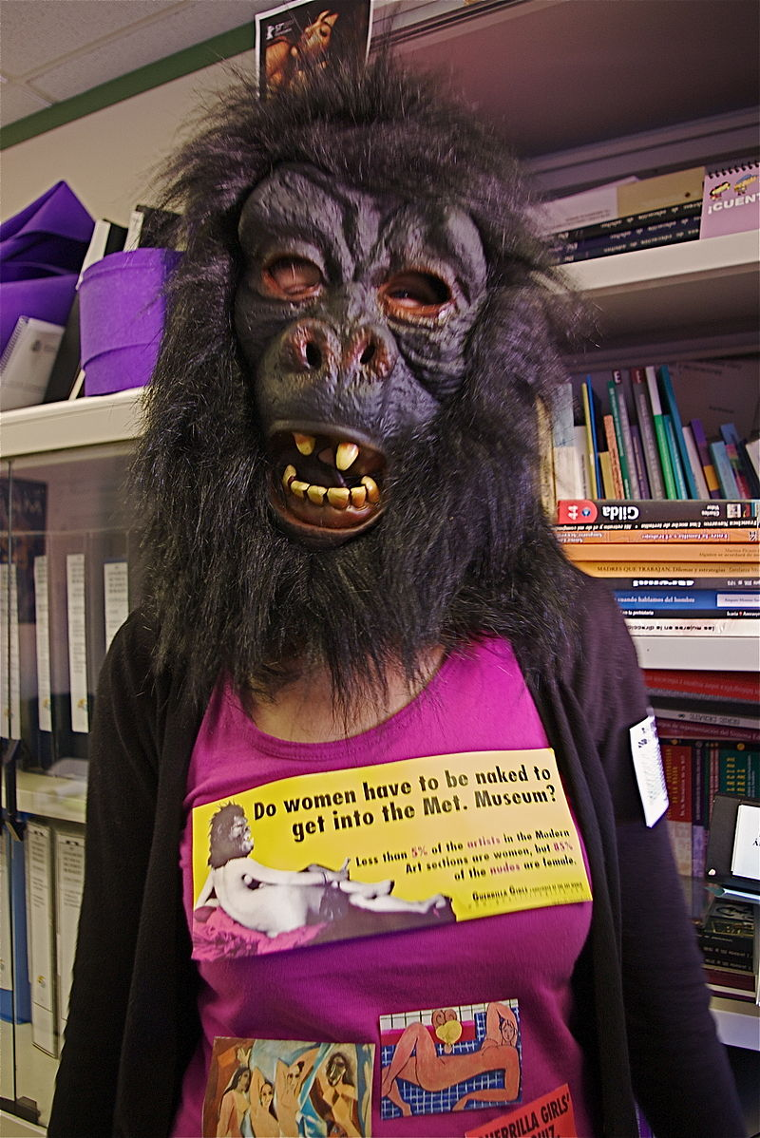
The Guerrilla Girls
https://en.wikipedia.org/wiki/Guerrilla_Girls
Guerrilla Girls are an anonymous group of feminist, female artists devoted to fighting sexism and racism within the art world.
The group was formed in response to the Museum of Modern’s Art exhibition “An International Survey of Recent Painting & Sculpture”.
In total, the show featured works by 169 artists - only 13 were female.
The group formed in NYC in 1985 with the mission of bringing gender and racial inequality in the fine arts into focus within the greater community.
Members are known for the gorilla masks they wear to remain anonymous. The masks conceal their identity because they believe that their identity is not what matters
"...mainly, we wanted the focus to be on the issues, not on our personalities or our own work."
Their identity is hidden to protect themselves from the backlash of prominent individuals within the art community.

Slide 3
Members & Names
Membership in the New York City group is by invitation only based on relationships with current and past members, and one's involvement in the contemporary art world.
A mentoring program was formed within the group, pairing a new member with an experienced Guerrilla
"It can only enhance us by having people of power who have been given credit for being a Girl, even if they were never a Girl." Men are not allowed to become Guerrilla Girls, but may support the group by assisting in promotional activities.
Guerrilla Girls names are pseudonyms generally based on dead female artists. Members go by names such as Kathe Kollwitz, Alma Thomas, Rosalba Carriera, Frida Kahlo, Julia de Burgos, and Hannah Höche.
This also helped to solve the problem of media interviews; the group was often interviewed by phone and would not give names, causing problems and confusion amongst the group and the media.
https://en.wikipedia.org/wiki/Guerrilla_Girls

Slide 4
Protest Art
Given most attention for their bold protest art
Their works, mainly posters, are used to express their ideals, opinions and concerns with regard to a variety of social topics.
Posters have always been fact-driven.
To be more inclusive and to make their posters more eye-catching, the Guerrilla Girls pair facts with humorous images: "We use facts, humor and outrageous visuals to expose sexism, racism and corruption in politics, art, film and pop culture.“
In the early days, posters were brainstormed, designed and then hung around New York City. The first posters were mainly black and white fact-sheets, highlighting inequalities between male and female artists with regard to number of exhibitions, gallery representation and pay.
The posters also intended to reveal how sexist the art world was in comparison to other industries and to national averages. For example, in 1985 they printed a poster showing that the salary gap between men and women in the art world was starker than the United States' average, proclaiming "Women in America earn only 2/3 of what men do. Women artists earn only 1/3 of what men do."
Early posters also often targeted specific galleries and artists.
https://en.wikipedia.org/wiki/Guerrilla_Girls

