Slide 1
How To Build Unit Timelines
Mrs. Senick
Perspectives in Art

Slide 2
What is a timeline?
Timeline* –
Noun
1. a linear representation of important events in
the order in which they occurred.
2. a schedule; timetable.
Timelines are often ordered by dates, times, events
* http://www.dictionary.com/browse/timeline

Slide 3
Why Make a Timeline in this class?
Create a visual organizer
To see possible relationships between art movements, historical events, etc.
To understand sequence of events (cause & effect)

Slide 4
Timeline Requirements -
Each unit will have a corresponding timeline
Unit name, student name, class period, and teacher’s name should all be visible on the backside of your timeline
Requirements for each entry:
Example of art
Artist’s name (if applicable)
Title of work
Year created
Medium
Dimensions
Where it is now located (if applicable)
Art style/period

Slide 5
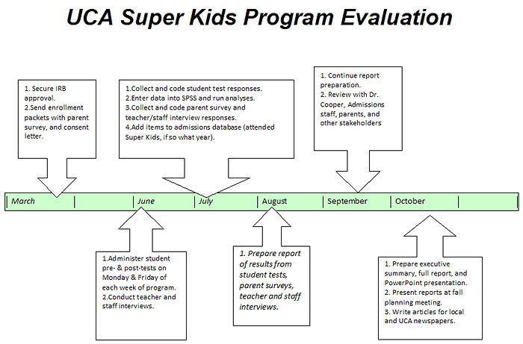
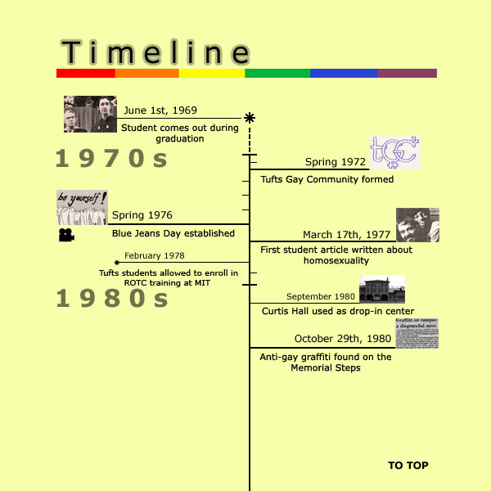
Timeline Examples -

Slide 6
Timeline Design Examples -

