Slide 1
Value Study
Studio Honors
Senick

Slide 2
Value
The lightness or darkness of an object
Value can be shown in many ways
Hatching, Cross-Hatching, Blending, Stippling
Squiggles, Zig-Zags, Cirlces
Value scales are often used to show a range of values

Slide 3
This Project…
Is three separate parts
Each part will be a Summative grade
The three parts will become a series
The entire project will be a Summative Grade

Slide 4
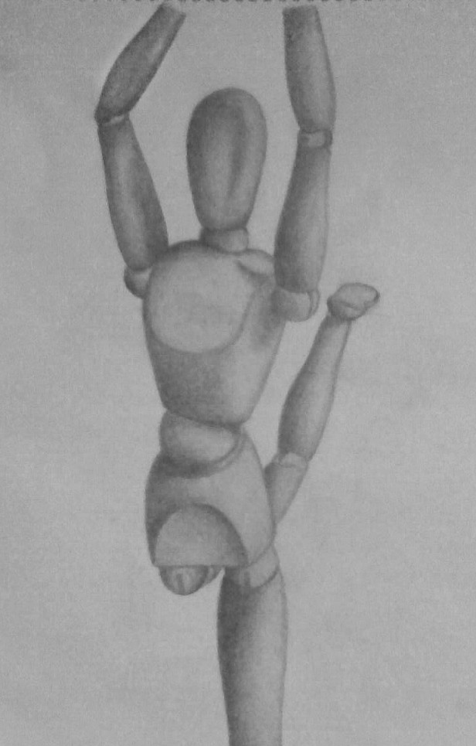
Part I – Black on White
White paper with addition of black values.
This is what you already do!!
Use whichever value shading technique you prefer
Use the pencils 2H – 6B along with the charcoal pencils and even the white pencils in the back of the room in the drawer.
Settle on a pose for the mannequin and put it near the window for good lighting!
If you can’t decide on a pose, maybe AP or Mr. Johnson can help… make it INTERESTING, not BORING!

Slide 5
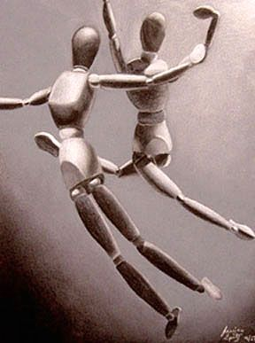
Part II – Black and White on Gray
Gray paper
Black values (using pencil) to create shadows
White pencil to create highlights
Use the same materials, and a different pose.

Slide 6
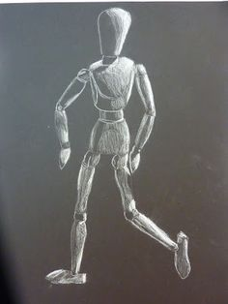
Part III – White on Black
Black paper with white additions to show highlights
New pose, same materials.

Slide 7
Final Grade
In addition to the three summative grades for completion of EACH separate artwork, we will be mounting the final three artworks onto one paper to create a unified whole piece showing a series of artworks.
This will also become a summative grade.
Ask Mrs. Milito for assistance in finding and mounting the paper.

