Slide 1
Before we start…
Warm up
I’m handing things back
Your tests will be handed back so that you can see the grade.
I will be recollecting them
If you want to retake the test, you MUST stay after on TUESDAY to retake the test.
I will average your scores together to get your final score
Tuesday is the only day my calendar allows me to stay after school
Keep all artwork in your portfolio.
If I ASKED to keep your work for display, please place it on the brown table where you got your warm up.

Slide 2
Physical Space - LANDSCAPES
Senick

Slide 3
OBJECTIVES: SWBAT … -Understand & use physical space on a 2D surface to create a watercolor torn paper landscape collage - Visually represent a foreground, middle ground, & background, using overlapping objects & planes & changing object’s size & placement in relation to view the horizon line - Utilize multiple materials / media at hand to create a work of art that references features of various global landscapes - Self reflect on use of illusion of depth, point of view, & artistic choice in an artist’s statement

Slide 4
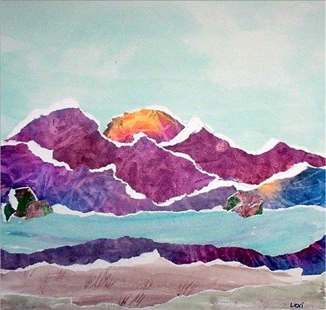
Watercolor Torn Paper Landscape Collage

Slide 5
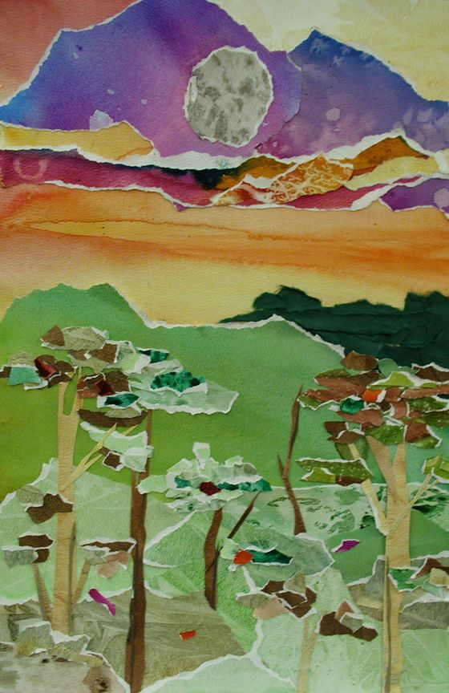
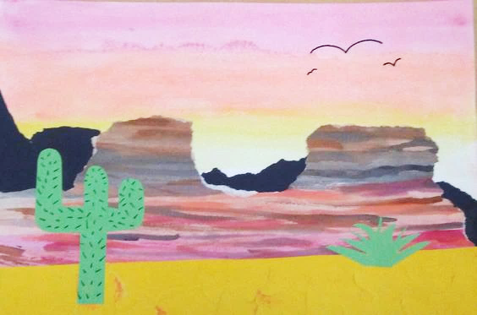
Collage:
For this project we’ll be using torn water color painted paper & construction paper objects
Assembling pieces of various material(s) to create a work of art

Slide 6
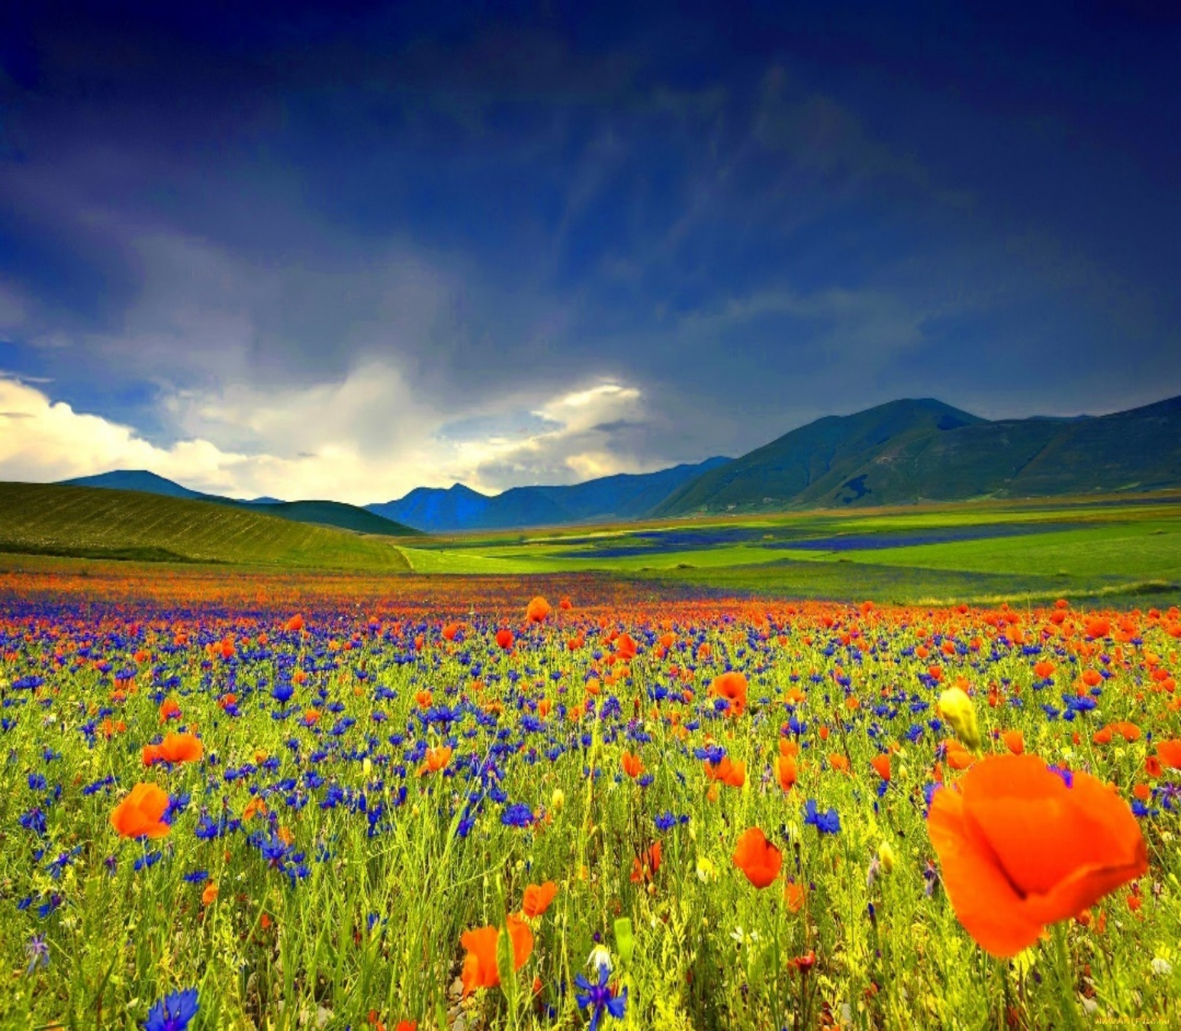
What is a landscape?
A genre of art that depicts the scenery of an area
Consists of a sky & a combination of:
natural terrain features; water, plants, rocks & man made structures
Horizon Line:
The point on a landscape where the sky meets the land / water
This also is always wherever our height/eye level is
Q? What Are some of the features you notice on this landscape?
Q? Where is the horizon line?

Slide 7
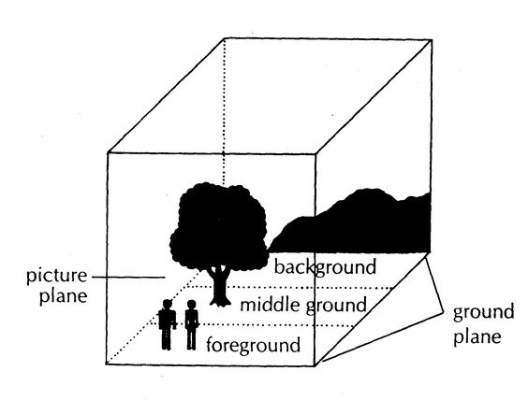
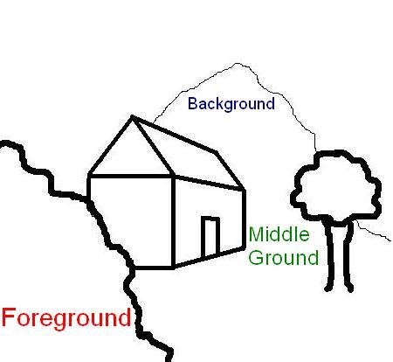
Features of a landscape
Foreground:
The area / objects closest to the viewer on the picture plane & is lowest on the image below the horizon line
Background:
The area /objects farthest from the viewer on the picture plane & is highest on the image above the horizon line
Middle Ground:
The area / objects between the foreground & background on the picture plane

Slide 8
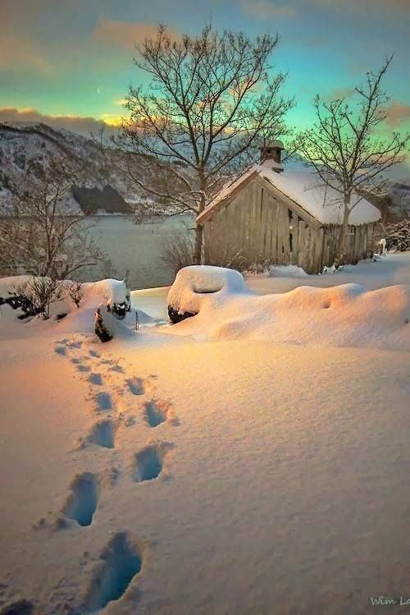
Which area is the foreground, middle ground, & background in this image? What are the objects you see in each area?
Background
Mountains
Sky
Middle Ground
Cabin
Trees
Lake
Foreground
Footsteps in snow
Gate

Slide 9
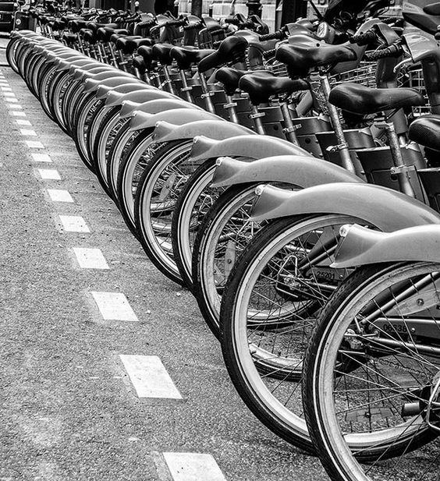
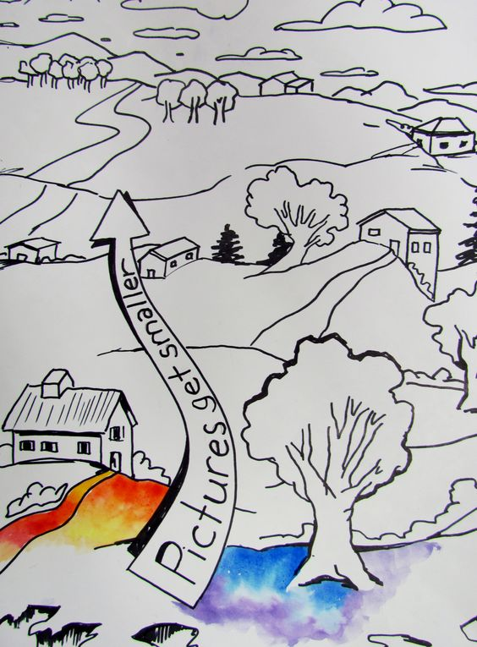
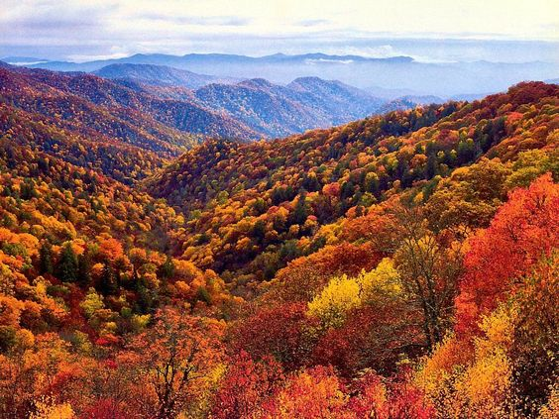
Illusion of Depth
Q: What illusions of depth do you see here?
Overlapping Objects
The view of an object is blocked by another object
Change in Size
Larger objects appear closer
Change in Placement
Objects placed low on the horizon line appear closer that high ones
Detail
Sharp details appear closer & fades in the distance
Value & Color Change
Dark / bright colors appear closer than dull / light ones

Slide 10
Point of View
HORIZON LINE
Perspective from which the viewer sees
High Point of View
High Point of View
Horizon line is higher on the plane & more ground shows
Low Point of View
Horizon line is lower on the plane & more sky shows
Low Point of View
HORIZON LINE

Slide 11
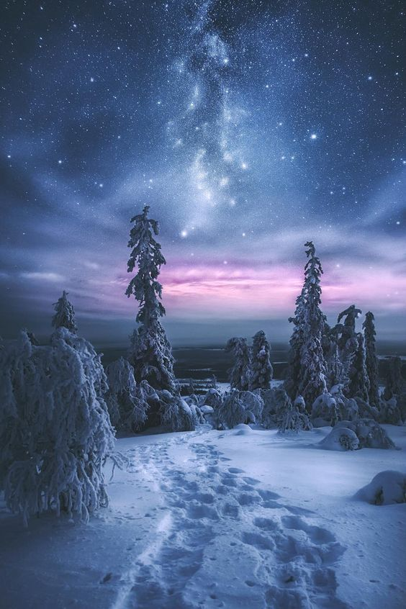
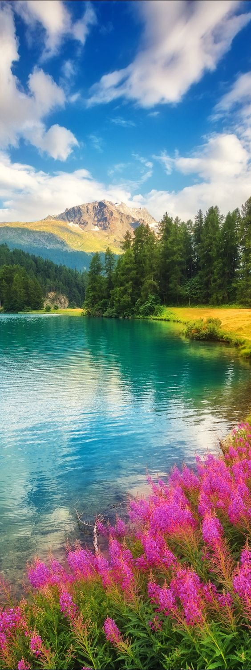
Practice
Sketch 3 possible landscapes of your own
label the foreground, middle ground, & background on both
Add 3 objects to your landscape
Foreground- Larger objects closer to the bottom
Background- Smaller objects high on the horizon line
Add color to your final decision

Slide 12
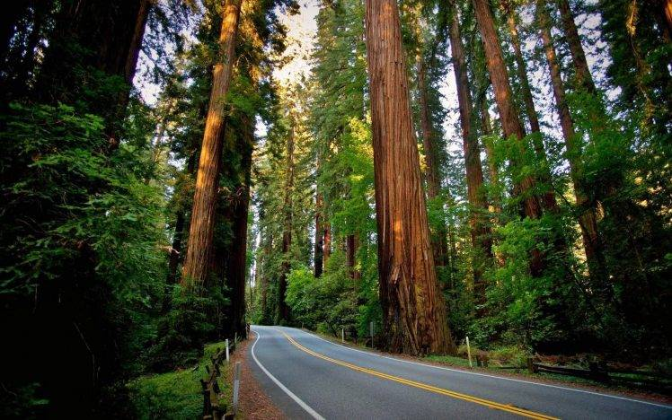
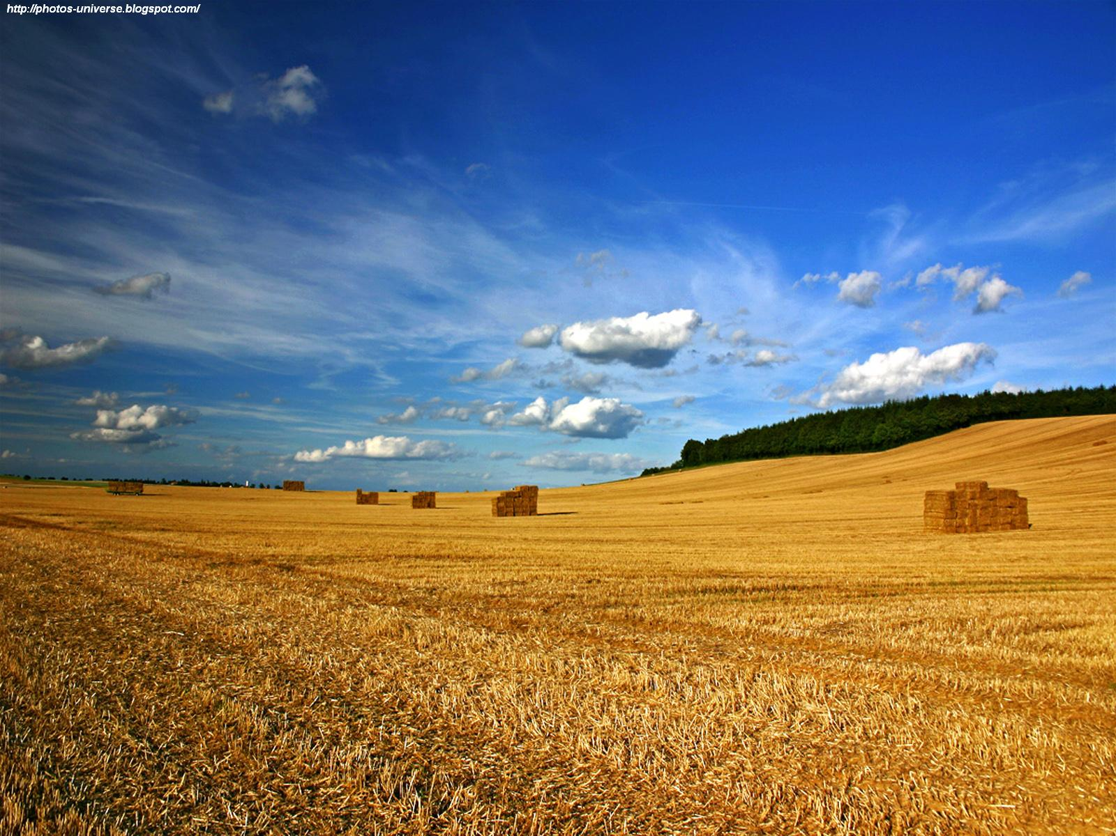
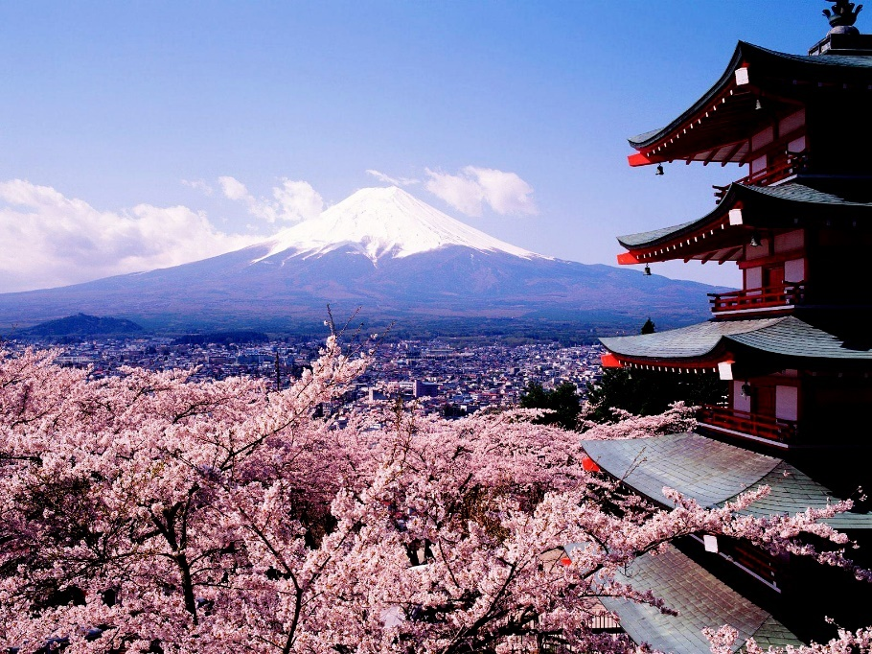
Brainstorming
Choose a landscape for your final drawing & further consider:
What is the view point?
High / low
What time of day is it?
Dawn/dusk, midday, midnight
What kind of terrain & water features?
Mountains, plateaus, rivers
What kind of objects will you add?
Animals, plants, rocks , buildings

Slide 13
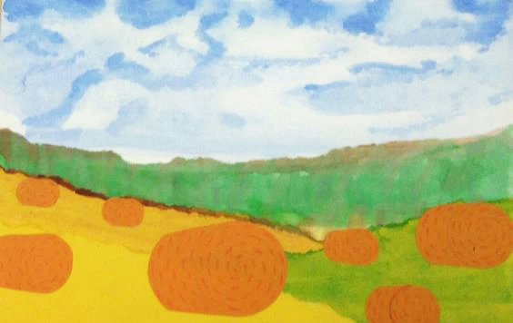
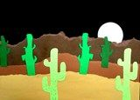
Process (Project Directions)
Sketch overall terrain features on final paper in pencil
Do not add objects on ground or details yet!
Watercolor over each section of your landscape
Use various watercolor techniques
Wet on wet (makes nice loose sky / water features)
Wet on dry (makes clear land features)
Paint on main features, color changes, & textures
Color or ground, rocks, & water

Slide 14
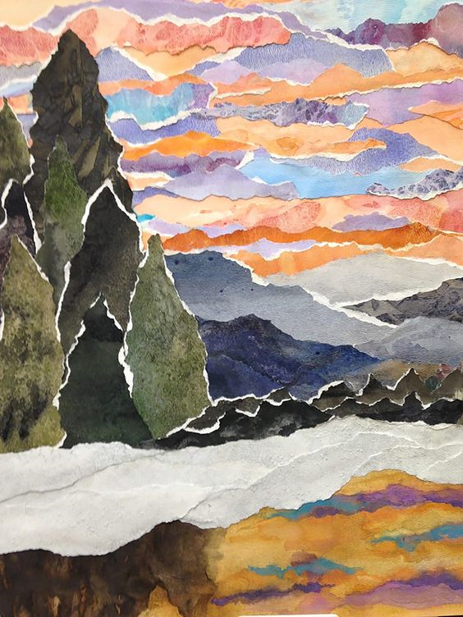
Directions Continued
Tear along the terrain features
Horizon line, mountains, hills, foreground, etc.
Tear all the way across
Layout pieces slightly overlapping & glue in place
Background 1st (bottom), 2nd middle ground (middle), & 3rd foreground (top)
Cut out objects to place on the ground
Remember large objects in the foreground
Small objects in the background
Add detail to the objects

Slide 15
Artist Reflection Write a paragraph answering the following about your artwork, & cite visual evidence in your response. * What kind of landscape did you choose & why? * What is the view point & time of day? * What kind of terrain / water features did you include? * What kind of objects will you add on the ground? * What techniques did you use to give the illusion of depth?

