Slide 2
Zentangle Animals
Art 1
Mrs. Senick
Lesson 2

Slide 3
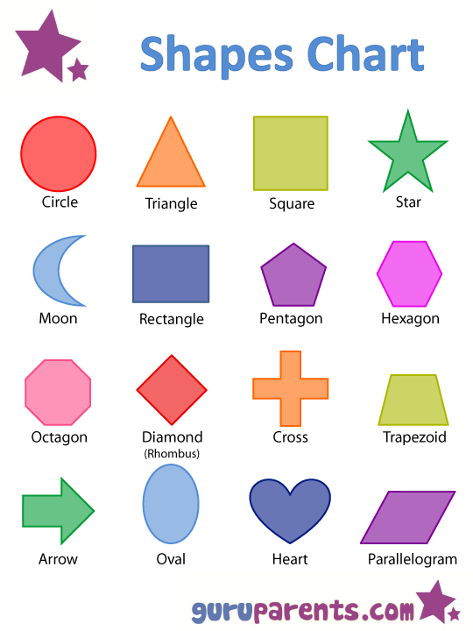
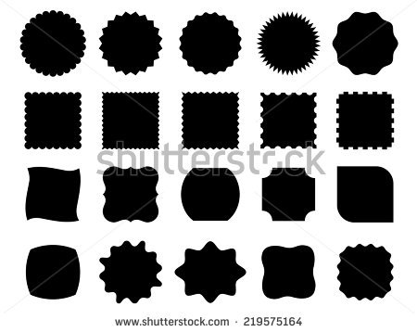
shape
Shape can be either geometric or organic
Think back to your portfolio directions
What is a geometric shape?
What is an organic shape?
How do you know the difference?

Slide 4
Practice
Draw a bow tie on your page
Divide the bow tie into sections (use the contour line to help you do this)
Fill each section of the bow tie with a different design
One line
One geometric shapes
One organic shapes
One pattern
Continue this until the entire bow tie is filled

Slide 5
Our task
Choose an animal (any animal)
Draw the contour line of that animal
Divide the animal into smaller spaces (use the curves of the animal to show you where to create your sections)
Fill the animal with various lines, shapes, and patterns
Continue this process until your animal is completely made up of these designs

Slide 6
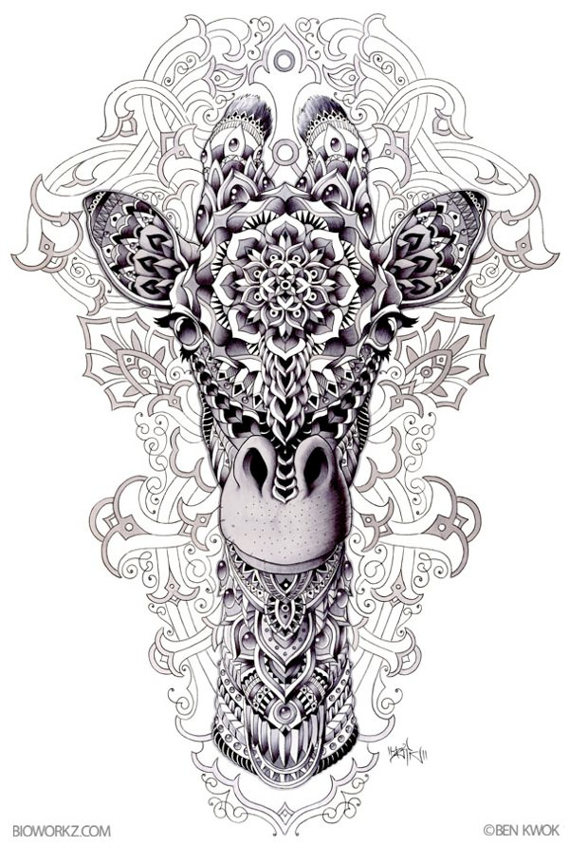
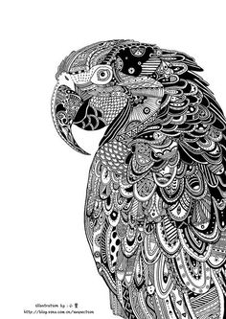
Zentangle animal

Slide 7
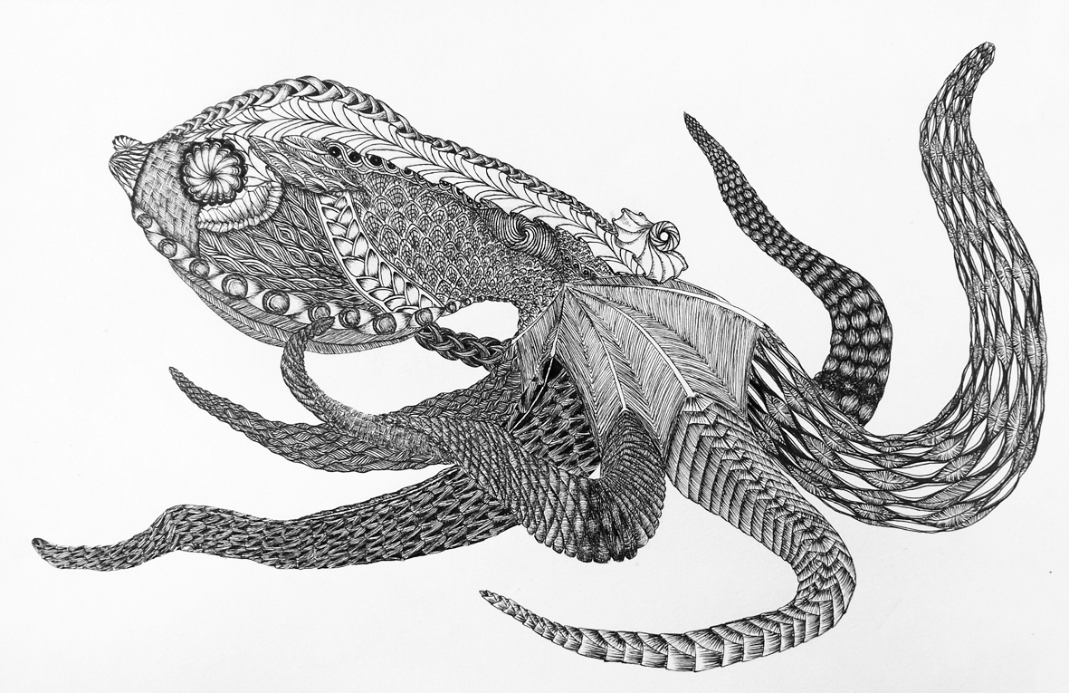
Which is more successful? Why???

Slide 8
Let’s practice designs
Use the last page to fill each square with some kind of line, shape, or pattern
Remember to use line quality, geometric and organic shapes, and patterns
Do not STRESS over the number of squares
Do not copy your neighbor’s designs…
When your page is filled, raise your hand

Slide 9
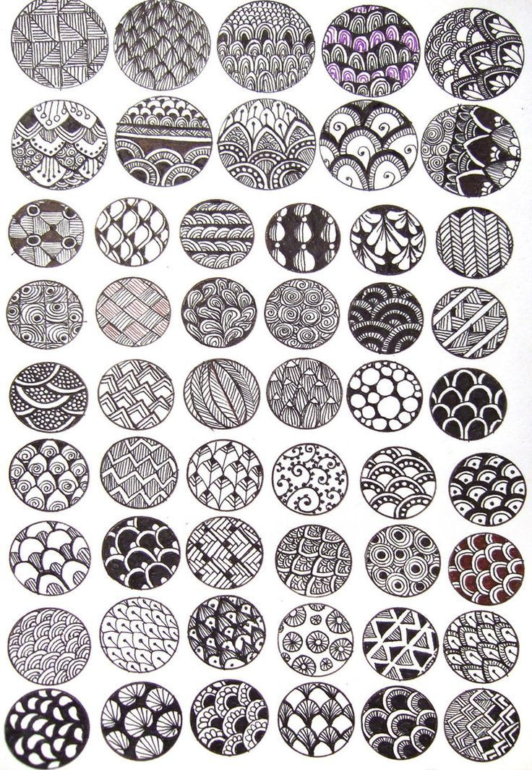
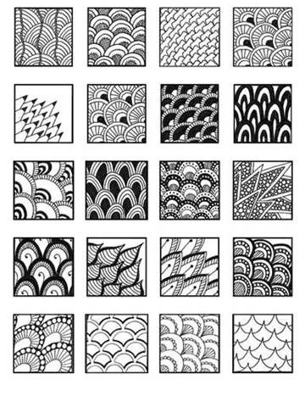

Slide 10
How to complete the project
Do the work!
Begin with the guided notes
Practice with the bow tie
Practice at least 25 designs
Add some of the designs to the bow tie
Draw 4 different animals as sketches and practice sectioning off the animal using the contours of the animal and the design ideas
Choose your final image (one of the animals) and do this on final paper
Using sharpie ONLY (black and white… NO COLOR, NO PENCIL)
Complete the self-reflection rubric and written response for TWO separate summative grades.

